Slide 1
Donor Recognition Dinner
Northern Oklahoma College Foundation, Inc.
March 12, 2020
2019 Year End Review

Slide 2
NOC Mission Statement
Northern Oklahoma College, the State’s first public community college is a multi-campus, land-grant institution that provides high quality, accessible, and affordable educational opportunities and services which create life-changing experiences and develop students as effective learners and leaders within their communities in a connected, ever-changing world.

Slide 3
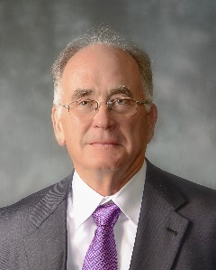
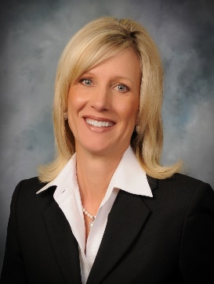
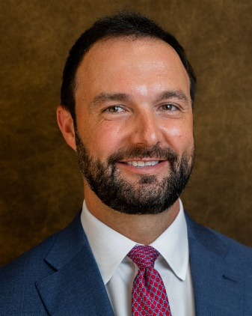
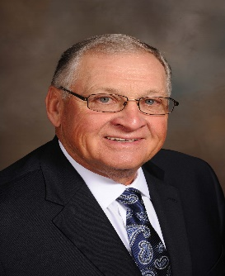
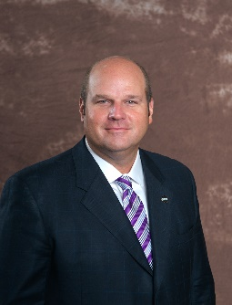
NOC Board of Regents
2019-2020
Jodi Cline, Vice Chair
Ponca City, OK
Stan Brownlee, Member
Enid, OK
Dale DeWitt, Chair
Braman, OK
Chad Dillingham, Secretary
Enid, OK
Michael Martin, Member
Stillwater, OK

Slide 4
Purpose of the Foundation
The purpose of the Northern Oklahoma College Foundation shall be to enhance the educational opportunities and the environment of Northern Oklahoma College. The Foundation is organized exclusively for the benefit of the educational, literacy and scientific activities of the college, chartered under the constitution and laws of the State of Oklahoma. The principal function of Northern Oklahoma College Foundation, Inc. is to promote Northern Oklahoma College and the welfare of its programs and students by providing scholarships, loans and other awards as deemed appropriate.

Slide 5
Mission of the Foundation
The Northern Oklahoma College Foundation seeks private support by establishing lifelong relationships with its donors, alumni and friends while supporting the mission of Northern Oklahoma College and providing financial assistance and quality educational experiences to our students, programs and employees.

Slide 6











Northern Oklahoma College Foundation, Inc.
Board of Trustees 2019-2020
Community Leaders
Linda Brown
Jami Groendyke
Kristi DesJarlais
Mark Detten
Mike Loftis
Vice Chair
LynnDe Funk
Chair
David Cummings
Past Chair
Jim Rodgers
Dr. Gordon Laird
Bert Mackie
Tom Poole

Slide 7





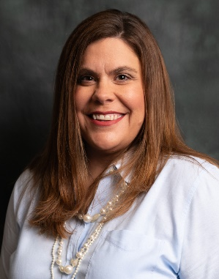

Northern Oklahoma College Foundation, Inc.
Board of Trustees 2019-2020
Regents and Administrators
Regent Dale DeWitt
Dr. Cheryl Evans
NOC President
Regent Jodi Cline
Sheri Snyder
Executive Director
Anita Simpson
Treasurer
Jill Green
Development & Donor
Relations
Kim Ochoa
Alumni & Community Relations

Slide 8
Northern Oklahoma College Foundation, Inc.
Total Net Assets – Approximately $12 Million
Academic Year | Scholarship Award | Number of Recipients | Loan Award | Number of Recipients
2018-2019 | $260,831.39 | 392 | $105 | 2
2017-2018 | $260,763.74 | 333 | $570 | 3
2016-2017 | $249,529 | 312 | $26,579 | 107
2015-2016 | $219,333 | 243 | $25,429 | 95
2014-2015 | $209,576 | 248 | $20,815 | 62
2013-2014 | $143,574 | 189 | $3,225 | 14
2012-2013 | $96,670 | 135 | $10,359 | 53
2011-2012 | $99,800 | 201 | $6,569 | 35
2010-2011 | $79,989 | 90 | $17,326 | 92
2009-2010 | $78,966 | 114 | $1,134 | 7
2008-2009 | $79,220 | 118 | $3,802 | 21
2007-2008 | $88,960 | 126 | $3,757 | 27
2006-2007 | $79,220 | 118 | $4,333 | 24
2005-2006 | $63,848 | 117 | $6,848 | 40
2004-2005 | $59,333 | 121 | $17,975 | 103
2003-2004 | $44,787 | 116 | $15,545 | 85
2002-2003 | $56,008 | 138 | $14,778 | 86
2001-2002 | $64,645 | 161 | $9,354 | 55
2000-2001 | $33,030 | 74 | $8,545 | 52
1999-2000 | $24,641 | 76 | $11,763 | 79
1998-1999 | $25,806 | 71 | $7,457 | 48
1997-1998 | $21,850 | 54 | $5,645 | 43
Whether a gift is established in honor of special individual or in memory for one’s experience at Northern Oklahoma College, the results are the same…helping students pursue their academic goals and continuing to build a tradition of excellence at NOC.
This chart reflects the scholarship and loan awards given during the past years as taken from the Northern Oklahoma College Foundation – Statement of Program Service Accomplishments.

Slide 9
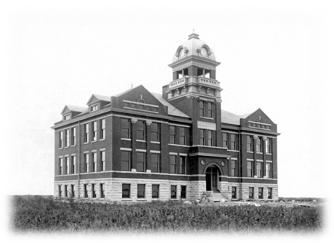
The Central Hall Society
The Northern Oklahoma College Foundation has established the Central Hall Society in order to recognize those Alumni and Friends who have remembered NOC in their estate planning. The Central Hall Society recognizes and honors the legacy of these donors.
Membership in the Central Hall Society is open to those who:
Make planned gifts in the form of charitable remainder trusts (including pooled income funds and uni-trusts), lead trusts, gift annuities, or deferred gift annuities; or
Make gifts of life insurance or have named the college as the beneficiary of their policy; or
Have confirmed non-contingent, bequest provisions; or
Have named the college as a non-contingent beneficiary of their IRA or other retirement plan
Consider Remembering NOC in your Planned Giving

Slide 10
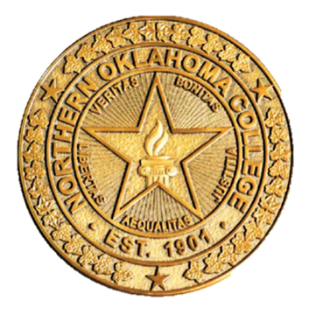
The NOC Presidential Partners Program is an annual giving program through the NOC Foundation supporting the college and enriching the experience of NOC students who desire to support the institution’s tradition of excellence.
2018-2019 Programs/Activities Supported
Enid Young Professional Event
Journal Record –Woman of the Year Event
PLC Promotional Items
PLC Activities
2019 DaVinci Honors & Awards Banquet Registration
NOC Employee Professional Development
NOC Employee Polo Shirts
NOC Gateway Alumni Poster Displays
NOC Employee Holiday Luncheons
Maverick Cheer
Ag/Sci/Eng. National Council for Undergraduate Research Conference
NASNTI Advisory Board Lunch
Criminal Justice Bonnie and Clyde Presentation
DMI Student Showcase
Language Arts Chautauqua Teacher Institute
NOC Employee Wellness Committee
Guest Artist Art Exhibits and Receptions
Business Division Love’s Cup Competition
#Lifechanging Campaign
NOC Enid 20th Celebration Challenge Coins
After a successful completion of our annual Presidential Partners Program drive campaign, we are pleased to report that we received $49,419.60 in total contributions for the 2018-2019 academic year. These donations supported Northern Oklahoma College’s mission while supporting projects and expenses for students, faculty and staff

Slide 11
Presidential Partners Program
2018-2019 Campaign - Donors
VISIONARY PARTNER ($5,000 – Above): Diemer Family Foundation; Dr. Cheryl & Tom Evans; Charles Zody
LEADER PARTNER ($2,500 - $4,999): Chad & Lisa Dillingham; Dr. Rick Edgington
SCHOLAR PARTNER ($1,000 - $2,499): Bill & Barbara Bridwell; Jodi Cline; Robert & Jacque Erner; Evans Family Foundation; GH2 Architects, LLC; John & Virginia Groendyke; Ford & Maxine Lasher; Mike & Kim Loftis; Loftis & Wetzel; Bert & Janice Mackie; Tom & Judy Poole; Bill & Susie Phelps; Renfro Family Foundation – Carl & Brenda Renfro;
Drs. Don & Pam Stinson
BENEFACTOR PARTNER ($500 - $999): John & Linda Brown; Tim & Ginny Coffman; Dan & Kay Dillingham; Robert & Sue Easterling; Patricia Hullet
PATRON PARTNER ($250 - $499): Dr. Jerry Blankenship; Dennis & Valorie Buss; Evelyn Coyle; Don and Brenda Dobbs; Jason & Cara Beth Johnson; Gary Kirtley; Brent & Marcy Price; Coby & Sheri Snyder; Daniel Wood

Slide 12
Greater Gifts Drive & NOC Employee Campaign
The annual greater gifts drive (direct mailing campaign) was mailed out to our alumni/donor database the week of November 18. Additionally, the annual employee campaign was also sent out to solicit program and scholarship support. So far this year, the 2019-2020 annual drive and employee campaign has received over $125,000 in total contributions and employee payroll deductions pledged of over $38,000 from 33 NOC employees with the majority of those funds designated towards scholarships, programs, or departmental support.

Slide 13
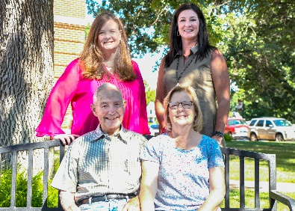
NEW SCHOLARSHIPS
Steichen Family Music Scholarship
Through the generous support of the Steichen Family, the establishment
of the endowed scholarship fund will assist students participating in vocal,
Music theatre or instrumental music on the NOC Tonkawa campus. Bob
and Margaret have been loyal supporters of NOC and the Fine Arts
program. Bob worked at Northern for over 20 years and all six of their
Children are Northern alums.

Slide 14
NEW SCHOLARSHIPS
BF Trust
Through two anonymous unrestricted gifts totally $2 million, the foundation gift acceptance committee established this endowment by directing these funds towards NOC Tonkawa for the greatest need of our institution. A portion of funds allowed the Foundation to submit a new endowed chair in the academic program area of Process Technology – Engineering, Physical Science and Process Technology Division. In addition to the endowed chair, funds will be used to establish new academic program development and new scholarships supporting the 2019-2025 Strategic Plan and recruitment, retention, and graduation goals.

Slide 15
AMENDED SCHOLARSHIPS
Enid Higher Education Council Scholarship Fund
Formally the Enid Higher Education Council Scholarship
Agreement has been amended to be awarded to both full and part-time students
Recipients may receive the award for a total of four semesters as a full-time student or eight semesters as a part-time student.
Tom and Sherry Muchmore Scholarship Fund
Formally the Ponca City News/Muchmore Scholarship
Name changed in June 2019, at the request of Tom and Sherry Muchmore

Slide 16
PENDING SCHOLARSHIPS
Jones Endowed Leadership Scholarship (T)
William W. & Marguerite Rodgers Sr. Memorial Scholarship (T)
Ruth Steichen Memorial (T)
Larry Rupp Memorial Nursing (T)
Robert N. Colombe & Robert B. Colombe Memorial (T)
Kenneth E. and Laura Yvonne Holmes Fund (T/E/S)
Pamela Sue McNeal Memorial Scholarship (T)
ReACT at NOC Scholarship (T)
Choral Arts Society of Northern Oklahoma (CASANO) Scholarship (T)
NOC Sheep Center (T)
Robert Morgan Memorial Nursing Scholarship Fund (T)

Slide 17
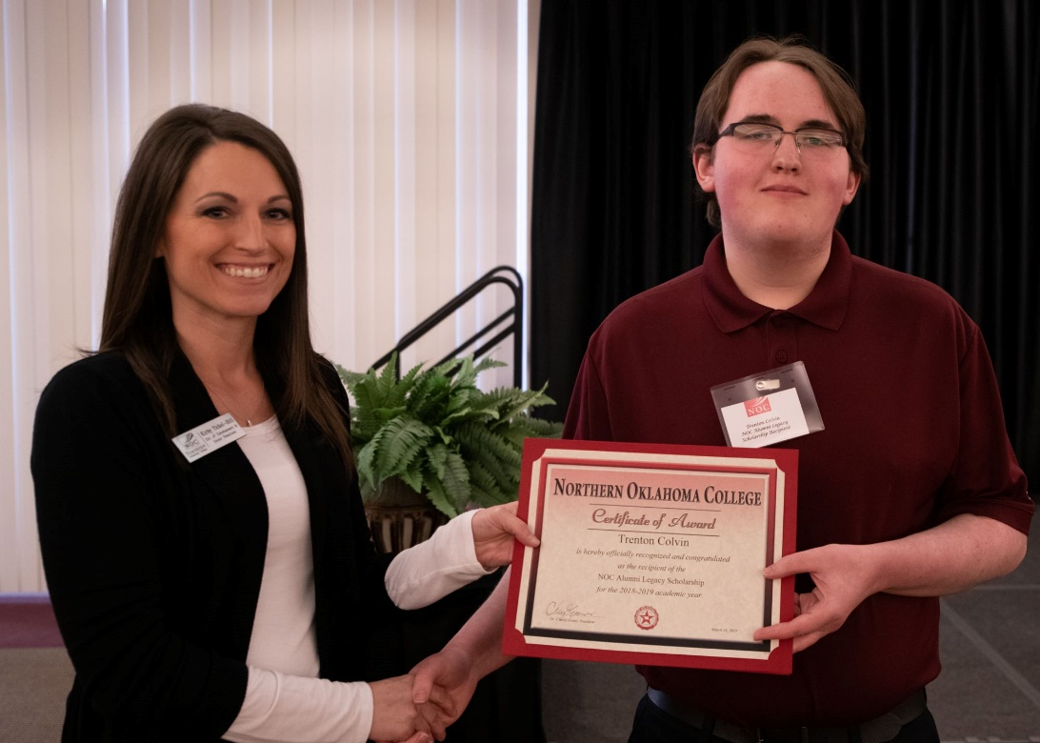
Scholarship Presentations
2019-2020 NOC ALUMNI LEGACY SCHOLARSHIP
Trenton Colvin of Blackwell was awarded the NOC Alumni Legacy Scholarship at the 2019 Alumni & Friends Reunion held March 30. He was awarded the scholarship by Kirby Tickel-Hill, former Director of Development & Donor Relations.

Slide 18
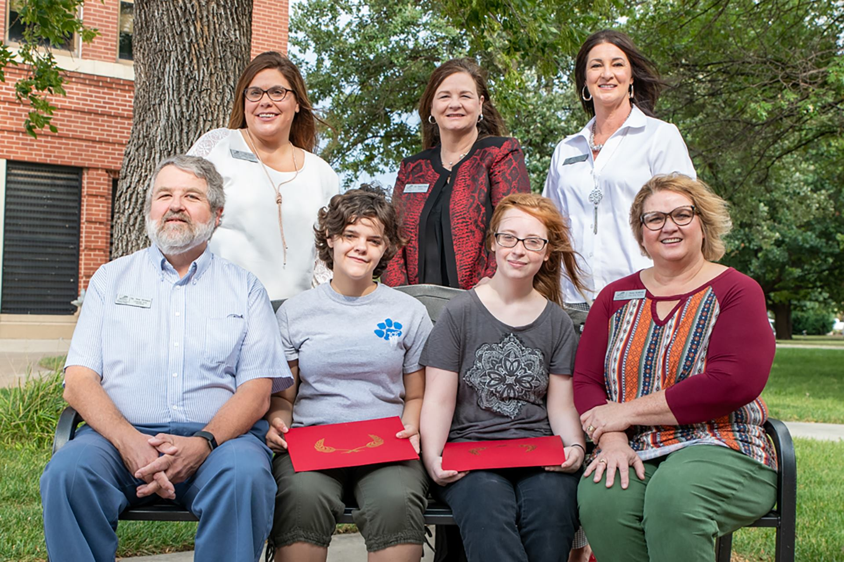
Scholarship Presentations
NORTH CENTRAL OKLAHOMA ARTS COUNCIL SCHOLARSHIP
NCOAC members Don Stinson and Jena Kodesh presented Larissa Henry and Kim Battles the 2019-2020 scholarships. Joining them is Jill Green, Development and Donor Relations; NOC President Cheryl Evans; and Sheri Snyder, NOCF Executive Director
Notes:
Larissa Henry and Kim Battles

Slide 19
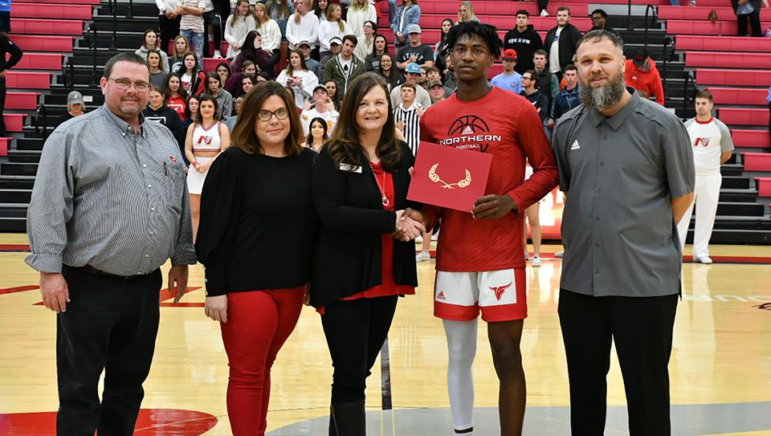
Scholarship Presentations
2019-2020 HAYS SCHOLARSHIP RECIPIENT
2019-2020 holder of the Donald R. Hays Basketball Scholarship is Tyrel Morgan. NOC President Cheryl Evans presented the scholarship to Tyrel. Joining them is Jeremy Hise, Athletic Director; Jill Green, Development and Donor Relations; and Donnie Jackson, men’s coach

Slide 20
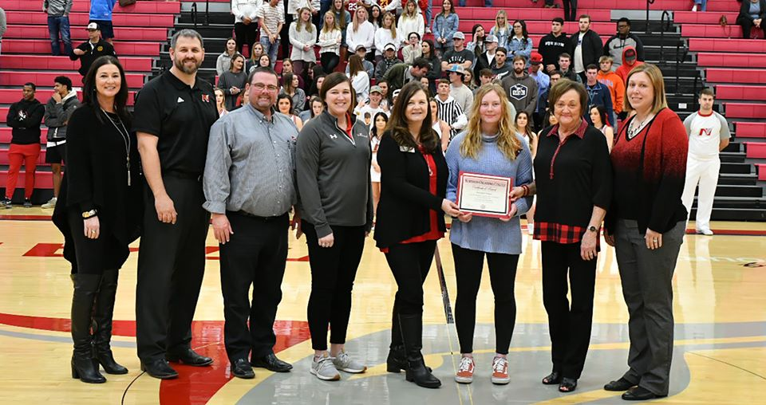
Scholarship Presentations
2019-2020 NEVONA KEGANS SCHOLARSHIP
2019-2020 holder of the Nevona Kegans Scholarship is Savannah Nelson. NOC President Cheryl Evans and Nevona Kegans presented the scholarship to Savannah. Joining them is Sheri Snyder, NOCF Executive Director; Ryan Paul, Dean of Students; Jeremy Hise, Athletic Director; Summer McClure, Athletic Trainer; and Suzi Brown, HPER Division Chair

Slide 21
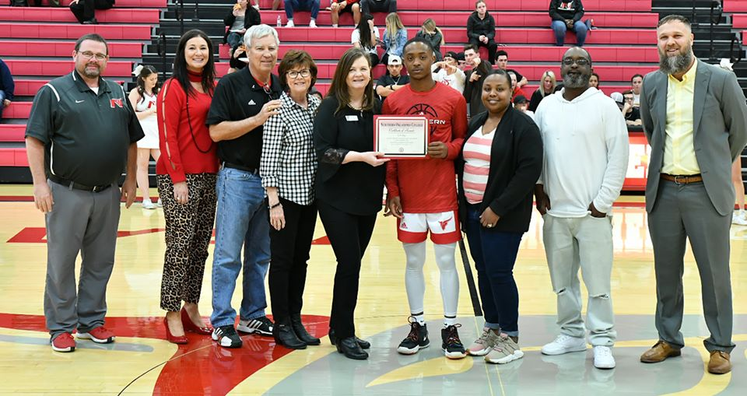
Scholarship Presentations
2020-2021 JARED WEIBERG ENDOWED SCHOLARSHIP
2020-2021 holder of the Jared Weiberg Endowed Scholarship is JD Ray. NOC President Cheryl Evans and Weiberg’s Parents, Mick and Vina presented the scholarship to JD. Joining them is Jeremy Hise, Athletic Director; Sheri Snyder, NOCF Executive; Men’s Basketball Coach Donnie Jackson; and JD’s parents.
Notes:
JD Ray was presented the Jared Weiberg Endowed Scholarship Award Feb. 17 at NOC. Pictured: NOC Athletic Director Jeremy Hise, NOC Foundation Executive Director Sheri Snyder, Mick Weiberg, Vina Weiberg, NOC President Dr. Cheryl Evans, JD Ray, Deshauna Walker, Earl Ray, and Coach Donnie Jackson

Slide 22
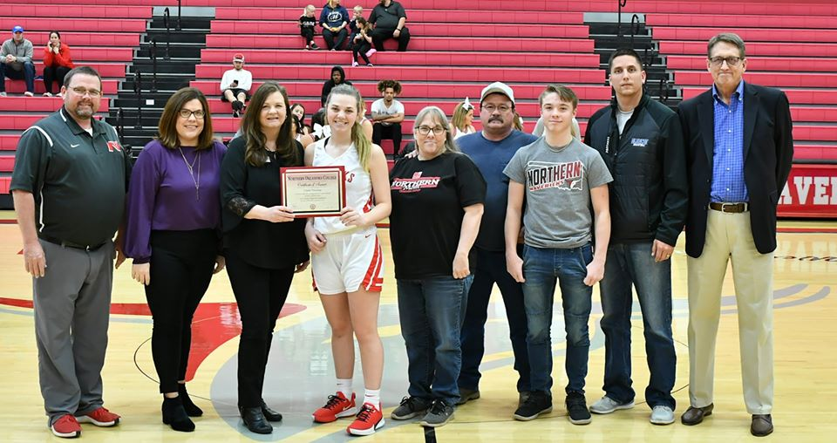
Scholarship Presentations
2020-2021 LEO CANADAY MEMORIAL SCHOLARSHIP
2020-2021 holder of the Leo Canaday Memorial Scholarship is Cassie Manning. NOC President Cheryl Evans presented the scholarship to Cassie. Joining them is Jeremy Hise, Athletic Director; Jill Green, Development & Donor Relations; Women’s Basketball Coach Greg Krause; Cassie’s family and high school coach.
Notes:
JD Ray was presented the Jared Weiberg Endowed Scholarship Award Feb. 17 at NOC. Pictured: NOC Athletic Director Jeremy Hise, NOC Foundation Executive Director Sheri Snyder, Mick Weiberg, Vina Weiberg, NOC President Dr. Cheryl Evans, JD Ray, Deshauna Walker, Earl Ray, and Coach Donnie Jackson

Slide 23
NOC FOUNDATION GRANTS
Masonic Fraternity of Oklahoma Endowment Grant
The Foundation has awarded $4,125 for the 2019-2020 academic year to
the following programs:
DMI Epic Shorts Student Film Festival
Thunder Club – First Friday in Tulsa with artist Yatika Fields
Honors Composition II/Lincoln Academy Book Project “This I Believe”
Music Theatre – New York City Fall Break Trip
Criminal Justice – American Criminal Justice Association Conference
Art – Kansas City Museum Experience

Slide 24
NOC FOUNDATION GRANTS
Presidential Partners Grant
The Foundation has awarded over $34,000 to the following programs for 2019-2020
NOC Professional Development
President’s Leadership Council Activities
NOC Employee Social, Cultural & Community Relations Programs
Language Arts – Chautauqua Teachers Institute
Enid Campus – Putt Putt Course
NASNTI – Artist Receptions
NOC Advisory Board Luncheons
Enid Baseball – National Championship Rings
Biological Science– National Council on Undergraduate Research Conference
Nursing – Oklahoma Hope
President’s Leadership Council Promotional Items
NOC Employee – NOC Shirts
Music Theatre – New York City Trip
Language Arts – Chikaskia Literary Festival
NOC Employee – Training Refreshments

Slide 25
NOC FOUNDATION GRANTS
Presidential Partners Grant
The Foundation has awarded over $34,000 to the following programs for 2019-2020
Mass Communication – Lunch & Learn with Alumnus M. Scott Carter
Mass Communication – Lunch & Learn with OKC Fox’s Shelby Cargill and Anthony West
NOC Enid – Disc Golf Collaboration with NWOSU & City of Enid
Criminal Justice - American Criminal Justice Association Conference
Art – Kansas City Museum Trip
Student Affairs – Leadercast Women – Take Courage Lunch Series
Community Relations – The Willie Spears Experience
Engineering/PS/PTEC – American Chemical Society Midwest Regional Meeting

Slide 26

Enid Higher Education Council, Inc.
2018-2021 Campaign Drive
Thank you to the following donors who support the mission of the Enid Higher Education Council
Anonymous | AT&T | David and Sharon Trojan | Atwood Distributing, L.P. | BancCentral | Rick and Janet Cunningham
Greater Enid Chamber of Commerce | Tom and Cheryl Evans | Groendyke Transport, Inc. | Bank of Oklahoma | Security National Bank | Dr. Jerry Blankenship
BDP, LLP | John B. Stambaugh P.C. | NBC Oklahoma | Stride Bank | Culligan of Enid | Rick and Kim Caruthers
Dense Mechanical, Bob Dense | Dillingham Foundation | Enid Public Schools | Humphrey/Guarantee Abstract | INTEGRIS Bass Baptist Health Center | GBV Enterprises, Inc.
Harold Hamm Foundation | Dr. and Mrs. Barry Pollard | Ed and Susan Vineyard | Kevin and Mindy Shimanek | Brent and Marcy Price | Farm Credit of Enid
Bob and Cathie Berry | Steve and Lisa Glasser | Dr. Wayne McMillen | Henson Construction Co. | Scheffe Prescription Shop | Dr. Steven Mackie
Stan and Darlene Tatum | St. Mary’s Regional Medical Center | Kyle Williams | Michael and Kelley Wright | Pioneer Cellular | Myra Ward

Slide 27
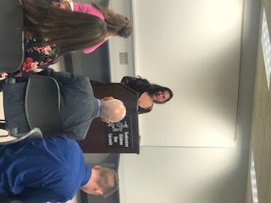
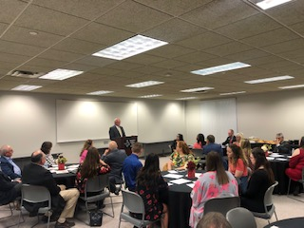
Enid Higher Education Council Donor Event
Approximately 40 board members, donors, students, and guests attended the quarterly meeting as well as a donor appreciation event of the NOC/NWOSU Joint Advisory Board on November 19 on the NWOSU Enid campus. NOC Enid scholarship recipient Cydi Beasley did an outstanding job representing NOC as she thanked the donors.

Slide 28

OSRHE Endowed Chair Program
2019 Status Report on the Program
Approved NOC Accounts with the Oklahoma State Regents
1 Chair (Approved/Funded); 4 Chairs (Approved/Pending in Que); 5 Lectureship Total = 10
Joe Lewis Lectureship Chair – Lectureship chair in the Social Science (Criminal Justice) Division, Tonkawa Campus
$25,000 private donation provided by the Estate of Joe Lewis
25,000 public matching monies
$50,000 Endowed Lectureship (Established 2003/matching monies approved 2005)
Sam Leonard Lectureship Chair – Lectureship chair in the Business Division, Tonkawa Campus
$25,000 private donation provided by the Estate of Joe Lewis
25,000 public matching monies
$50,000 Endowed Lectureship (Established 2003/matching monies approved 2006)

Slide 29
OSRHE Endowed Chair Program
2019 Status Report on the Program
Approved NOC Accounts with the Oklahoma State Regents
Dick Lambertz Lectureship Chair – Lectureship chair in the Business Division, Enid Campus
$25,000 private donation provided by the Enid Trade Promotion Association
25,000 public matching monies
$50,000 Endowed Lectureship (Established 2003/matching monies approved 2006)
Don Westfall Lectureship Chair – Lectureship chair in the Social Science Division, Enid Campus
$25,000 private donation provided by the Enid Trade Promotion Association
25,000 public matching monies
$50,000 Endowed Lectureship (Established 2003/matching monies approved 2006)

Slide 30
OSRHE Endowed Chair Program
2019 Status Report on the Program
Approved NOC Accounts with the Oklahoma State Regents
Carl and Carolyn Renfro Lectureship Chair – Lectureship chair to provide support for cultural and community enrichment offerings in northern Oklahoma to include lecture and performance series on the campus of Northern Oklahoma College in Tonkawa and in the Ponca City area.
$100,000 private donation provided by Carl and Carolyn Renfro
$100,000 public matching monies
$200,000 Endowed Lectureship (Established and matching monies approved 2006)

Slide 31
OSRHE Endowed Chair Program
2019 Status Report on the Program
Approved NOC Accounts with the Oklahoma State Regents
PROPOSED ENDOWED CHAIRS SUBMITTED FOR APPROVAL DECEMBER 2011
Ima Faythe Berglund Mathematics Chair* – If approved, the endowed chair would provide support for the Science and Mathematics Division to begin recruiting efforts to appoint a faculty member as holder of the chair on the Tonkawa Campus of Northern Oklahoma College.
$250,000 private donation provided by the Estate of Ima Faythe Berglund
$250,000 requested public matching monies
$500,000 Endowed Chair in Mathematics

Slide 32
OSRHE Endowed Chair Program
2019 Status Report on the Program
Approved NOC Accounts with the Oklahoma State Regents
*NOTIFIED OF APPROVAL – SEPTEMBER 2012 (Approved/Matching Funds began 2013)
Ima Faythe Berglund Science Chair – If approved, the endowed chair would provide support for the Science and Mathematics Division along with the Agricultural and Life Science Division to begin recruiting efforts to appoint a faculty member as holder of the chair on the Tonkawa Campus of Northern Oklahoma College.
$250,000 private donation provided by the Estate of Ima Faythe Berglund
$250,000 requested public matching monies
$500,000 Endowed Chair in Biological Science
PROPOSED ENDOWED CHAIR SUBMITTED FOR APPROVAL JUNE 2012 (Approved/Pending in Que):
Leora E. Calkins Agriculture and Life Sciences Chair – If approved, the endowed chair would provide support for the Agriculture and Life Science Division to begin recruiting efforts to appoint a faculty member as holder of the chair on the Tonkawa Campus of Northern Oklahoma College.
$250,000 private donation provided by the Estate of Leora E. Calkins
$250,000 requested public matching monies
$500,000 Endowed Chair in Agriculture

Slide 33
OSRHE Endowed Chair Program
2019 Status Report on the Program
Approved NOC Accounts with the Oklahoma State Regents
PROPOSED ENDOWED CHAIRS SUBMITED FOR APPROVAL MAY 2019 (Approved in July/Pending in Que):
Ima Faythe Berglund Engineering Chair – If approved, the endowed chair would provide support for the Engineering, Physical Science, and Process Technology Division to begin recruiting efforts to appoint a faculty member as holder of the chair on the Tonkawa Campus of Northern Oklahoma College.
$250,000 private donation provided by the Estate of Ima Faythe Berglund
$250,000 requested public matching monies
$500,000 Endowed Chair in Engineering
BF Trust Process Technology Chair – If approved, the endowed chair would provide support for the Engineering, Physical Science, and Process Technology Division to begin recruiting efforts to appoint a faculty member as holder of the chair on the Tonkawa Campus of Northern Oklahoma College.
$250,000 private donation provided by an anonymous gift from
Charitable Remainder Annuity Trust No. 1
$250,000 requested public matching monies
$500,000 Endowed Chair in Process Technology

Slide 34
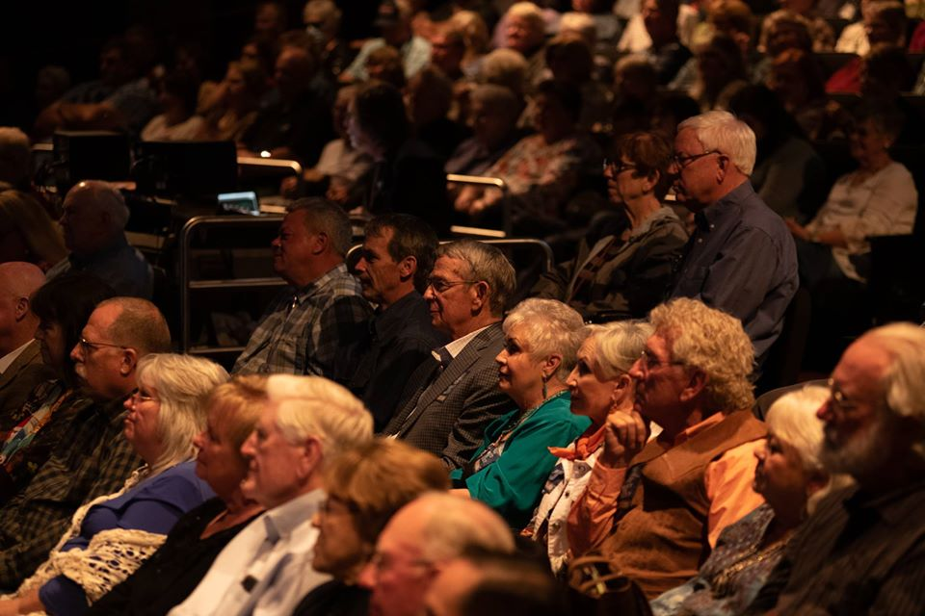
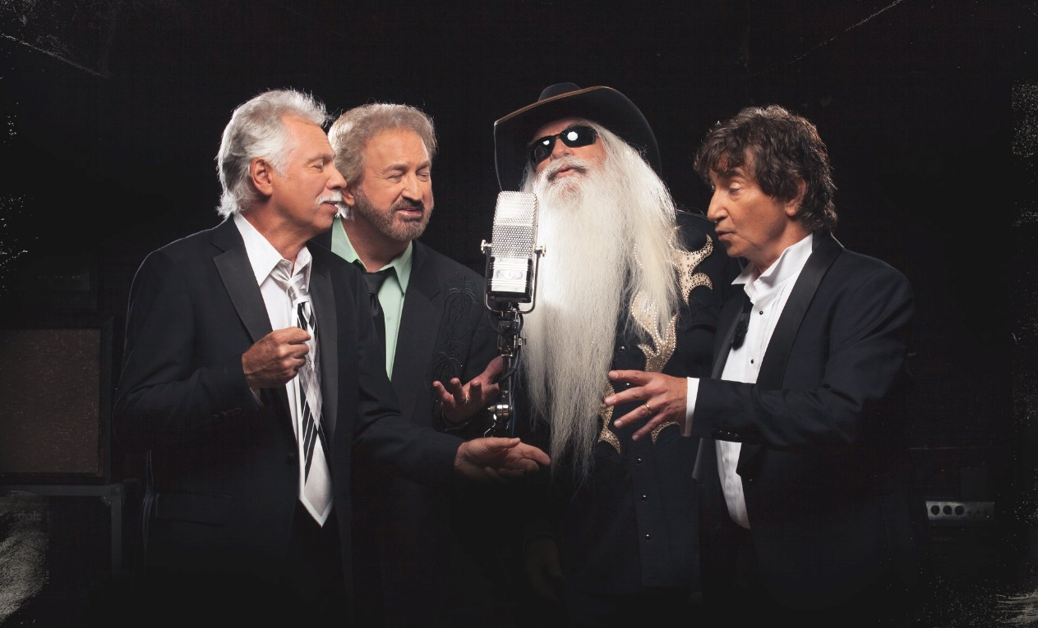
Carl and Carolyn Renfro Spring 2019 Endowed Lectureship Program
Over 570 were in attendance for the Carl and Carolyn Renfro Spring Lectureship as the OAKRIDGE BOYS returned to campus on April 25
Notes:
What day was the oakridge boys

Slide 35
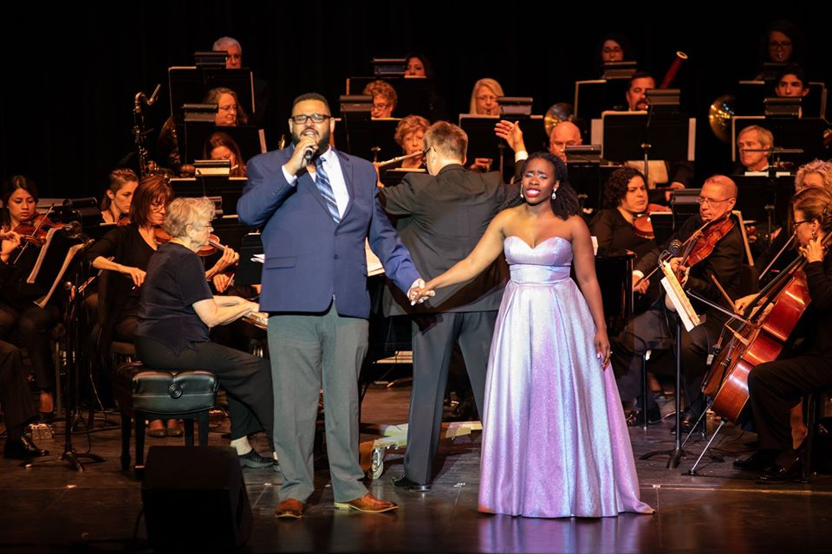
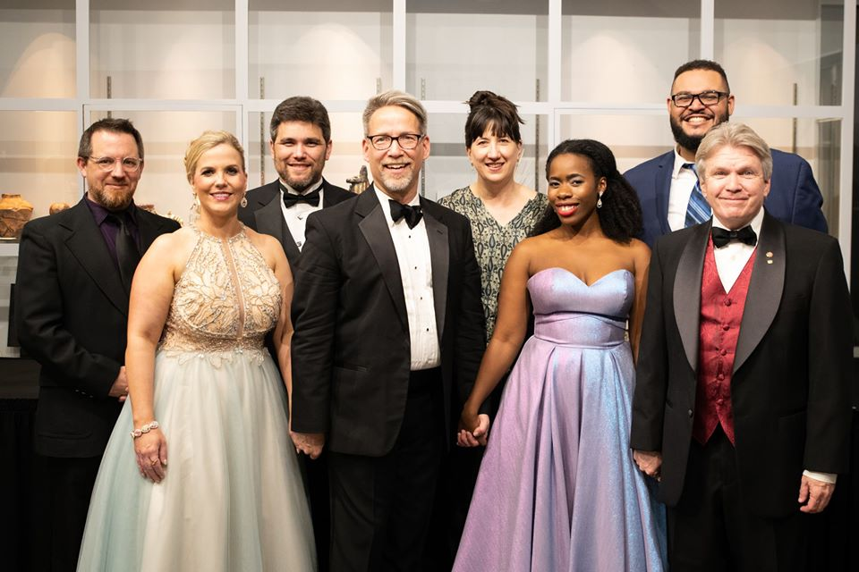
Community Event
GALA XXIV Concert
Over 300 guests attended the annual Gala concert on April 28 in the Kinzer Performing Arts Center. Maestro Gerald Steichen conducted the Gala, featuring Saprano Jasmine Habersham and Cellist Nancy Ives along with NOC Faculty Edward Dixon, Dineo Heilmann, Shannon Bradford and Gala Orchestra

Slide 36
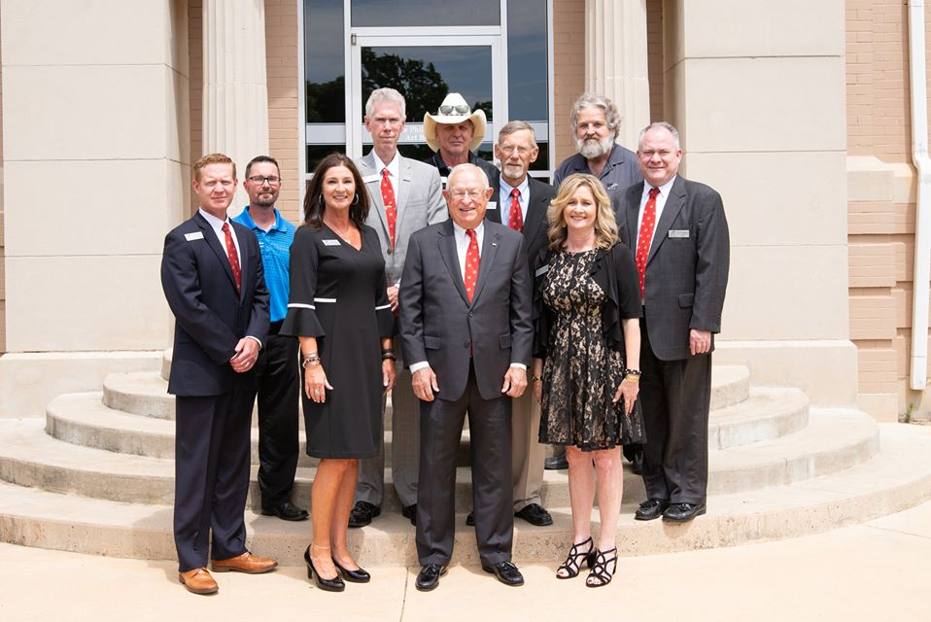
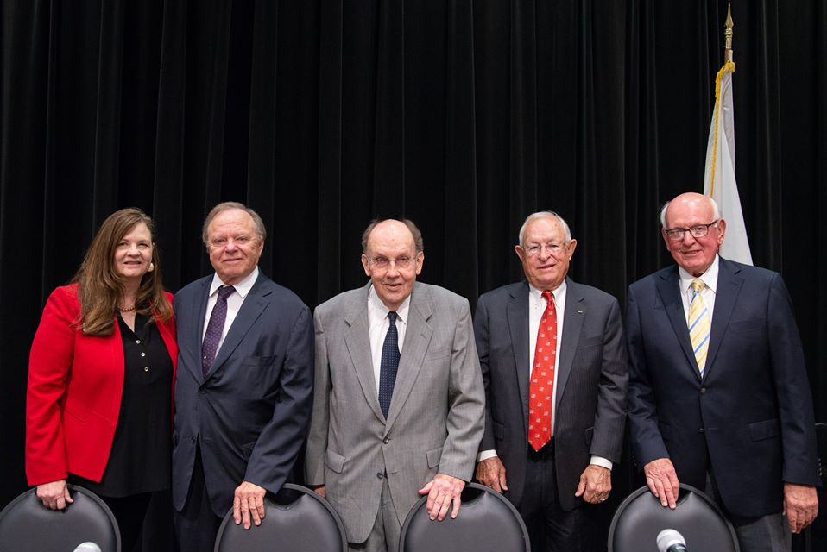
NOC Enid 20-Year Anniversary
September 2019, Dr. Evans moderated a panel discussion with Harold Hamm, Dan Dillingham, Past NOC President Joe Kinzer and Bert Mackie; the four influential men were instrumental in helping NOC secure the Phillips University location for the expansion of NOC in Enid in 1999.
Current NOC employees who helped prepare the Enid campus for classes in August 1999

Slide 37
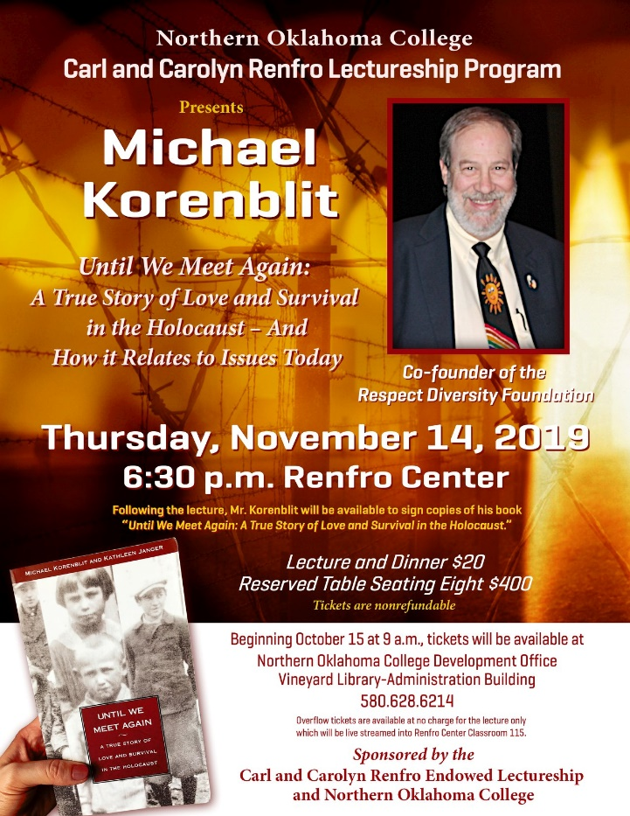
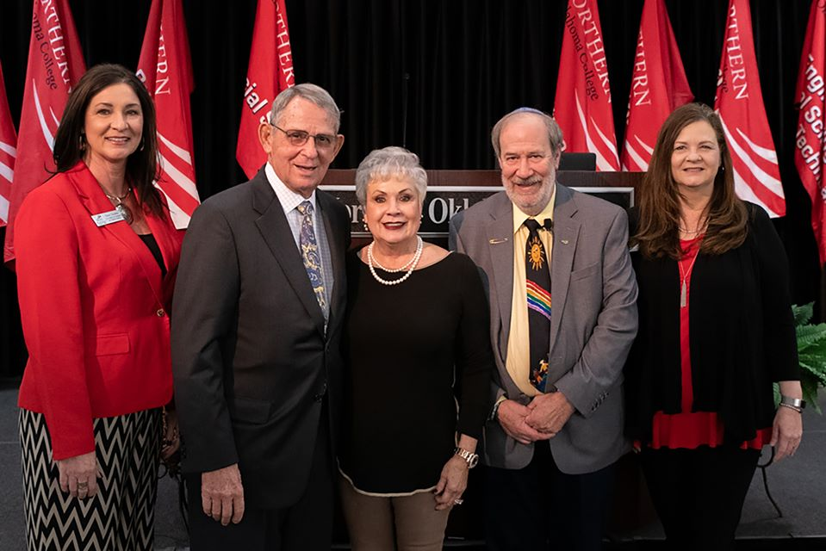
Carl and Carolyn Renfro Fall 2019 Endowed Lectureship Program
Over 500 were in attendance for the Carl and Carolyn Renfro Fall Lectureship with Michael Korenblit, Until We Meet Again on November 14

Slide 38
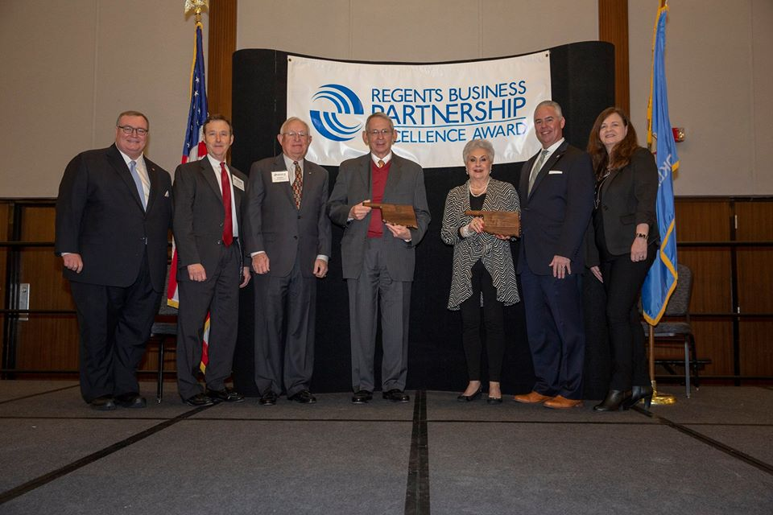
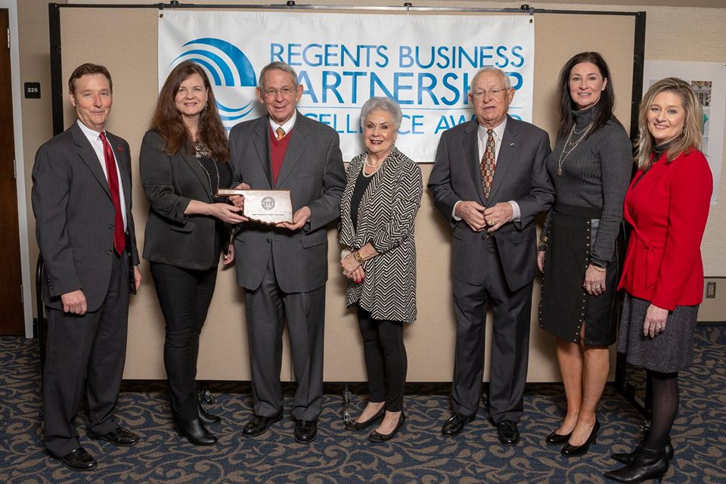
OSRHE Business Partnership Excellence Award
NOC had the honor of recognizing the Renfro Family Foundation as the 2019 Business Partner during an awards luncheon at the University of Central Oklahoma. This award is designed to highlight partnerships and to further cultivate the higher learning environment through the State Regents’ Economic Development Grants

Slide 39
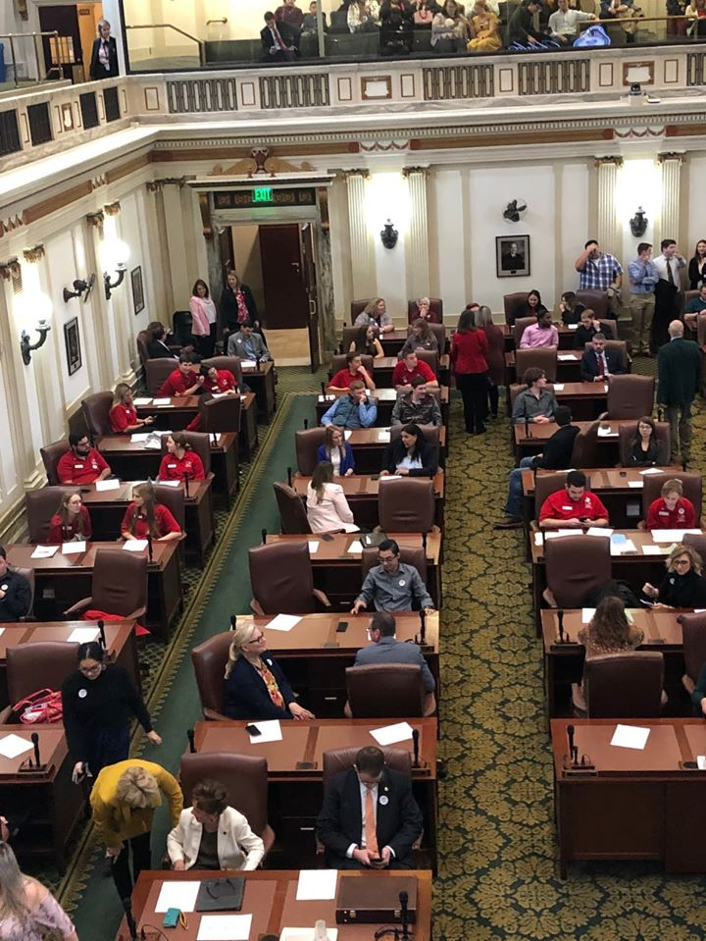
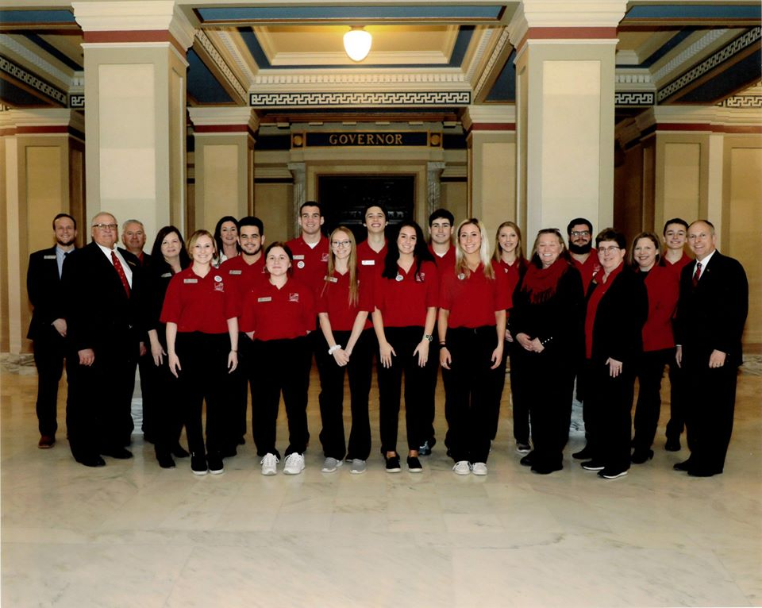
NOC Students Visit Oklahoma State Capitol
A contingency group of 12 students attended Higher Education Day at the Capitol on Feb.
Notes:
What day was higher ed day

Slide 40
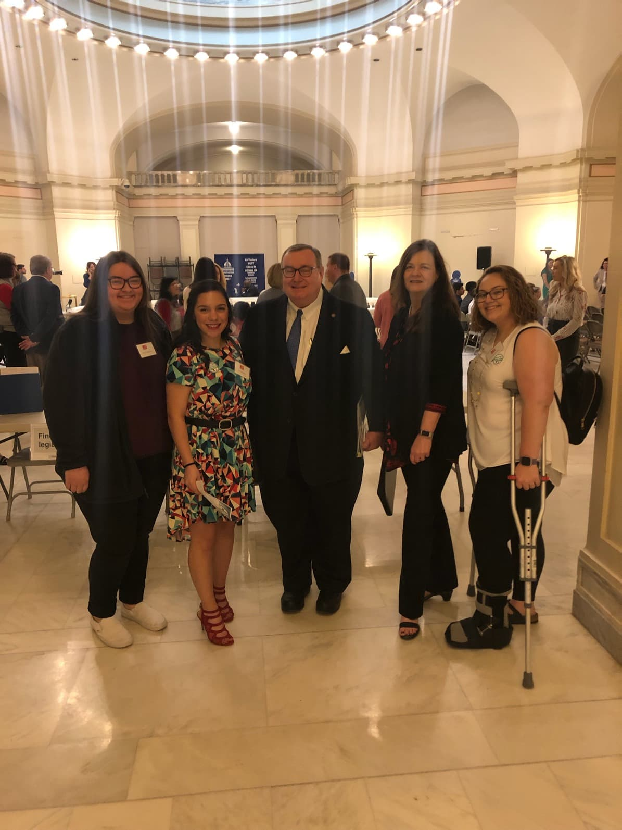
NOC Students Visit Oklahoma State Capitol
Oklahoma’s Promise Day at the Capitol
Notes:
Get pictures from Oklahoma Promise Day at the capitol

Slide 41
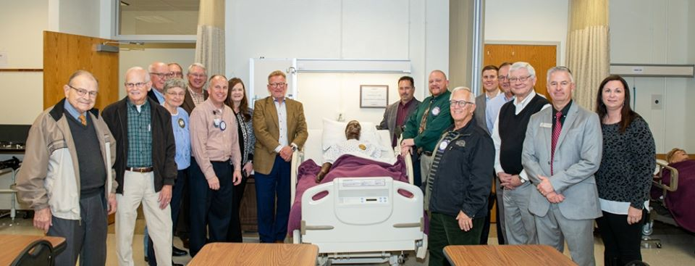
Enid Rotary Donation to NOC Nursing Program
The Enid Rotary Club and Rotary District 5750 donated a NSG Kelly Mannequin to NOC Nursing. The computerized Kelly Mannequin will ensure that students experience everything they will see in the real world.

Slide 42
NOC ALUMNI & FRIENDS ASSOCIATION
Developed in January 2006, the NOC Alumni and Friends Association is a great way for members to stay connected with NOC and former classmates. Membership is open to all graduates of Northern, former students, and friends of NOC.
As a member of the Association you have the right to the following benefits:
Official Membership Card
NOC Alumni Automobile Decal
Dependents are eligible for a Non-Residential Legacy Scholarship
$5 Fall, Spring & Summer Discounts at the Wellness Center (Tonkawa)
10% Discount on NOC Logo Merchandise at the Bookstores
Special Notice/Invitation Alumni & Campus Events
LOOK FOR NEW BENEFITS IN THE COMING MONTHS!!

Slide 43
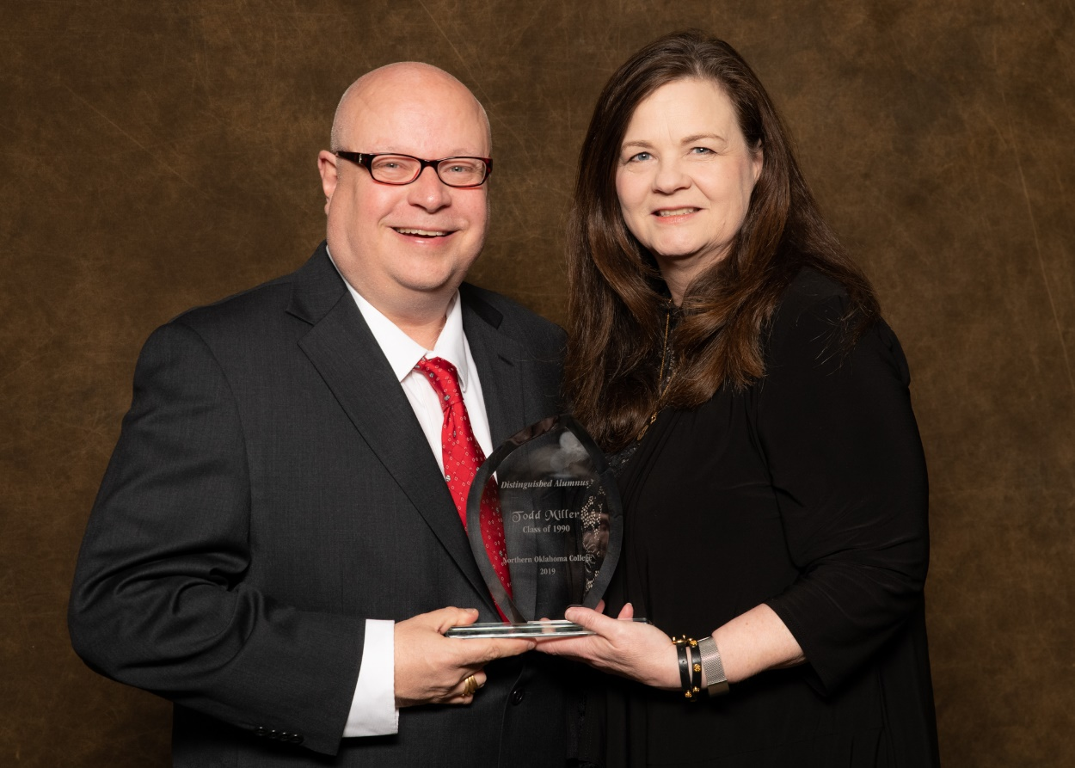
2019 Distinguished Alumni Hall of Fame Inductee
Mr. Todd Miller, Class of 1990 was inducted into the Northern Oklahoma College Distinguished Alumni Hall of Fame at the Alumni and Friends Reunion held Saturday, March 30, 2019

Slide 44
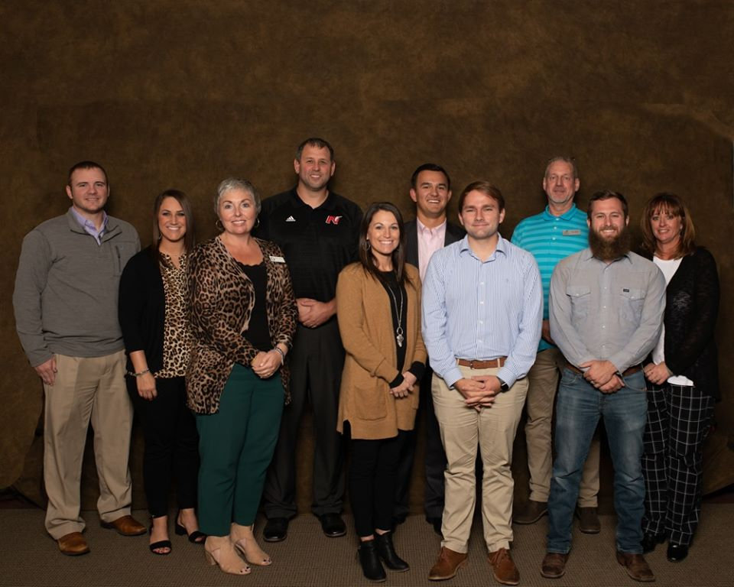
NOC ALUMNI ADVISORY BOARD
Fall 2019, the NOC Alumni Board came to fruition. Members will be appointed to a rotating two year term and the board will meet quarterly. Members of the Alumni Advisory Board are:
Wendy Terrazas
Kirby Hill
Cale Minx
Reece Simpson
Garrett Johns
Ryan Paul
Clayeton Hammock
Brad Matson
Natalie Beurlet

Slide 45
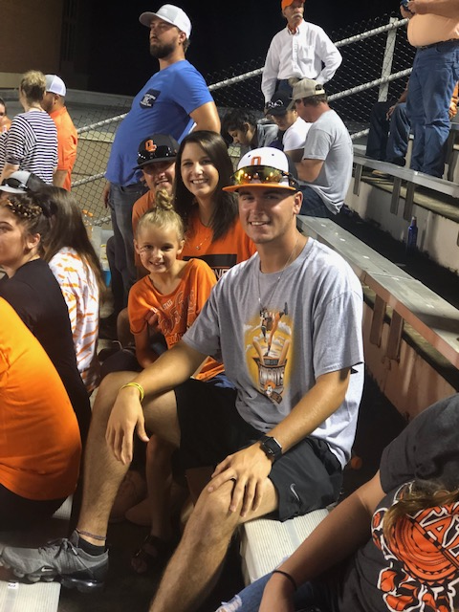
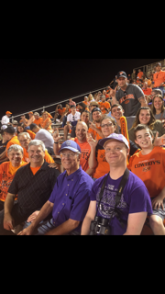
Alumni and Community Relations Events
OSU Tailgating Football Event
46 guest attended the NOC’s OSU tailgating event on September 28th to cheer on the Cowboys as they battled against Big 12 opponent Kansas State.

Slide 46
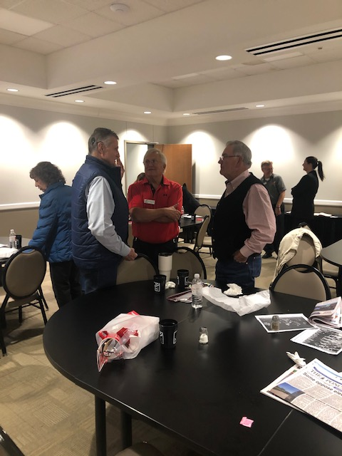
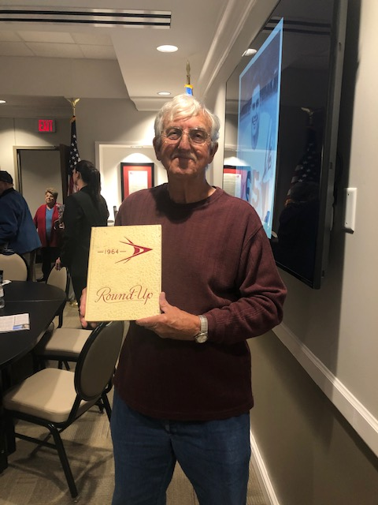
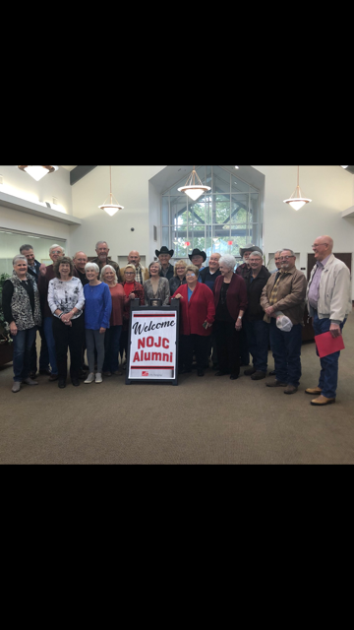
Alumni and Community Relations Events
NOJC Maverick Sports Reunion
NOC Foundation hosted the annual NOJC Maverick Sports Reunion at Tonkawa on October 25. Many of the attendees had not been back to campus since the 1960’s.

Slide 47
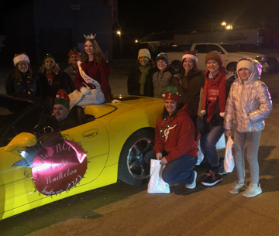
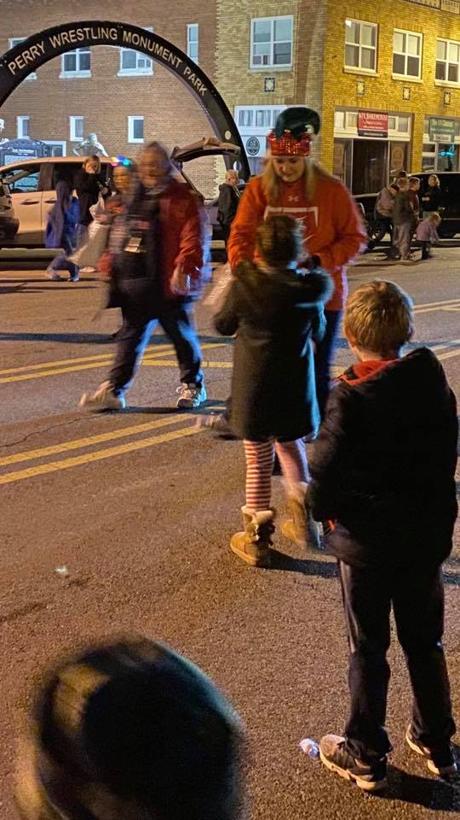
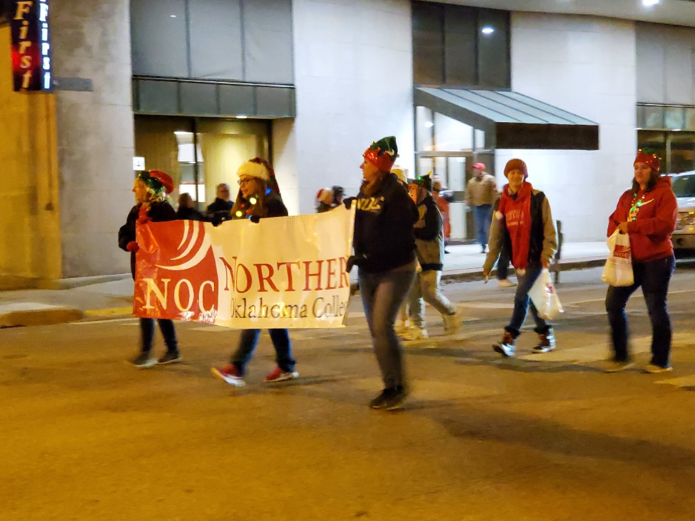
Alumni and Community Relations Events
During the Christmas Season, NOC Faculty, Staff, and Alumni participated in Christmas parades in Blackwell, Tonkawa and Perry

Slide 48
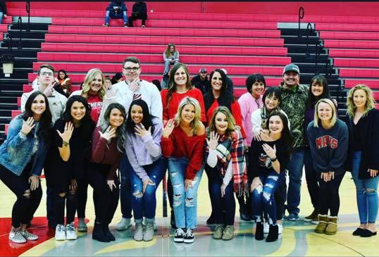
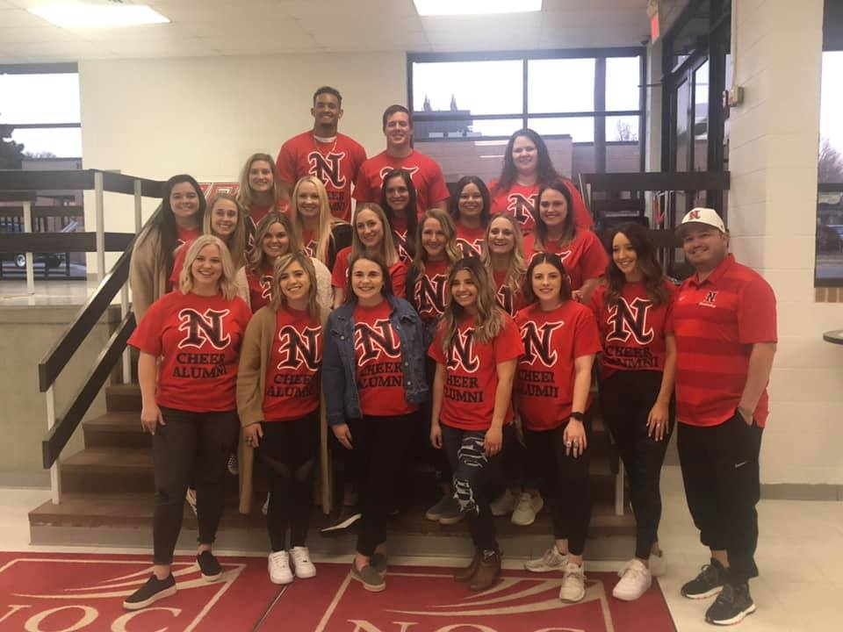
Alumni and Community Relations Events
NOC Enid Cheer Reunion
NOC Tonkawa Cheer Reunion

Slide 49
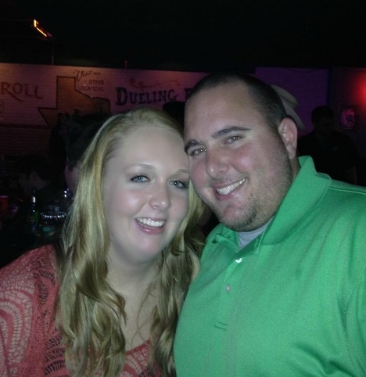

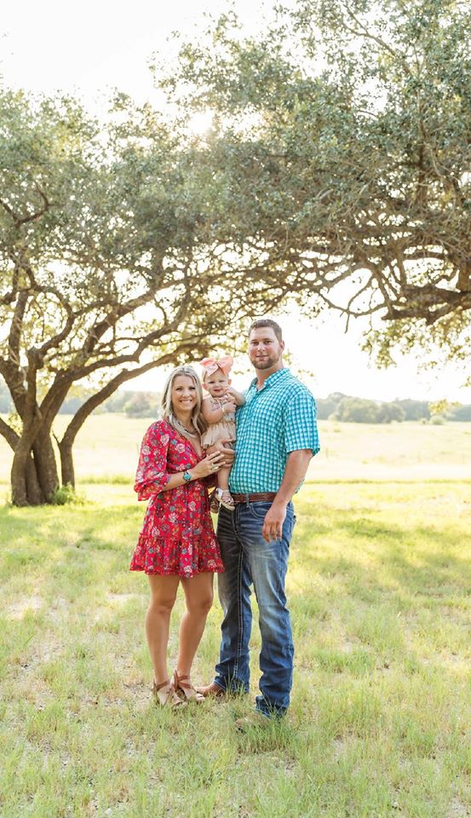
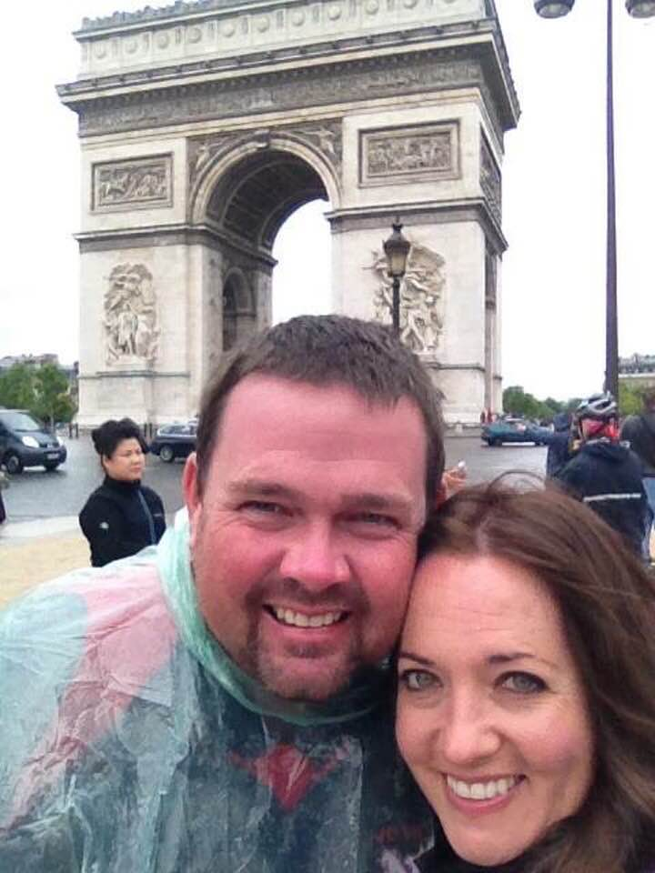
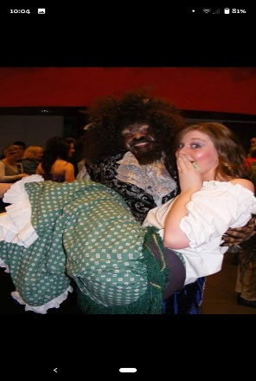
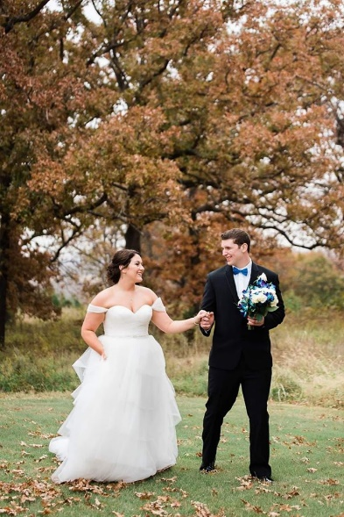
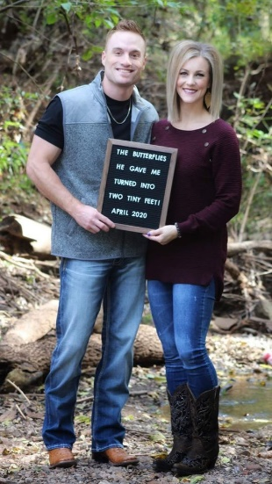
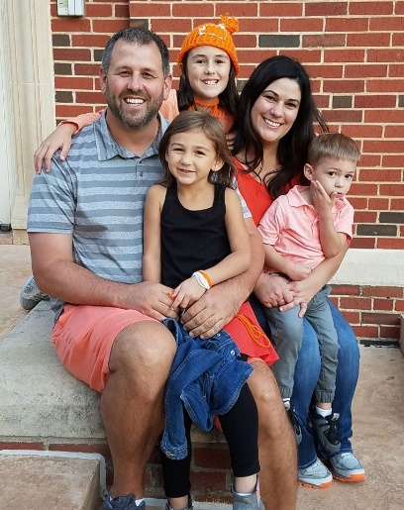










Slide 50




2019 Donor Recognition Dinner

Slide 51





2019 Donor Recognition Dinner

Slide 52





2019 Donor Recognition Dinner

Slide 53





2019 Donor Recognition Dinner

Slide 54





2019 Donor Recognition Dinner

Slide 55







2019 Donor Recognition Dinner

Slide 56






2019 Donor Recognition Dinner

Slide 57




2019 Donor Recognition Dinner

Slide 58

Aspen names Northern Oklahoma College as a Top 150 U.S. Community College
The Aspen Institute is a community-serving organization with global reach whose vision is a free, just, and equitable society. For 70 years, the Institute has driven change through dialogue, leadership, and action to help solve the world’s greatest challenges. Headquartered in Washington, D.C., the Institute has offices in Aspen, Colorado, and New York City, and an international network of partners. For more information

Slide 59

Thank You For Your Continued Support!

Slide 60

Mark Your Calender

