Slide 1
Northern Oklahoma College Foundation, Inc.
Year In Review
April 7, 2022

Slide 2
NOC Mission Statement
Northern Oklahoma College, the State’s first public community college is a multi-campus, land-grant institution that provides high quality, accessible, and affordable educational opportunities and services which create life-changing experiences and develop students as effective learners and leaders within their communities in a connected, ever-changing world.

Slide 3
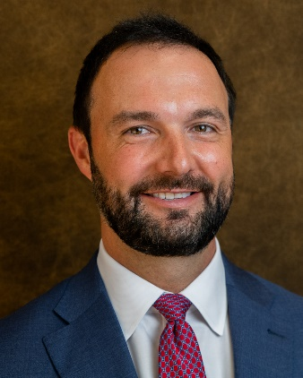
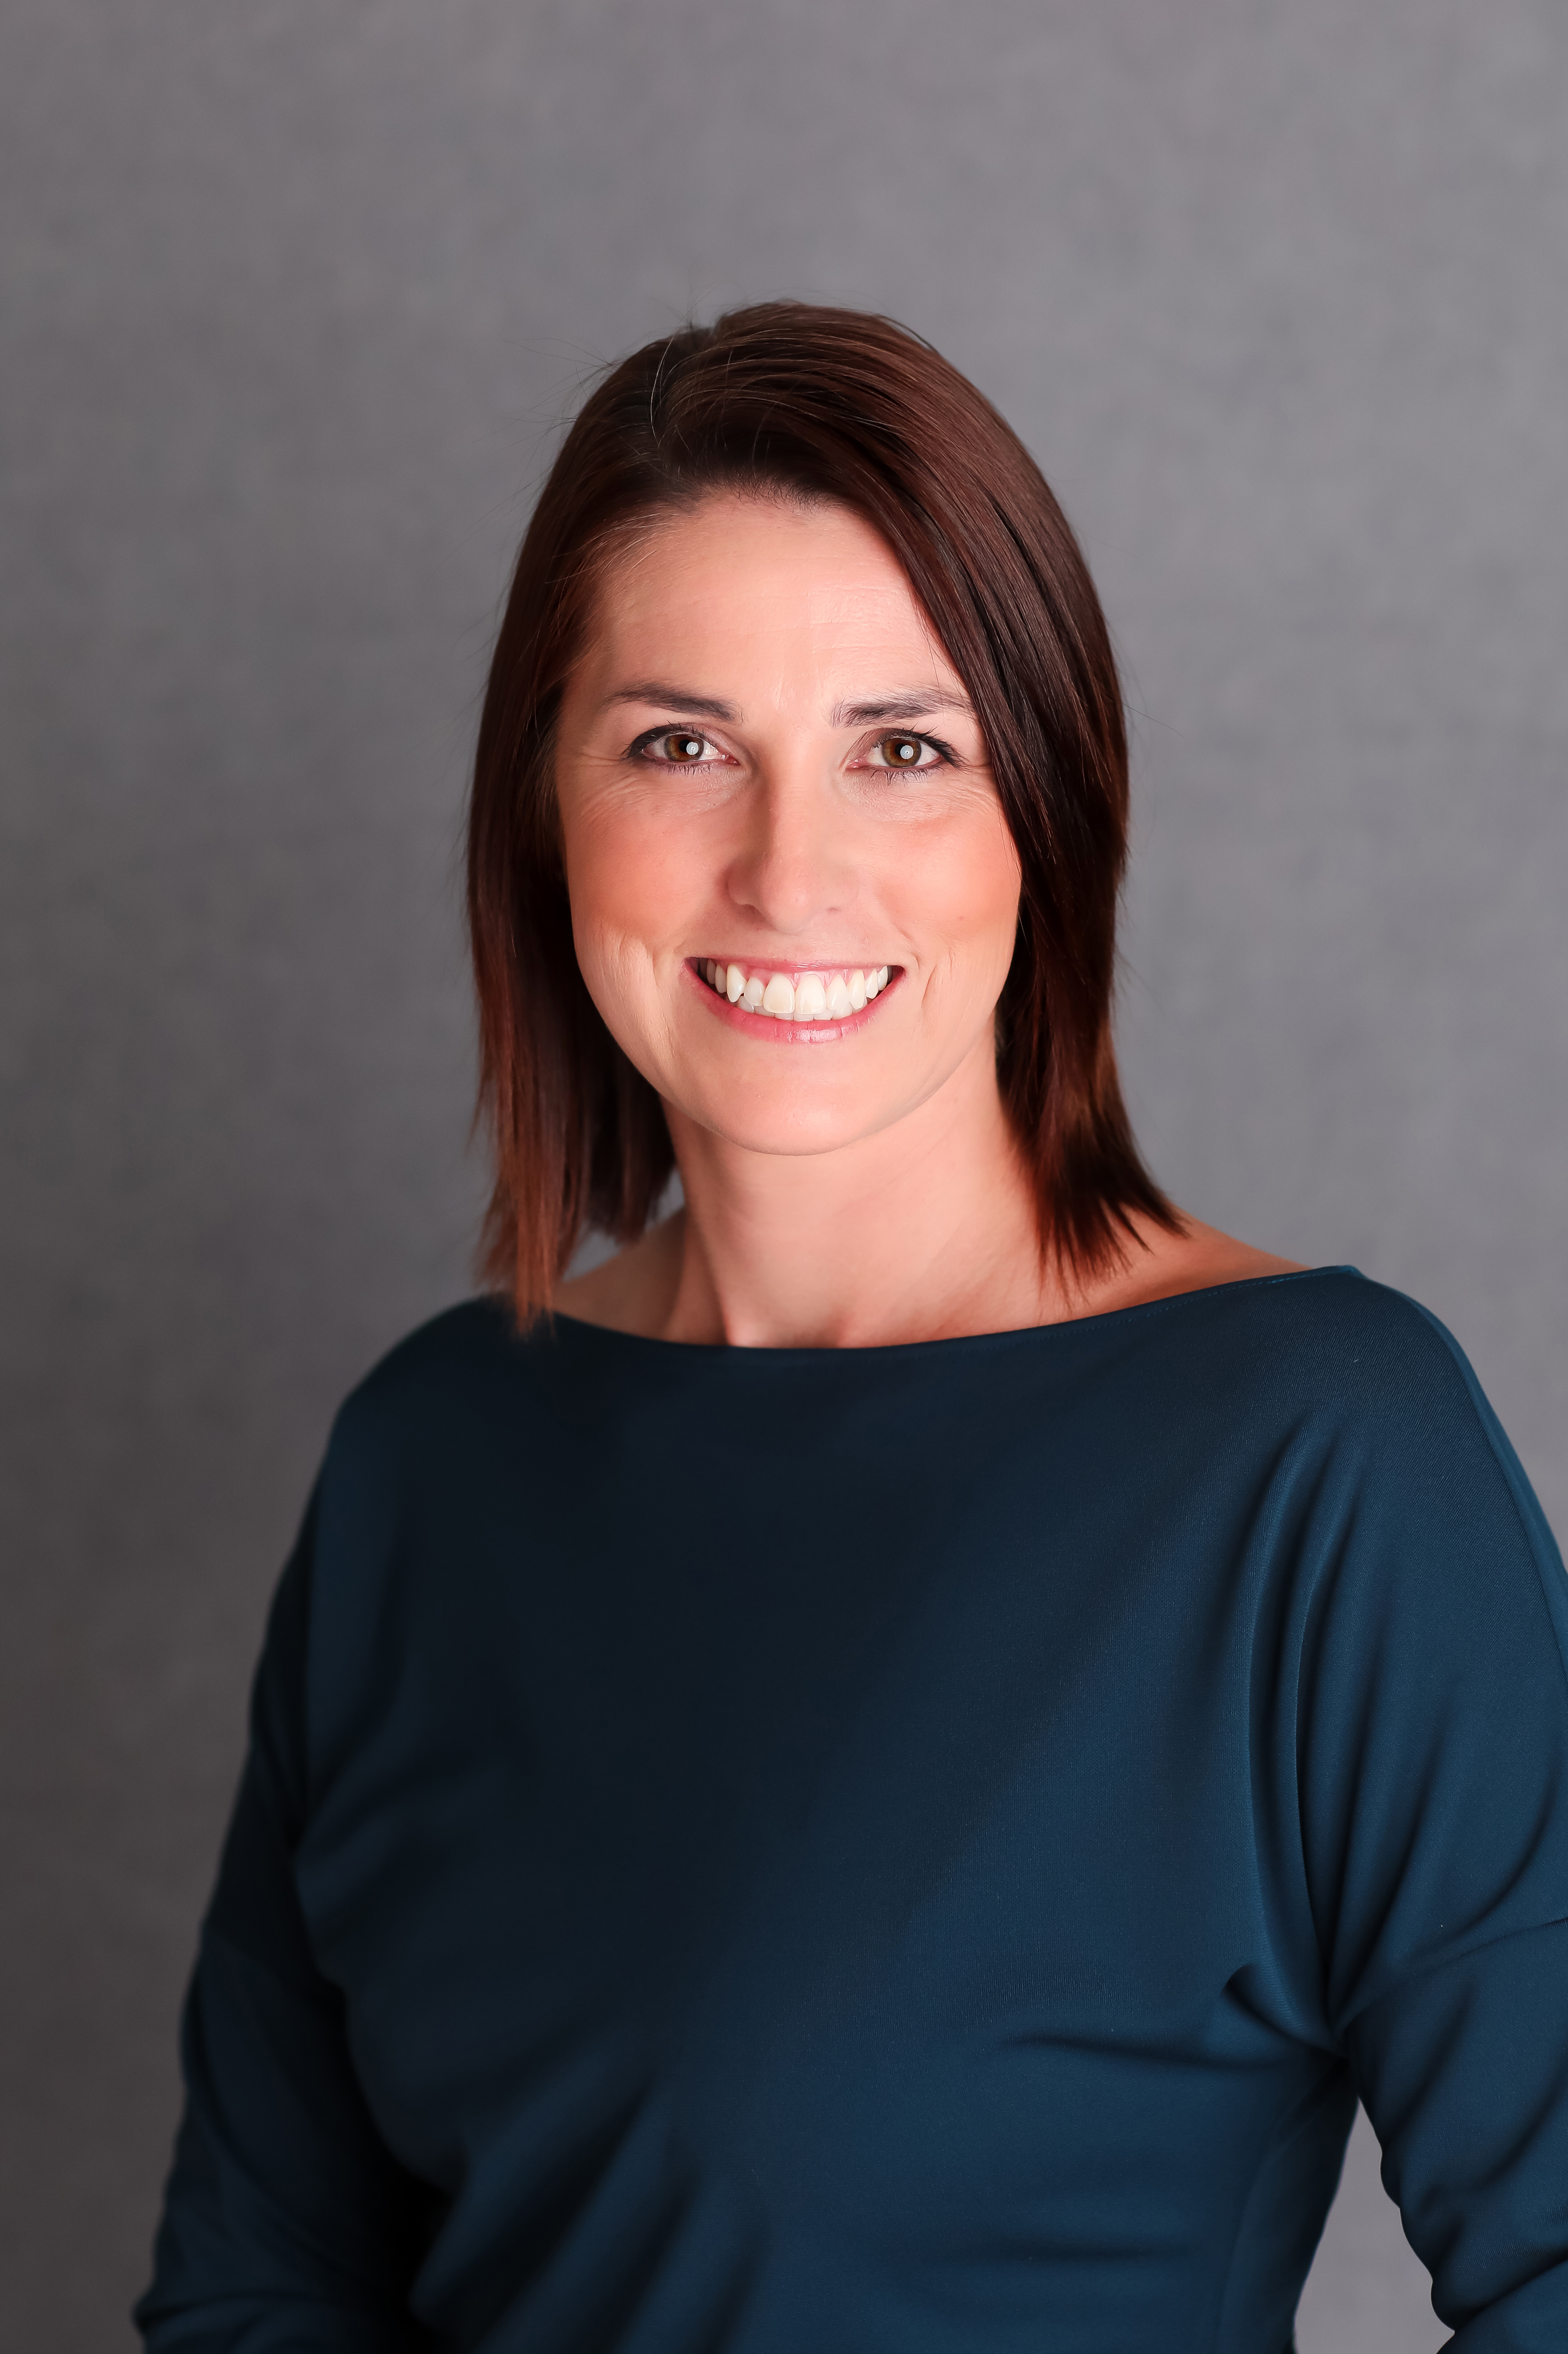
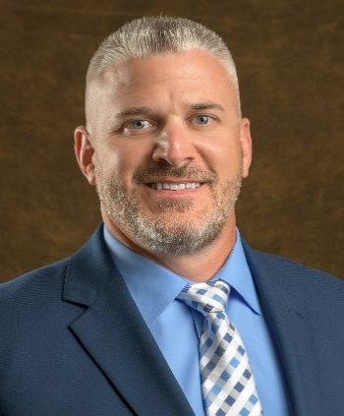
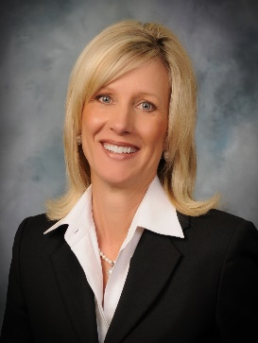
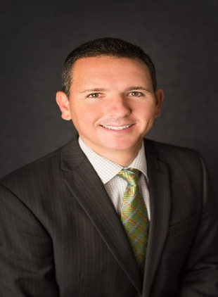
NOC Board of Regents
2021-2022
Michael Martin, Chair
Stillwater, OK
Jami Groendyke, Vice Chair
Enid, OK
Jodi Cline, Member
Ponca City, OK
Bradley Fox, Member
Ponca City, OK
Jason Turnbow, Member
Enid, OK
Notes:
Add photo of Regent Martin and update offices

Slide 4
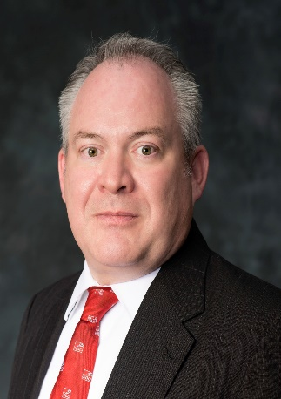
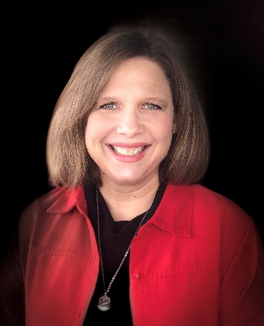
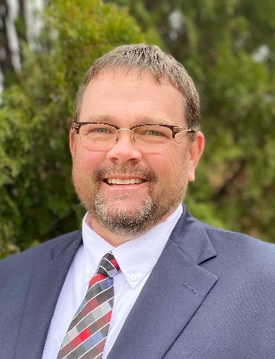
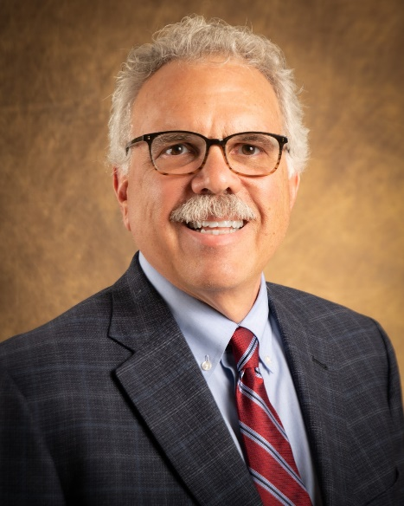
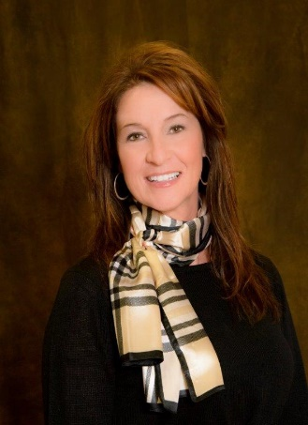
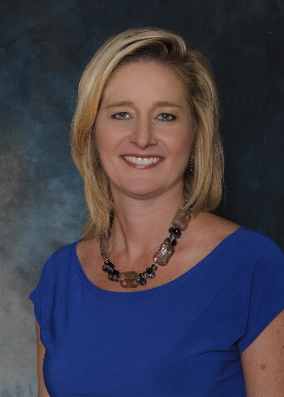
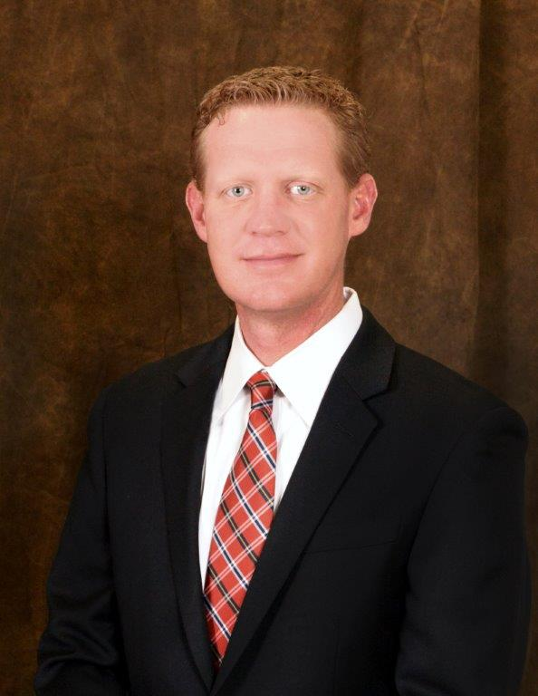
NOC Executive Council
Dr. Rick Edgington
VP Enrollment Management
Diana Watkins
Interim VP Academic Affairs VP Stillwater
Jeremy Hise
VP NOC Enid
Sheri Snyder
VP Development & Community
Relations
Dr. Clark Harris
President
Anita Simpson
VP Financial Affairs
Jason Johnson
VP Student Affairs

Slide 5
Purpose of the Foundation
The purpose of the Northern Oklahoma College Foundation shall be to enhance the educational opportunities and the environment of Northern Oklahoma College. The Foundation is organized exclusively for the benefit of the educational, literacy and scientific activities of the college, chartered under the constitution and laws of the State of Oklahoma. The principal function of Northern Oklahoma College Foundation, Inc. is to promote Northern Oklahoma College and the welfare of its programs and students by providing scholarships, loans and other awards as deemed appropriate.

Slide 6
Mission of the Foundation
The Northern Oklahoma College Foundation seeks private support by establishing lifelong relationships with its donors, alumni and friends while supporting the mission of Northern Oklahoma College and providing financial assistance and quality educational experiences to our students, programs and employees.

Slide 7
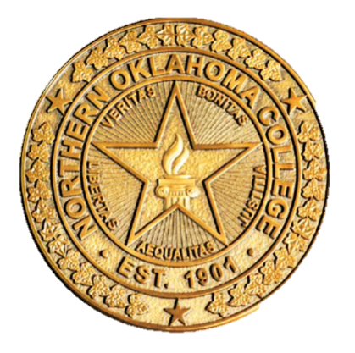
Presidential Partners Program
2021-2022 Campaign Donors
Visionary Partners ($5,000 – Above) Diemer Family Foundation
Leader Partner ($2,500 - $4,999) Dr. Rick Edgington; Charles Zody
Scholar Partner ($1,000 - $2,499) John & Linda Brown; John Campbell; Robert Easterling; Evans Family Foundation; John & Virginia Groendyke; Dr. Clark & Paula Harris; Loftis & Wetzel Insurance; Bert & Janice Mackie; Renfro Family Foundation – Carl & Brenda Renfro; Patrick Rooney; Marjilea Smithheisler
Benefactor Partners ($500 - $999) Bill & Barbara Bridwell; Chad & Lisa Dillingham; Rodney & Delaine Kutz; Ford & Maxine Lasher; Todd & Mary Margaret Miller; Drs. Don & Pam Stinson
Patron Partners ($250 - $499) Evelyn Coyle; Dr. Cheryl & Tom Evans; Pat Hullet, Jason & Cara Beth Johnson; Gerald Nield; Daniel Wood

Slide 8
Scholarship History
Academic Year | Scholarship Award | Number of Recipients | Loan Award | Number of Recipients
2020-2021 | $196,692 | 394 | $60 | 1
2019-2020 | $245,123 | 395 | $75 | 1
2018-2019 | $260,351 | 392 | $105 | 2
2017-2018 | $261,764 | 333 | $570 | 3
2016-2017 | $249,529 | 312 | $26,579 | 107
2015-2016 | $219,333 | 243 | $25,429 | 95
2014-2015 | $209,576 | 248 | $20,815 | 62
2013-2014 | $143,574 | 189 | $3,225 | 14
2012-2013 | $96,670 | 135 | $10,359 | 53
2011-2012 | $99,800 | 201 | $6,569 | 35
2010-2011 | $79,989 | 90 | $17,326 | 92
2009-2010 | $78,966 | 114 | $1,134 | 7
2008-2009 | $79,220 | 118 | $3,802 | 21
2007-2008 | $88,960 | 126 | $3,757 | 27
2006-2007 | $79,220 | 118 | $4,333 | 24
2005-2006 | $63,848 | 117 | $6,848 | 40
2004-2005 | $59,333 | 121 | $17,975 | 103
2003-2004 | $44,787 | 116 | $15,545 | 85
2002-2003 | $56,008 | 138 | $14,778 | 86
2001-2002 | $64,645 | 161 | $9,354 | 55
2000-2001 | $33,030 | 74 | $8,545 | 52
1999-2000 | $24,641 | 76 | $11,763 | 79
1998-1999 | $25,806 | 71 | $7,457 | 48
1997-1998 | $21,850 | 54 | $5,645 | 43

Slide 9



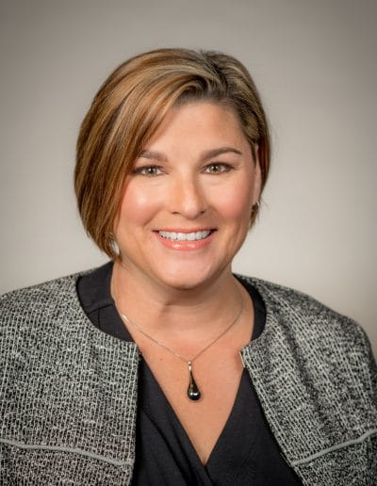





Northern Oklahoma College Foundation, Inc.
Board of Trustees 2021-2022
Community Leaders
David Cummings
LynnDe Funk
Dr. Gordon Laird
Misty Thurman
Mark Detten
Vice Chair
Linda Brown
Chair
Mike Loftis
Past Chair
Bert Mackie
Tom Poole

Slide 10

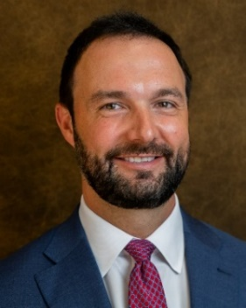
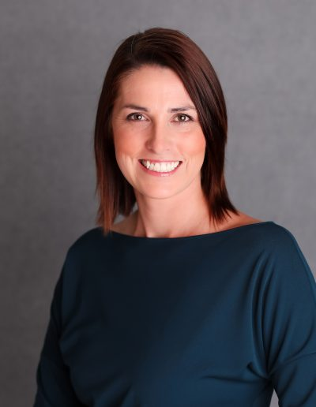

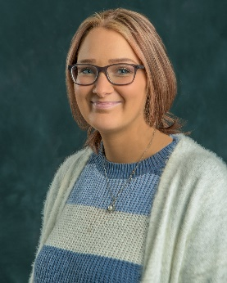
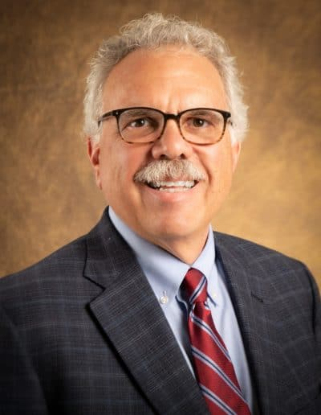

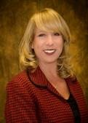
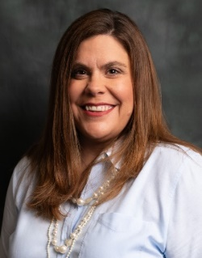
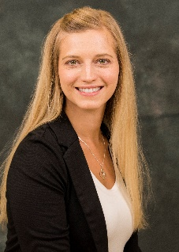
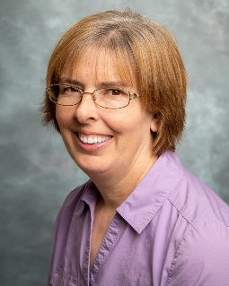
Northern Oklahoma College Foundation, Inc.
2021-2022
Regents, Administrators and Support Staff
Sheri Snyder
Executive Director
Anita Simpson
Treasurer
Regent Michael Martin
Regent Jami Groendyke
Heather Swain
Asst. to the Director
Rachel Love
Asst. to the Treasurer
Dr. Clark Harris
NOC President
Candy Oller
Gift Processing
Dr. Jill Green
Development & Donor
Relations
Kayla Wooderson
Alumni & Community Relations
Kerri Gray
Scholarships

Slide 11
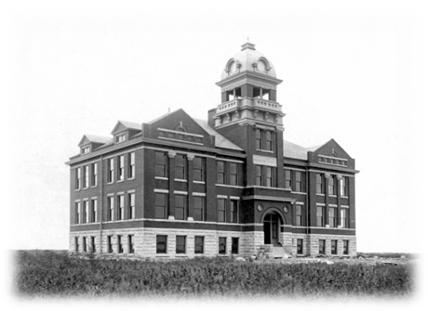
The Central Hall Society
The Northern Oklahoma College Foundation has established the Central Hall Society in order to recognize those Alumni and Friends who have remembered NOC in their estate planning. The Central Hall Society recognizes and honors the legacy of these donors.
Membership in the Central Hall Society is open to those who:
Make planned gifts in the form of charitable remainder trusts (including pooled income funds and uni-trusts), lead trusts, gift annuities, or deferred gift annuities; or
Make gifts of life insurance or have named the college as the beneficiary of their policy; or
Have confirmed non-contingent, bequest provisions; or
Have named the college as a non-contingent beneficiary of their IRA or other retirement plan
Consider Remembering NOC in your Planned Giving

Slide 12
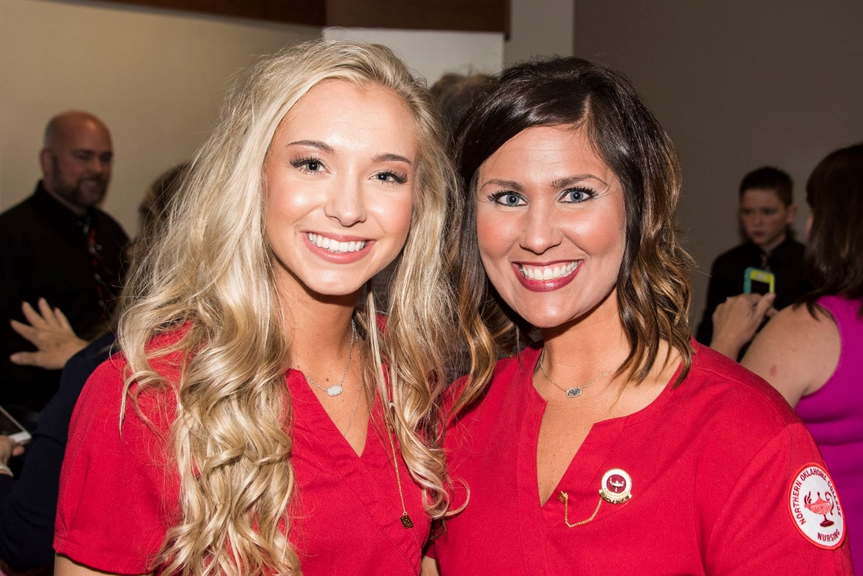
NEW SCHOLARSHIPS
LPN Bridge Scholarship
Through an anonymous donor, the LPN Bridge Scholarship was established to assist working LPN’s earn their RN.

Slide 13
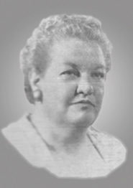
NEW SCHOLARSHIPS
The Rowena Gharst Corr Scholarship
This permanently restricted endowed scholarship was established by the estate of her son, William Reade Corr. Ms. Corr was a lifelong educator who earned her teaching certificate at age 17. This scholarship will be awarded to a full or part-time student from either Perry or Bartlesville, which is where Ms. Corr spent most of her teaching career

Slide 14
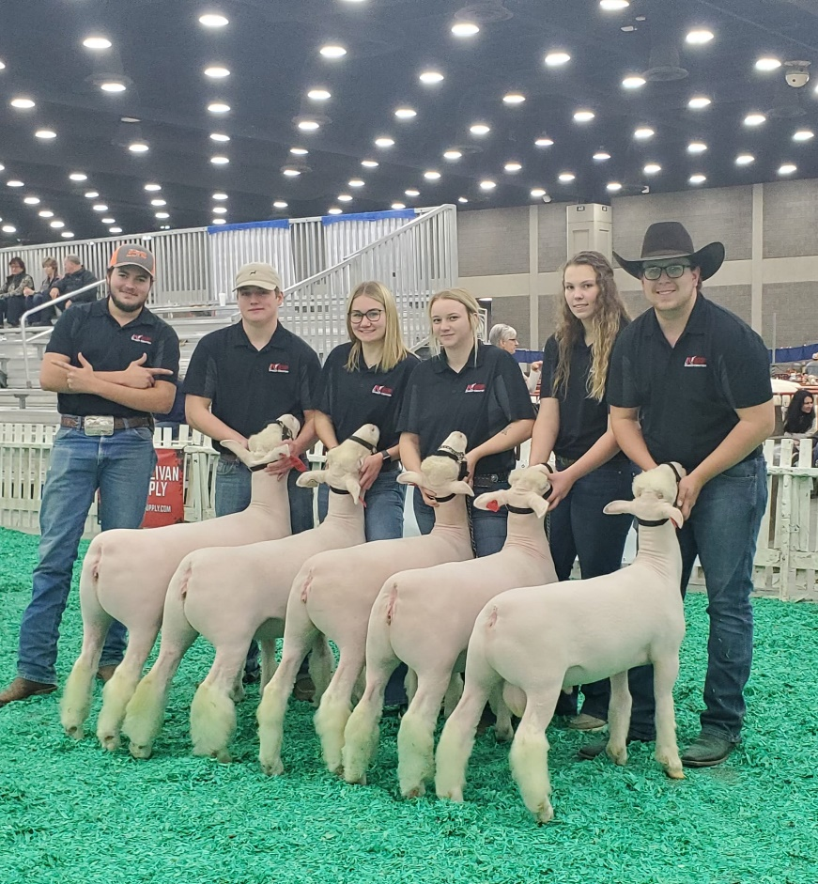
NEW SCHOLARSHIPS
NOC Sheep Center Scholarship
Through fundraising efforts, the sheep center established an endowed scholarship to award a cash award to a sophomore student who works at the sheep center. The award will be given annually at the awards ceremony.

Slide 15
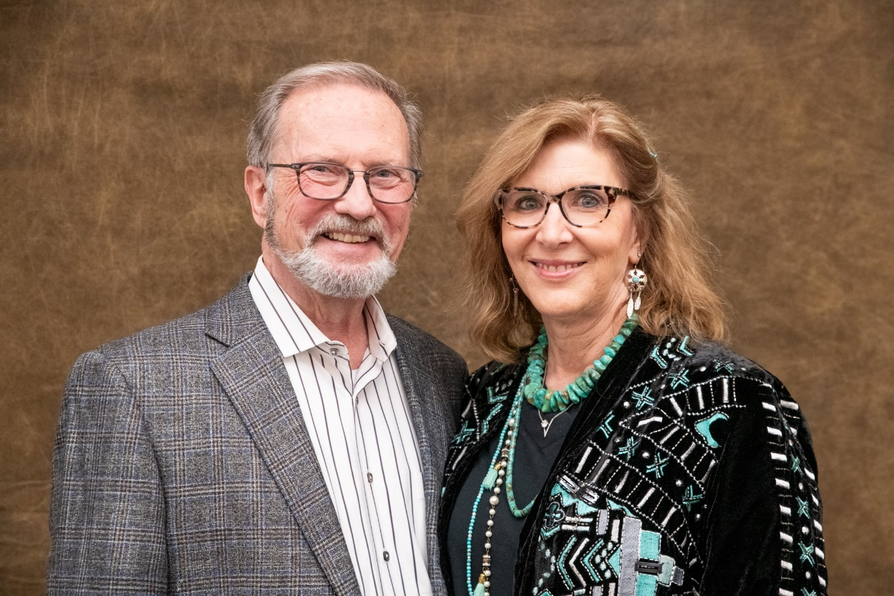
NEW SCHOLARSHIPS
Loftis Access to Success for Blackwell High School Concurrent Students Scholarship
Mike and Kim Loftis generously set up this scholarship to cover any cost to Juniors and Seniors at Blackwell High School that is not covered by funding through the state of Oklahoma for concurrent students. They have set no limit as to the number of credit hours eligible students can have covered under the scholarship.

Slide 16
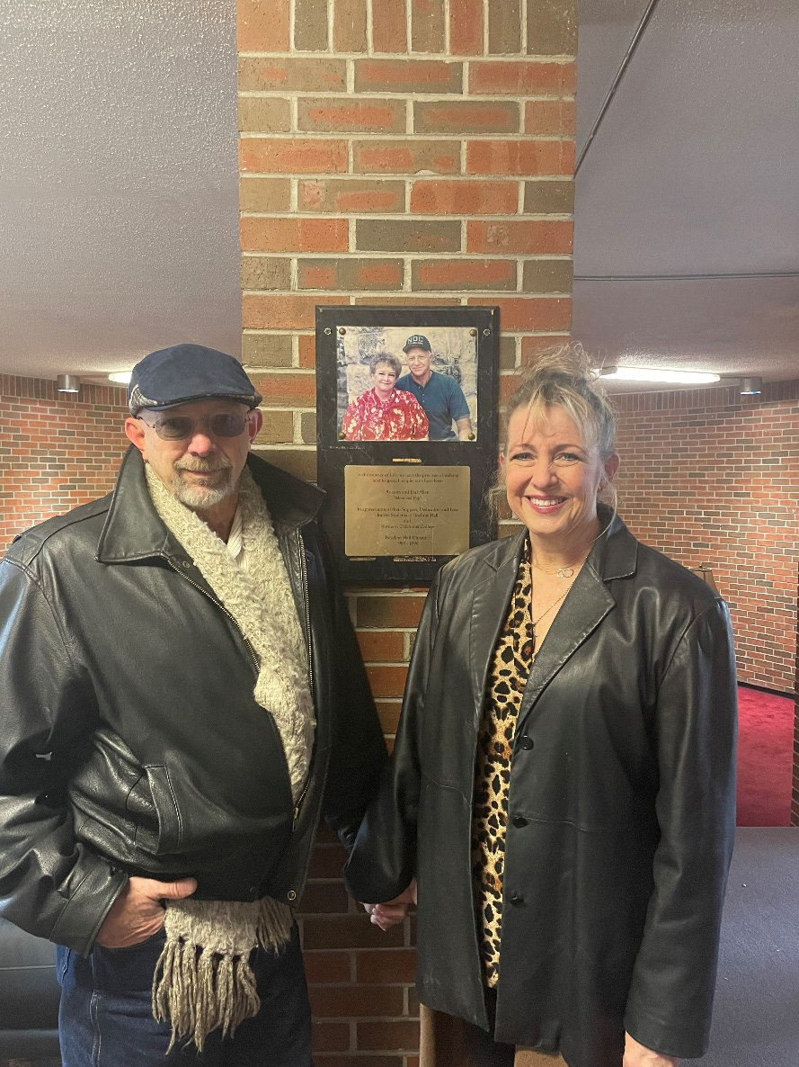
NEW SCHOLARSHIPS
Mom and Pops Allen Scholarship
Dirk Allen and Sherri Whitehead, children of Earl and Roberta Allen, affectionately known as Mom and Pops, established this scholarship in their parents honor.
Mom and Pops were dorm parents in Boehme Hall on the Tonkawa campus from 1989-1996

Slide 17
Northern Oklahoma College Foundation
2022 Honor Roll

Slide 18
Major Club
Enel Green Power NA, Inc.
Stan and Kendall Claybaker
Diemer Family Foundation
Dillingham Insurance
Dr. Rick Edgington
Enid Concrete Co., Inc.
Enid Higher Education Council, Inc.
Evans Family Foundation
Dr. Cheryl and Tom Evans
Estate of William R. Corr
Dr. Jim and Ann Halligan
Hays Charitable Trust
Dr. Kathryn Jones
Dr. Gordon and Sherri Laird
Loftis and Wetzel Insurance – Mike and Kim Loftis

Slide 19
Major Club
Bert and Janice Mackie
Park Avenue Thrift
Phillips66
Bill and Susie Phelps
Doctor Pickens Museum Inc. – Hugh Pickens
Renfro Family Foundation - Carl and Brenda Renfro
Drs. Don and Pam Stinson
University Center of Ponca City
Darrell and Grace Wessels

Slide 20
Heritage Club
A-Line TDS, Inc.
Art and Nevona Bossert
Bill and Barbara Bridwell
John and Linda Brown
John Campbell
Jackie Conrady
Bruce Dale
Richard and Lori Davis
Dr. Ann and Tom Dugger
Robert Easterling
The Ellis Foundation
Robert and Jacque Erner
Jeff and LynnDe Funk
Ike and Marybeth Glass
Hayden and Jami Groendyke
John and Virginia Groendyke
Dr. Clark and Paula Harris
Jeremy and Brandy Hise

Slide 21
Heritage Club
Ideal Homes of Norman, LP
Jason and Cara Beth Johnson
Floyd Jones and Jodi Cline
Dawn Kisner
Dr. Pete and Tricia Moore
Evelyn Otto
Peter Pan Cleaners
Phillips Univ. Alumni & Friends Assoc.
Tom and Judy Poole
Jim and Sue Ann Rodgers
Jeffrey Rogers
Patrick Rooney
Eric and Anita Simpson
Vincent Siren
Marjilea Smithheisler
Coby and Sheri Snyder
Dr. Wendy Stone
Mick and Vina Weiberg

Slide 22
President’s Club
Stan Anderson
William Beaty
Lyn and Jerri Boyer
Stan and Gail Brownlee
Buck Cattle Company, LLC
Tim and Linda Burg
Royce and Kathlyn Caldron
Bob Case
Meg Coots
Evelyn Coyle
Delphi Study Club
Andrew and Kristi DesJarlais
Mark and Jayne Detten
Chad and Lisa Dillingham
Steve and Jeanne Friesen
Dr. Jill and David Green
Bret Hanza Cattle Company LLC.
Jay L. Helm

Slide 23
President’s Club
Joe R. Kreger
Rodney Kutz
Ford and Maxine Lasher
Steve and Cheryl Marquardt
Todd and Mary Margaret Miller
Mike and Helen Sellers
Darin and Christy Snider
Brad and Misty Thurman
Ben and Stephanie Treiner
Jason and Torry Turnbow
Constance Van Ausdall
Randy Walker
Tom Walker
Dave and Dr. J. Munson Welsh

Slide 24
Crimson Club
Mike and Lynn Goodale
Jan Adams
Nancy Appleman
Kevin Bailey
Joann Black
Dr. Jerry Blankenship
Lewis Carter
Dr. Jeremy Cook
Diemer Construction Co, LLC Employees
Mark and Kaye Dick
Don and Brenda Dobbs
Leonard and Vickie Epperson
Dr. Justin and Mara Funk
Dineo Heilmann
Patricia Hullet
Janet Jarvis
Bill and Kim Korn
Langdon Publishing Co., Inc.

Slide 25
Crimson Club
Linn Laughrey
Paula Lewis
Louis and Janet McCarter
Tom and Sherry Muchmore
Gerald Nield
Kim Ochoa
Brad Purdy
Odylon Rico
James Schaefer
Marilyn Seagraves
Daniel Wood
Vernon and Norma Young

Slide 26
Round Up Club
Dr. Paul Bowers
Rex and Irene Ackerson
Mary Adams
Tyrone and Amanda Bell
David Bloss
Carol Bouldin
Aaron and Suzi Brown
Carolyn Brown
Joe and Janet Buck
Dennis and Valerie Buss
Bill and Sharon Butler
Rhett and Jill Butler
Anna Cales
Mark and Cherri Calvert
Robert Campbell
Kimberly Caruthers
Silvio and Margaret Cianfrone
Dr. Jack Cnossen
Tim and Ginny Coffman

Slide 27
Round Up Club
Duncan and Cheryl Coons
Tamera Davis
Chris and Lynn DeMuth
Sharon Depriest
Dale and Carol DeWitt
Robert Doenges
E. Ray or Linda Downs Rev. Trust
Jack Drake
Larry and Sharon Dye
Mark A. Edmiston & Lynn A. Sund
GH2 Architects, LLC
James and Marilyn Gilbert
Tom and Krista Gleason
Christi Gonzalez
Brad Gordon
Chad and Tara Greb
Lauren Hale
Clayeton Hammock

Slide 28
Round Up Club
Richard Hefton
Kirby Hill
William Hodge
Cleo and Kenna Jackson
Leslie Johns
J. Kelly Johnson
Clayton and Nancy Johnson
Elizabeth Kastl
Michele Keeling
Jerry Kirkaptrick
Greg and Sigrid Krause
Jim and Bea Kreger
Barry and Cheryl Lane
Kenneth Martin
Buddy McCarty
Patrick Mulligan
Stephen and Patricia Myers
Cameron and Sherryl Nelson

Slide 29
Round Up Club
Homer and Barbara Nicholson
Lisa Nordquist
Robert and Julianne Norris
Candy Oller
Dr. Gerald O’Mealey
Dianna Holmes Pansze
Steve and Jonelle Parks
James Parnell
Ryan and Jennie Paul
Delmar and Irma Quade
Stephen and Debby Randall
Bob and Deanne Rice
Laurence “Bo” Riseling
Julia Anne Robeson
Michael Roberts
Rod and Allison Robinson
Roustabouts Alumni
Larry Rudiger

Slide 30
Round Up Club
J. Wesley Ruzek
Linus and Sue Schmitz
Stephanie Scott Bundy
Rick Scott Construction, Inc.
Ann Shahawy
Tom and Pat Sipe
Lynn and LouAnn Smith
Danny and Toni Snow
Barbara Stadler
Kevin Steichen
Thomas and Ruth Steichen
Tommy and Suzy Stergas
Randy and Linda Stevens
Major George R. and Nancy Stirman
Christopher Storm
Dr. James and Sharon Strate
Cindy Tate-Ball
William and Jane Thomason

Slide 31
Round Up Club
Randy and Robyn Turney
Edwin Urban
Wade and Diana Watkins
William and Rebecca Weeks
William Whitfield
Grady and Kayla Wooderson
Sharon Worden
Michael and Kelley Wright
Laural Zavodny

Slide 32
Gift In Kind
Albertson’s Companies, Inc.
Kurt Campbell, Ben Hainline and
Ray Weidman
Gene Dougherty
Dr. Cheryl and Tom Evans
Dr. Justin Funk
Dr. Clark and Paula Harris
Marcy Mulligan
Darrin Nassalroad

Slide 33
Northern Oklahoma College Foundation
2021-2022 Foundation Scholarship Recipients

Slide 34
Foundation Scholarship Recipients
H.S. “Hap” and Amelia Aisenbrey Scholarship
Alexia Klinger
Dr. Christina Akers Memorial Scholarship
Citabria Baker
Joyce Arlene Asbury Memorial Music Scholarship
Edgar Dominguez

Slide 35
Foundation Scholarship Recipients
Phyllis Kendall Asbury Scholarship
Cooper Anderson
Joan Bartlett Memorial Scholarship
Colt D. Jones
Dale and Mirth Beall Scholarship
Darah Dickover

Slide 36
Foundation Scholarship Recipients
Gene Belcher Foundation Scholarship
Boune Thorne
Anna Luna
Patricia Frickenschmidt
George and Floretta Bellmon Scholarship
Adam Brand

Slide 37
Foundation Scholarship Recipients
Ima Faythe Berglund NOC Endowment Engineering Scholarship
Kyson Snelson
Riley Price
Elric Cope
Phillip Prairie-Chief

Slide 38
Foundation Scholarship Recipients
Ima Faythe Berglund NOC Endowment Science Scholarship
Cade Ring
Ashley Evers
Ashley N. Hill
Alexis Klinger
Laney R. Jones
Alyssa Pando
Abigail Cardwell
Angelo Freytez
Clay Massey

Slide 39
Foundation Scholarship Recipients
Judy Blan Memorial Scholarship
Boune Thorne
Agness M. Bray Memorial Scholarship
Lesly Plank
John L. and Linda J. Brown Scholarship
Makenzie Hicks
A.D. Buck Scholarship
Laney R. Jones

Slide 40
Foundation Scholarship Recipients
James W. Buttram Memorial Scholarship
Bailey Hoeltzel
Leo Canaday Memorial Scholarship
Delaney Reimer
Jennie Goodson Cannon Scholarship
Collin Prince
Nikolas Hoecker
Allie Epperson
Mallory Kyler

Slide 41
Foundation Scholarship Recipients
Roy Chaney Scholarship
Tanner Cline
Landon Smykil
Halie Shirley
Robert Bryant Colombe Scholarship
Kenny Endl
Karlie Thomason

Slide 42
Foundation Scholarship Recipients
Lee and Iola Combrink Student Scholarship
Angelo Freytez
Aaron Mahan
Carol Diemer Memorial Scholarship
Hailey Fath
Delphi Study Club Scholarship
Jayden Ott
Earl G. Dodson Scholarship
Jayde Vaughan

Slide 43
Foundation Scholarship Recipients
Jerry and Lucille Donnelly Scholarship
Elric Cope
Verlin and Bonnie Easterling Scholarship
Erica Russell
Laney Jones
The Ellis Foundation Scholarship
Caitlin Flackman
Destini Carroll
Macey Mulherin
Samantha Smith

Slide 44
Foundation Scholarship Recipients
Enid Concrete Scholarship
Justin Coppock
Enid Higher Education Council Scholarship – Freshman
Essence Kearney
Jared Johnson
Brook Wilson
Ella Ayers
Camden Roberts

Slide 45
Foundation Scholarship Recipients
Enid Higher Education Council Scholarship – Part-Time
Enid Higher Education Council Scholarship – Sophomore
Mandi Fuksa
Kimberly Osburn
Anel Real
Julian Pendergraft
Shelby Crump
Shay Collins
Tiffany Goss
Tyrnie Johnson –Talley
Vanessa Kerr
Emme Hughes
Gage McNabb
Madalyn Keller
Abigail Crawford
Jessica Ruckel

Slide 46
Foundation Scholarship Recipients
Annie Marie Erwin Memorial Nursing Scholarship
Crystel Thomas
Annie Marie Erwin Memorial Book Scholarship
Olivia Baker
Hannah White
LeaAnn Shoemaker
Annie Marie Erwin Memorial Music Scholarship
Carli Pendleton

Slide 47
Foundation Scholarship Recipients
Edward D. Erwin Memorial Scholarship
Caitlin Flackman
Kathleen Marie Erwin Instrumental Music Scholarship
Connor Shear
Kathleen M. Erwin Nursing School Scholarship
Tara Mueggenborg
Reverend Phillip Douglas Erwin Nursing Schloarship
Katelyn Yee
Robert Kendall Erwin Memorial Nursing Scholarship
Alyssa Gartrell-Steadman

Slide 48
Foundation Scholarship Recipients
Maud Etter Memorial Scholarship
Skyler Jernigan
Kira Pendleton
Evans & Associates Scholarship
Baylee Bowen
Tom and Cheryl Evans Scholarship
Vanessa Wright

Slide 49
Foundation Scholarship Recipients
Lynn Meredith Fulton Scholarship
Mikaela Browning
Margaret Jo Gleeson Memorial Scholarship
Jayden Ott
Harold Hamm Scholarship
Kendyl Powers
Donald R. Hays Basketball Scholarship
Diondre Alexander
Joyce Haywood Memorial Scholarship
Whitney Blosser

Slide 50
Foundation Scholarship Recipients
Wilma Harman Music Scholarship
Makayla Seeney
Clarence Helton Memorial Scholarship
Emily Hale
Harvey Herrington Memorial Agricultural Scholarship
Micah Warren
Hullet Family Scholarship
Tiffany Young
Curtis Jackson Memorial Scholarship
Megan Rice

Slide 51
Foundation Scholarship Recipients
Anna Jenkins Memorial Scholarship
Gracie Griffith
Kay County Retired Educators Association Fund
Haiden Huster
Luke McHenry
Nevona Kegans Scholarship
Jamie Rowland
Carl and Joy Kerfoot Nursing Scholarship
Tiffany Young
Santana Keller

Slide 52
Foundation Scholarship Recipients
Melvin and Margaret Korn Scholarship
David Hernandez
Timothy Knutson Memorial Scholarship
Patrick Costello
Kreger-Sheets Memorial Scholarship
Kelby Linn
Charlotte Kretsch Endowed Scholarship
Max Horner
Dick Lambertz Memorial Scholarship
Baeleigh Henshall

Slide 53
Foundation Scholarship Recipients
Hazel West Litzenberger Memorial Scholarship
Blake Peterson
Alexis Vickrey
Loftis Access to Success for Blackwell High School Concurrent Student Scholarship
James Tripp
Austin Grossardt
Raegan Moore
Jake Smith
Kahle Lambert
Raven Gummow
Anna Tripp
Matthew Davis
Natasha Hindman

Slide 54
Foundation Scholarship Recipients
Jordan Marquardt Memorial Scholarship
Sharon Park
Dr. D.L. Mathews Scholarship
William Humphrey
George McCoy Memorial Scholarship
Luke Livian
Hugh McIntyre Memorial Scholarship
Kathryn Fraizer
David Hernandez

Slide 55
Foundation Scholarship Recipients
Joseph and Pamela Sue McNeal Memorial Scholarship
Krista Johnson
Moody Family Room and Board Scholarship
Billie Jervis
A.H. Muegge Memorial
Jayde Vaughan
David Paul Muegge Memorial
Reagan Twitty
Native American Scholarship
Kristina Kienholz

Slide 56
Foundation Scholarship Recipients
Curtis S. Norman Memorial Scholarhip
Rosette Pruitt
Northern Divisional Book Scholarship
Marissa Neil
Sabrina Jones
Phillip Prairie-Chief
Brandi Whittle
Morgan Fowble
Makayla Seeney
NOC/OSU Gateway Study Abroad Scholarship
Pablo Jaramillo
Vanessa Wright
Michael J. Gibson
Matthew Pawlikowski

Slide 57
Foundation Scholarship Recipients
Phillips University Alumni and Friends Scholarship
Phillips 66 Process Technology Scholarship
Chase Harmon
Jordan George
Michael Manns
Kelly Shoemaker
Matthew Uribe
Paden Allen
Ally Bartley
Kelsee Berghall
Jessica Ebel
Kacie Laporte
Chloe Middleton
Celsa Newman

Slide 58
Foundation Scholarship Recipients
Tom and Judy Poole Endowed Agriculture Scholarship
Jack Roubik
Maxine Follmer Prather Endowed Scholarship
Jayden Ott
Carl and Brenda Renfro Scholarship
Hannah Haley

Slide 59
Foundation Scholarship Recipients
Laurie Annie Rodgers Scholarship
Tracy Rupp
Mary Behar Schell Scholarship
Jan Schickram Memorial Vocal Music Scholarship
Regan Clapper
Alexander Cope
Jayden Ott
Riley Price
Colton Anson
Dylan Hamilton
Aubianna Villines

Slide 60
Foundation Scholarship Recipients
Ray M. Schiltz Memorial Scholarship
Hunter Fox
Taylor Family Character Scholarship
Betty Throop Music Scholarship
Cassidy Edsall
Blake Scott
Randall Caughlin
Rebecca Soto
Alex Cope
Riley Price
Jayden Ott

Slide 61
Foundation Scholarship Recipients
University Center of Ponca City Foundation, Inc. Scholarship
Brandy Musgrove
Jessalynn Neufeld
Makayla Shed Howard
Anthony Gazaway
Montana Ehrlich
Bayler Anderson
Cayden Anderson
Cayson Badley
Emma Bartley
Ashlyn Bickford
Mallory Blackstar
Blake Bristow
Virginia Bryce
Gavin Carleton
Kalyn Delaney
Grant Dye
Martin Engster
Ashlynn Fincher
Jay Glowacki
Eduardo Gonzalez
Kaitlyn Hagar
Alexis Hodges
Mark Hodgson
Sophie Hodgson
Jill Jackson
Jacob Liston
Megan Malloy

Slide 62
Foundation Scholarship Recipients
University Center of Ponca City Foundation, Inc. Scholarship
Michael Mayer
Abby McIntosh
Noah Parks
Brooks Revard
Hunter Robbins
Asher Scantlin
Lane Scholey
Anna Simers
Mia Steelmon
Hattie Steichen
Gage Stout
Rylee Strah
Isabella Sutterfield
Ashlyn Trousdale
Kendall Ware
Ean Watters
Brady Wicker
Haylee Willaford
Abby Williams
Carson Williams
Noah Woodward

Slide 63
Foundation Scholarship Recipients
Betty Throop Scholarship
Cassidy Edsall
Jared Weiberg Endowed Memorial Scholarship
Cameron Malray
Frances G. Wintersole Trust Scholarship
Parker Cooke

Slide 64
Foundation Scholarship Recipients
Zody Family Scholarship
Addison Doyen
Alyssa Pando
Keith L. Zody Scholarship
Ethan Howard

Slide 65
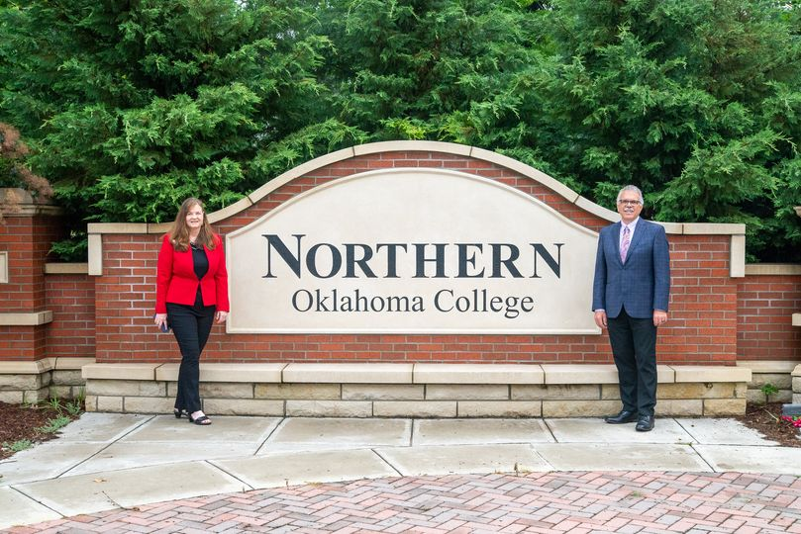
A New Era at NOC
Retiring President Dr. Cheryl Evans welcoming newly appointed President Dr. Clark Harris

Slide 66
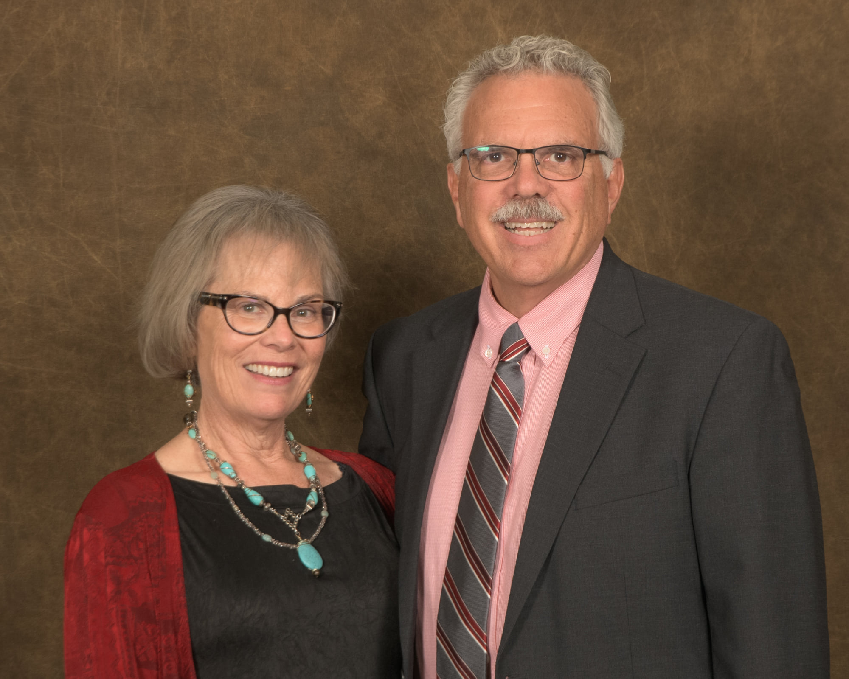
Welcome to the NOC Family
Dr. Clark and Paula Harris

Slide 67
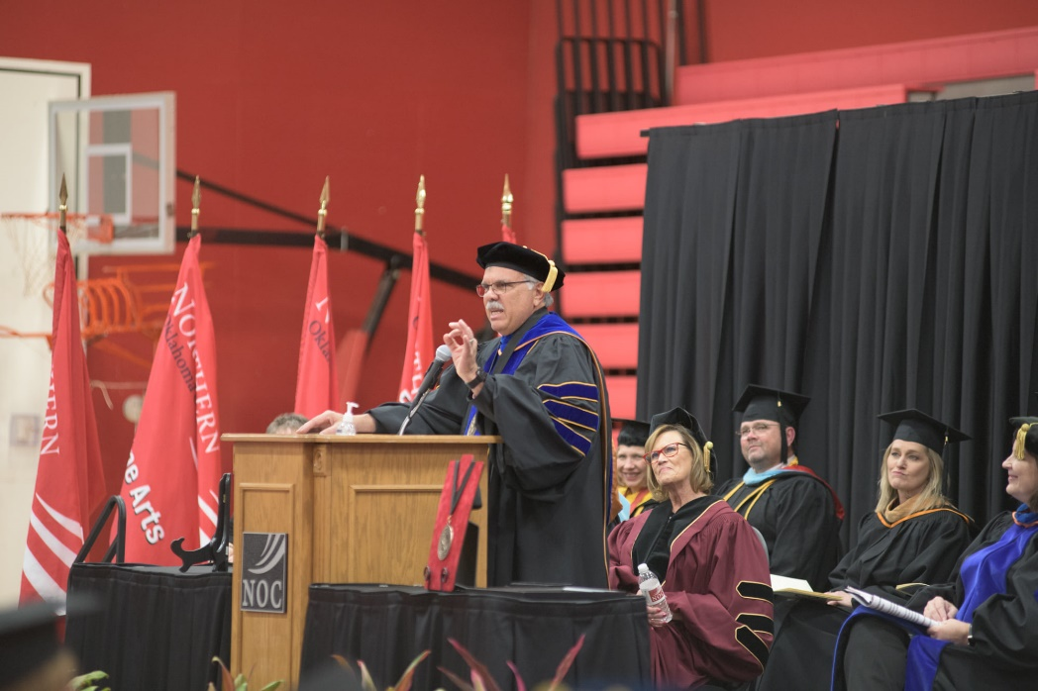
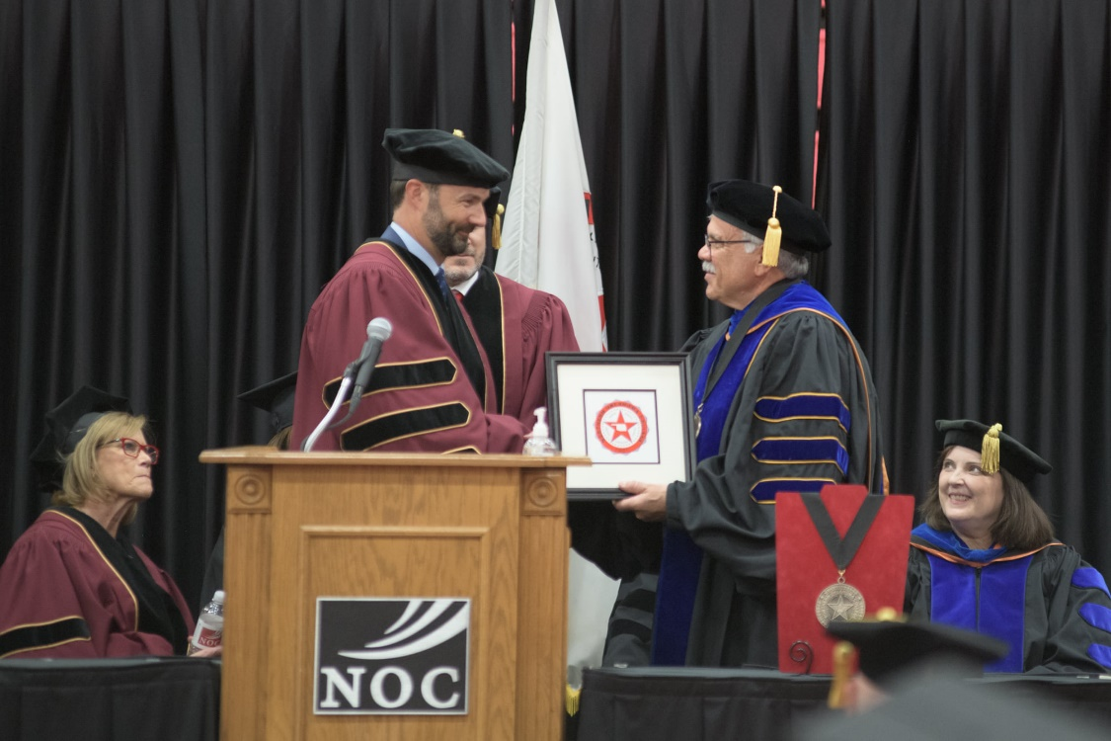
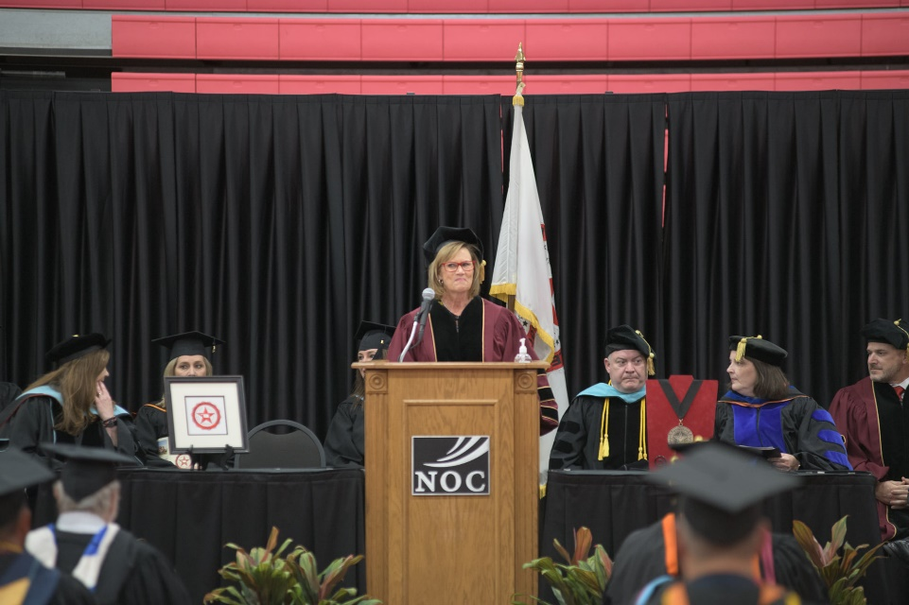
Dr. Harris’ Investiture

Slide 68
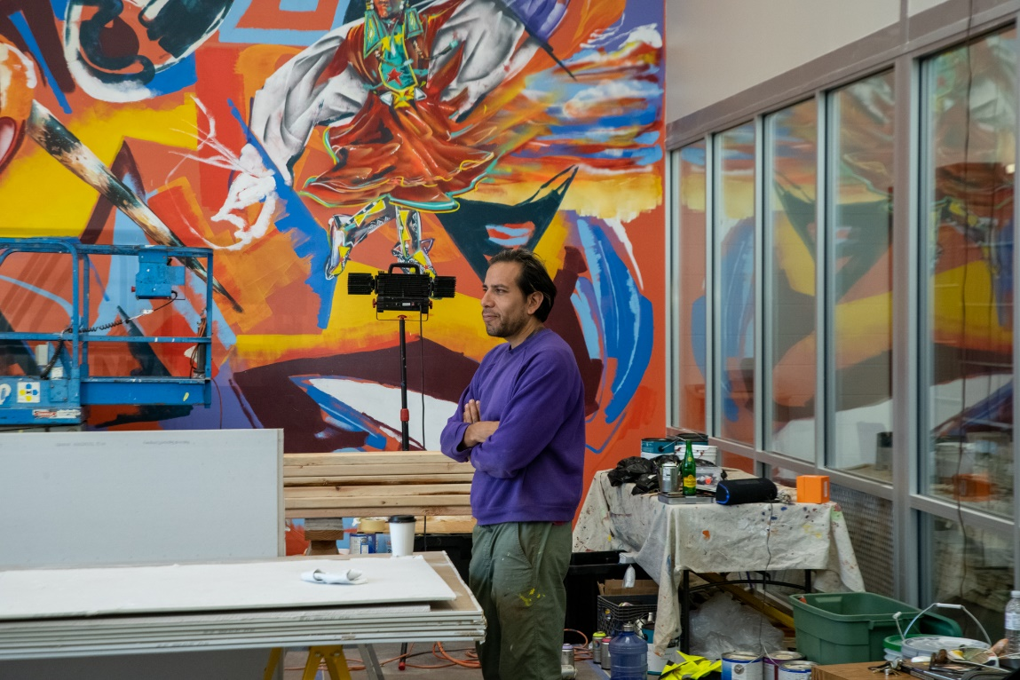
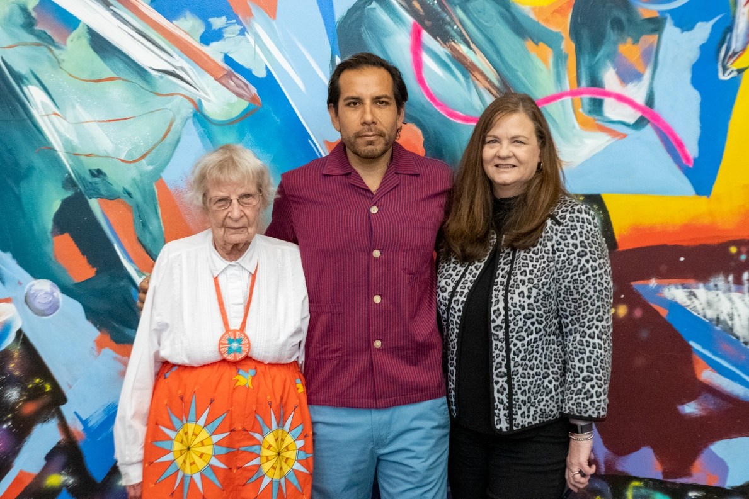
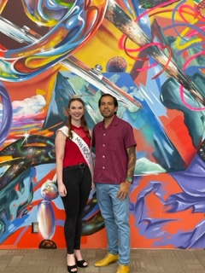
Pickens Museum Presents The Art of Yatika Starr Fields

Slide 69
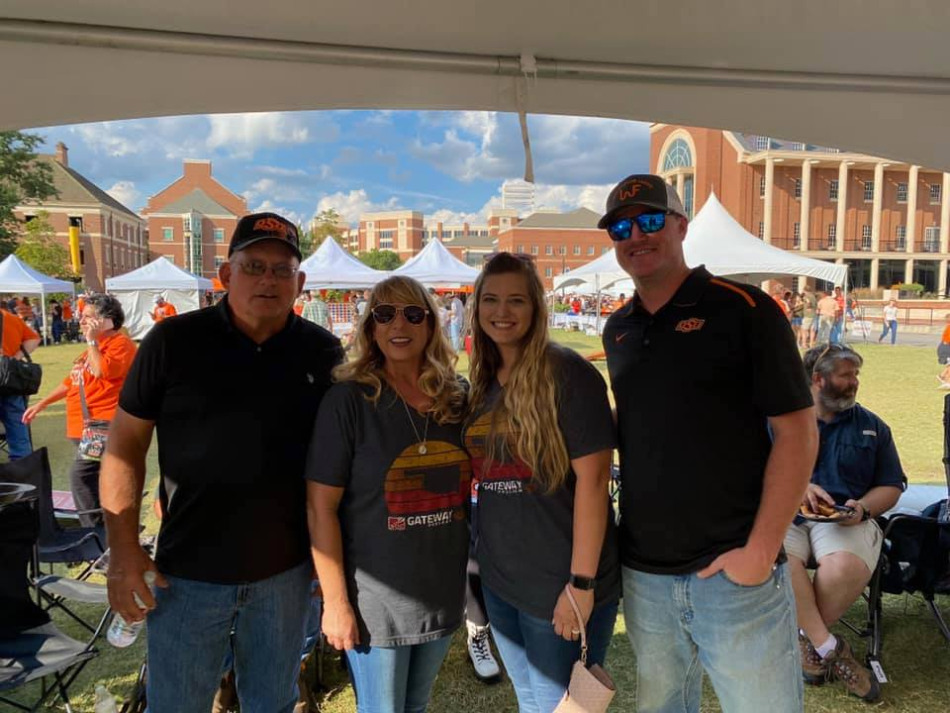
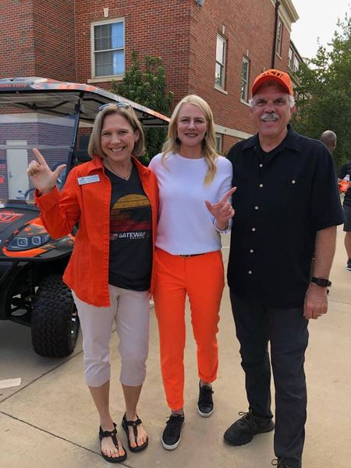
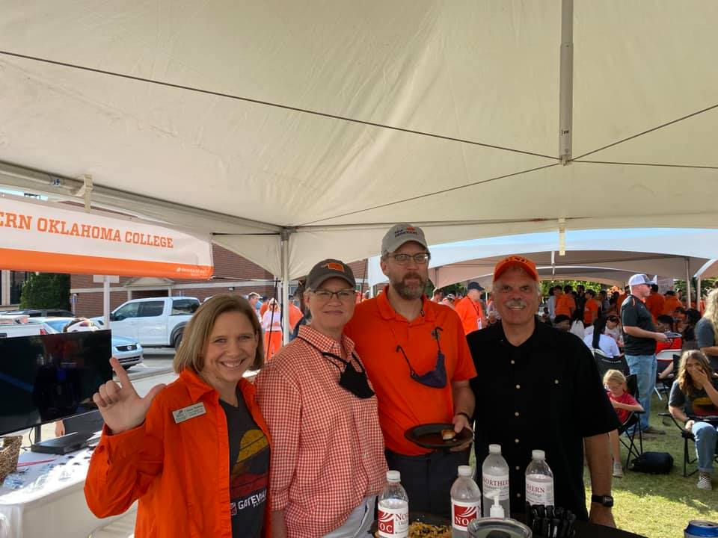
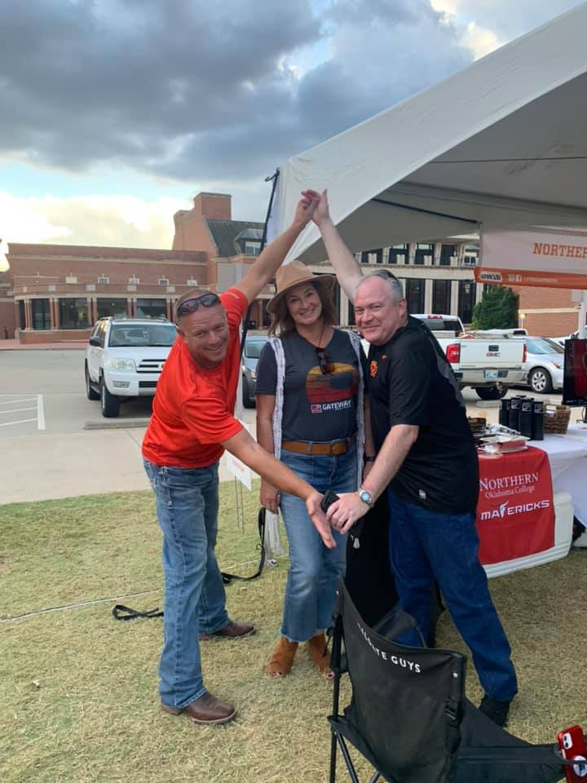
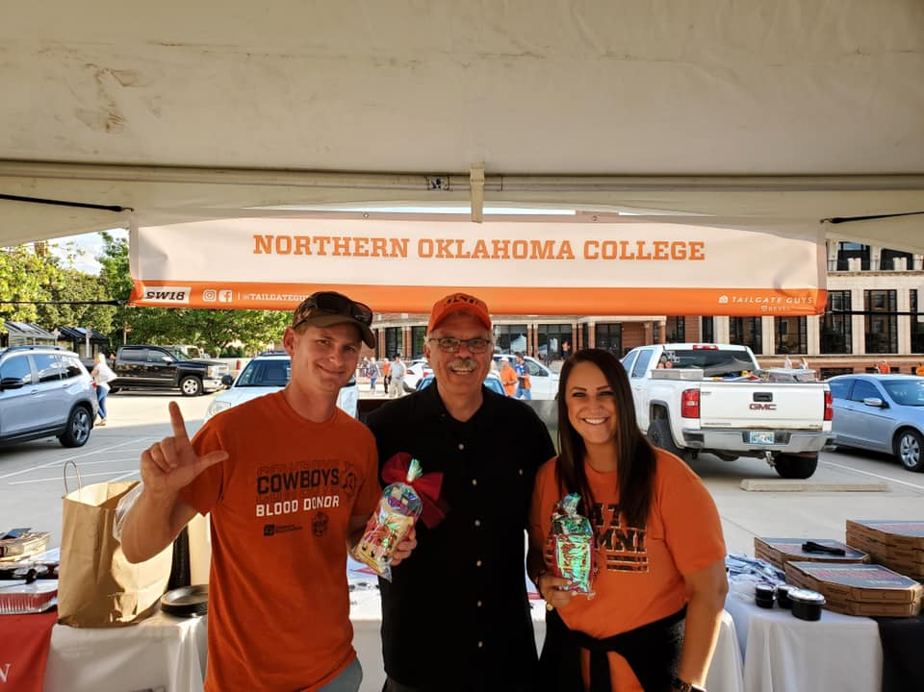
NOC/OSU Annual Tailgate

Slide 70
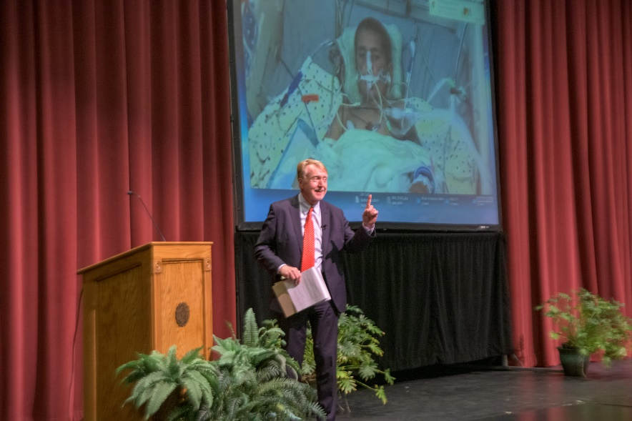
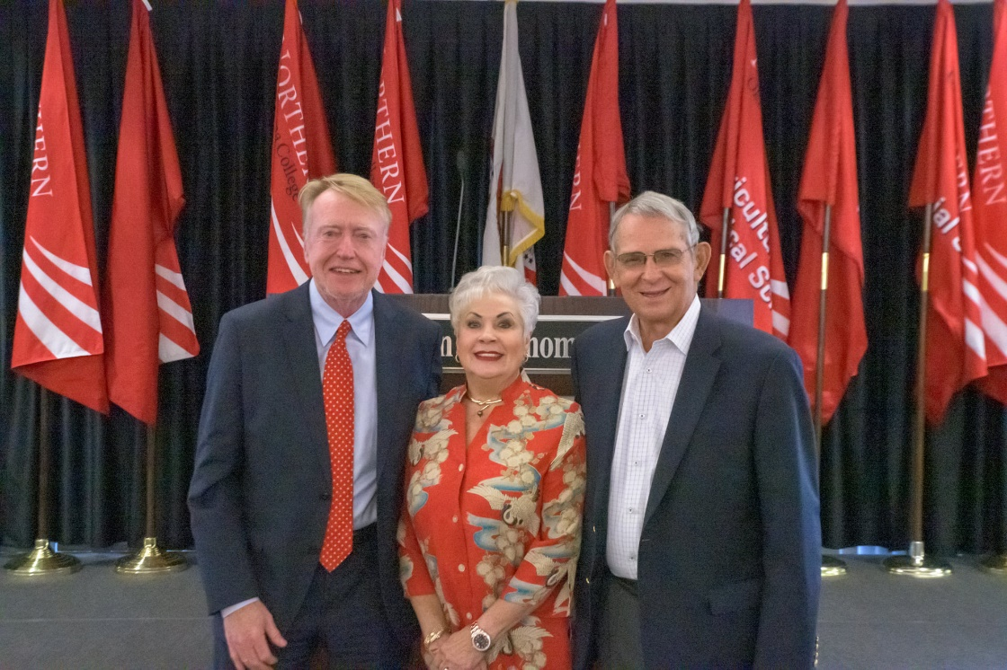
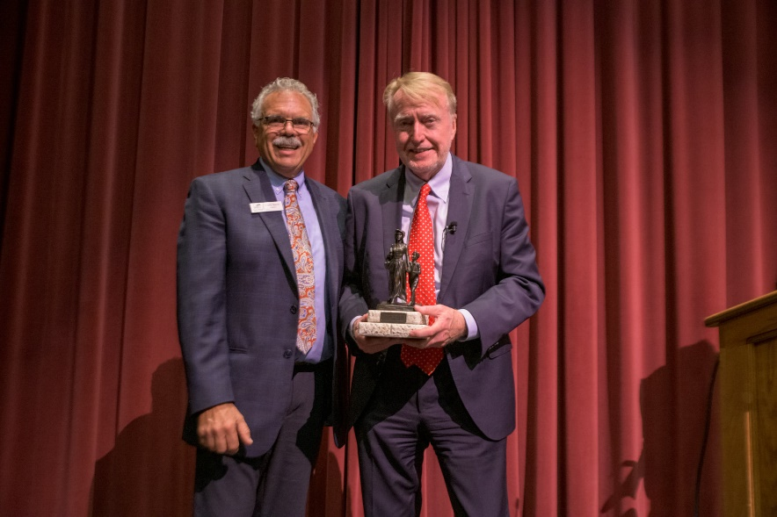
NOC Renfro Fall Lectureship featuring Mike Boettcher

Slide 71
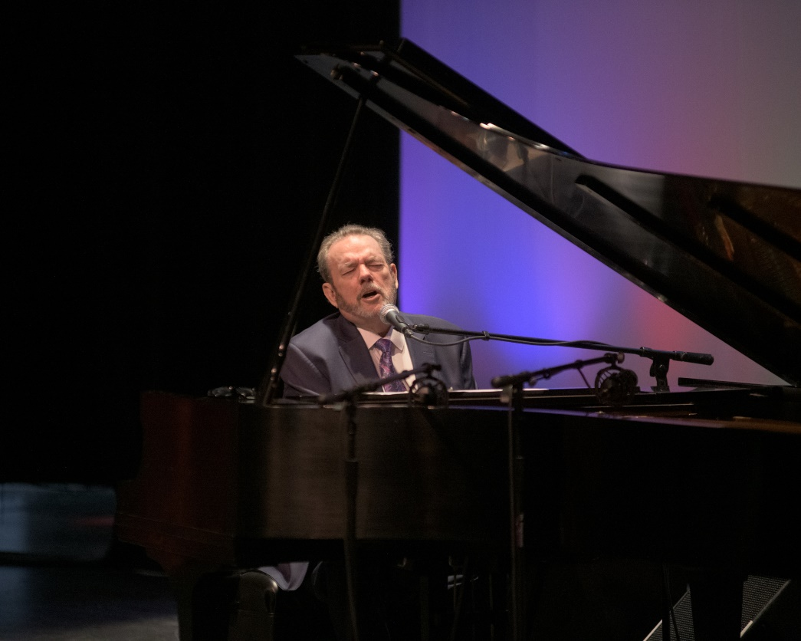
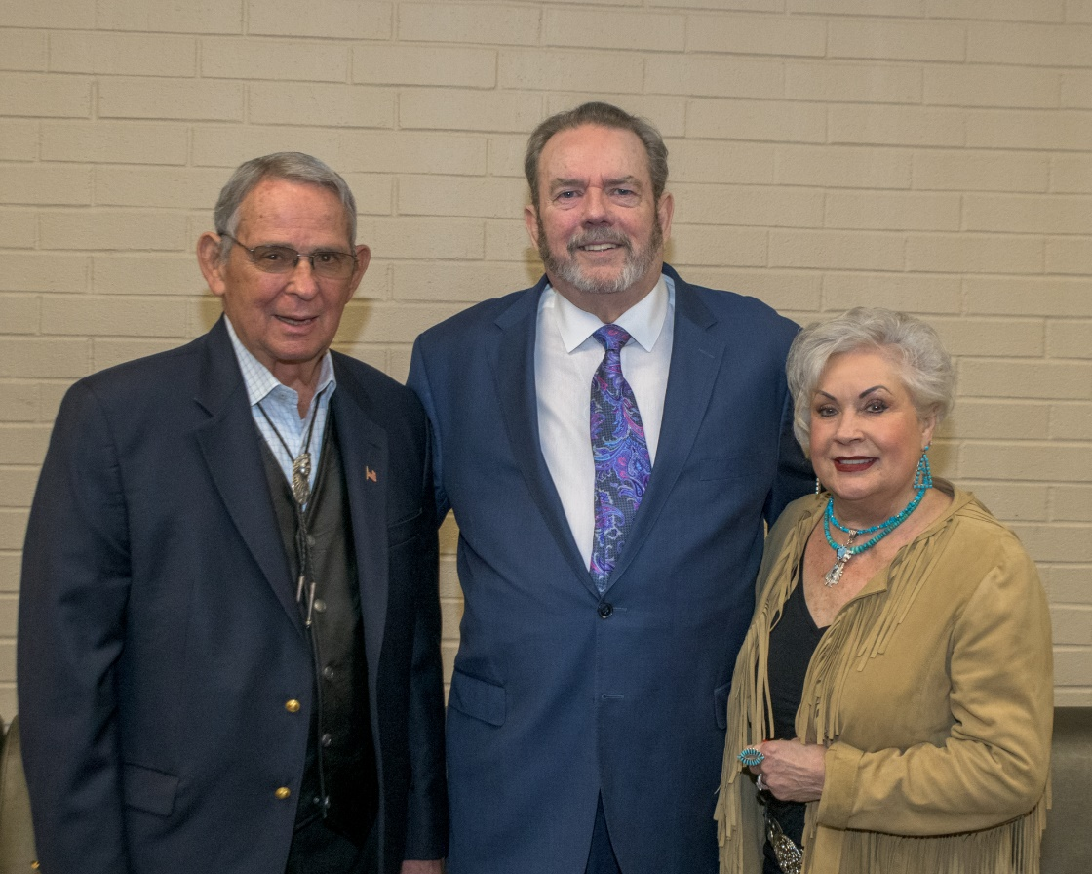
NOC Renfro Spring Lectureship featuring an Evening with Jimmy Webb

Slide 72
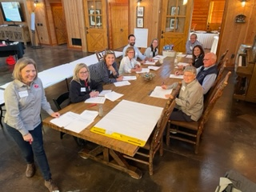
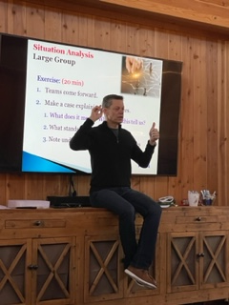
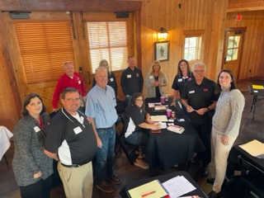
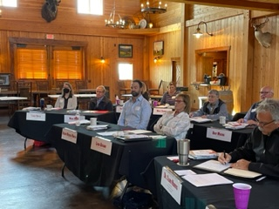

NOCF Strategic Planning Retreat

Slide 73



NOCF Strategic Planning Retreat

Slide 74


Scholarship Presentations
Cameron Malray awarded the Jared Weiberg Endowed Scholarship
David Owusu awarded the Donald R. Hays Basketball Scholarship

Slide 75


Scholarship Presentations
Lexie Boyer award the Leo Canaday Memorial Scholarship
Jamie Rowland awarded the Nevona Kegans Scholarship

Slide 76


Alumni Legacy Scholarship Presentations
2022 Presented to Jordan Nelson
2021 Presented to Caid Glowacki

Slide 77

2020 Distinguished Hall of Fame Inductees
Mr. John Kissinger – Class of 2002
Ms. Risha Grant – Class of 1991
Ms. Marta Sullivan – Class of 1996

Slide 78

2021 Distinguished Hall of Fame Inductees
Dr. Justin Funk – Class of 2005
Ms. Evelyn Coyle – Class of 1951

Slide 79

2022 Distinguished Hall of Fame Inductees
Dr. Tara Tucker-Vaughn – Class of 1989
Mr. Joe Kreger – Class of 1959

Slide 80

Miss NOC Alumni Reunion

Slide 81

Maverick Cheer Alumni Reunion

Slide 82




Legacy
Babies

Slide 83





NOC Foundation in the Communities

Slide 84
Thank You For Your Continued Support!

