Slide 1
Donor Recognition Dinner
Northern Oklahoma College Foundation, Inc.
March 7, 2019
(2018 YEAR END REVIEW)

Slide 2

NOC Mission Statement
Northern Oklahoma College, the State’s oldest community college, is a multi-campus, land-grant institution that provides high quality, accessible, and affordable educational opportunities and services which create life-changing experiences and develop students as effective learners and leaders within their communities in a connected, ever-changing world.

Slide 3
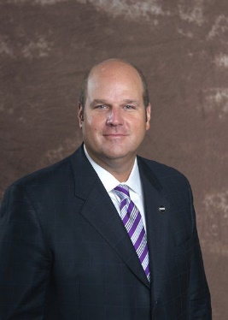
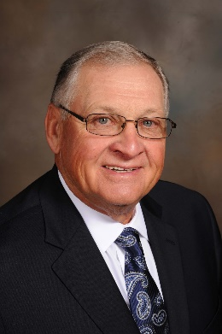
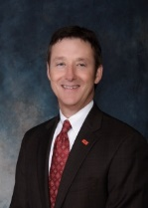
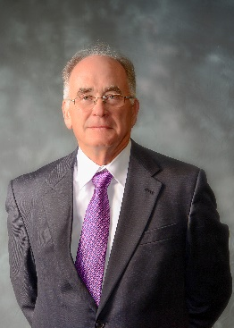
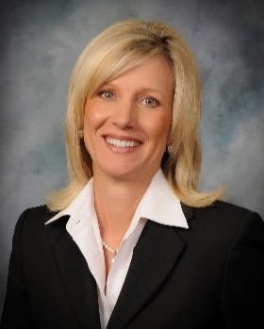
Northern Oklahoma College Board of Regents
2018-2019
Chad Dillingham, Chair
Dale DeWitt, Vice Chair
Jeff Cowan, Secretary
Stan Brownlee, Member
Jodi Cline, Member
Thank you for your leadership and support!

Slide 4
Purpose of the Foundation
The purpose of the Northern Oklahoma College Foundation shall be to enhance the educational opportunities and the environment of Northern Oklahoma College. The Foundation is organized exclusively for the benefit of the educational, literary and scientific activities of the college, chartered under the constitution and laws of the State of Oklahoma.

Slide 5
Mission of the Foundation
The Northern Oklahoma College Foundation seeks private support by establishing lifelong relationships with its donors, alumni and friends, while supporting the mission of Northern Oklahoma College and providing financial assistance and quality educational experiences to our students, programs and employees.

Slide 6
2010-2018 Strategic Goals of the Foundation
Evaluate the organization’s capacity and develop a structure which allows the Foundation to achieve goals.
Increase total assets to $12 million by 2018.
Enhance the “Greater Gifts” campaign.
Develop a plan for a capital campaign.
Develop a plan for an endowment/planned giving campaign.

Slide 7
Case Statement of the Foundation
“Stepping into the Future…2018”
Northern Oklahoma College Foundation, Inc. seeks to raise funds from private sources bringing total net assets to $12 million by 2018.
These funds will provide life changing experiences and opportunities to:
Ensure Northern continues to attract and recruit the best students and employees
Ensure excellent academic programs
Enhance student success and completion
Build and enrich the campus and community

Slide 8

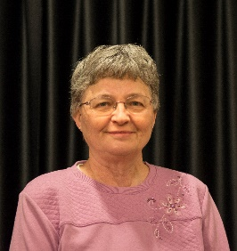
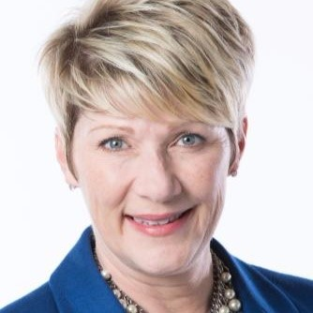

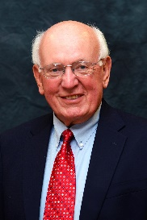
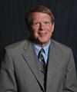
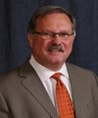
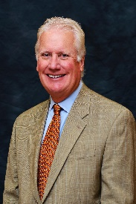
Northern Oklahoma College Foundation, Inc.
Board of Trustees (Community Leaders) 2018-2019
Mark Detten LynnDe Funk Kristi DesJarlais Tom Poole
Executive Committee
Chairman: Mr. David Cummings
Vice Chairman: Mrs. LynnDe Funk
Past Chairman: Mr. Mark Detten
Chief Executive Officer: Dr. Cheryl Evans
Executive Director: Mrs. Sheri Snyder
Treasurer: Mrs. Anita Simpson
Development Officer: Mrs. Kirby Tickel-Hill
Secretary: Mrs. Candy Oller
Bert Mackie Jim Rodgers Mike Loftis David Cummings

Slide 9

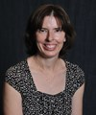

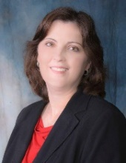

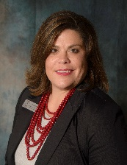

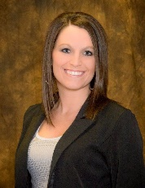


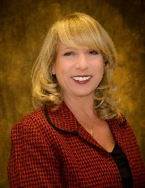
Northern Oklahoma College Foundation, Inc.
Board of Trustees 2018-2019
Group 1 Trustee (NOC Regents)
Regent Jeff Cowan (Term ends 6.30.2019)
Regent Chad Dillingham (Term ends 6.30.2019)
Group 3 Trustee (Community Leaders)
Mrs. LynnDe Funk (Term ends 6.30.2019)
Mr. Tom Poole (Term ends 6.30.2019)
Mr. David Cummings (Term ends 6.30.2020)
Mr. Mike Loftis (Term ends 6.30.2020)
Mr. Bert Mackie (Term ends 6.30.2020)
Mr. Jim Rodgers (Term ends 6.30.2020)
Mr. Mark Detten (Term ends 6.30.2021)
Mrs. Kristi DesJarlais (Term ends 6.30.2021)
Group 2 Trustee (NOC Leadership)
Dr. Cheryl Evans, NOC President
Mrs. Sheri Snyder, Executive Director
Mrs. Anita Simpson, Treasurer
Mrs. Kirby Tickel-Hill, Development & Donor Relations
Mrs. Jill Green, Director of Alumni & Community Relations
Dr. Pam Stinson, Ex-Officio
Dr. Edwin Vineyard, Ex-Officio
Stillwater Vice President, Ex-Officio
Dr. Rick Edgington, Ex-Officio
Mr. Jason Johnson, Ex-Officio
Group 4 Trustee (NOC Staff)
Mrs. Candy Oller, Gift Processing Coordinator
Mrs. Tammy Boyea, Admin. Asst. to Treasurer
Mrs. Kerri Gray, Institutional Scholarship Coordinator

Slide 10
Northern Oklahoma College Foundation, Inc.
Total Net Assets – Approximately $11 Million
Academic Year | Scholarship Award | Number of Recipients | Loan Award | Number of Recipients
2017-2018 | $261,764 | 333 | $570 | 3
2016-2017 | $249,528 | 312 | $26,578 | 107
2015-2016 | $210,156 | 214 | $25,492 | 95
2014-2015 | $209,576 | 248 | $20,815 | 62
2013-2014 | $143,574 | 189 | $ 3,225 | 14
2012-2013 | $ 96,670 | 135 | $10,359 | 53
2011-2012 | $ 99,800 | 201 | $ 6,569 | 35
2010-2011 | $ 79,989 | 90 | $17,326 | 92
2009-2010 | $ 78,966 | 114 | $ 1,134 | 7
2008-2009 | $ 79,220 | 118 | $ 3,802 | 21
2007-2008 | $ 88,960 | 126 | $ 3,757 | 27
2006-2007 | $ 79,220 | 118 | $ 4,333 | 24
2005-2006 | $ 63,848 | 117 | $ 6,848 | 40
2004-2005 | $ 59,333 | 121 | $17,975 | 103
2003-2004 | $ 44,787 | 116 | $15,545 | 85
2002-2003 | $ 56,008 | 138 | $14,778 | 86
2001-2002 | $ 64,645 | 161 | $ 9,354 | 55
2000-2001 | $ 33,030 | 74 | $ 8,545 | 52
1999-2000 | $ 24,641 | 76 | $11,763 | 79
1998-1999 | $ 25,806 | 71 | $ 7,457 | 48
1997-1998 | $ 21,850 | 54 | $ 5,645 | 43

Slide 11
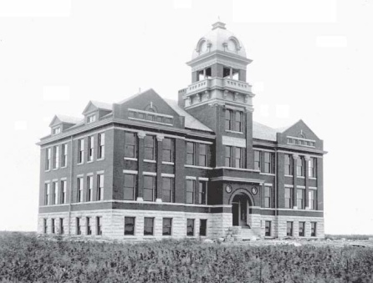
Central Hall Society
The Northern Oklahoma College Foundation has established the Central Hall Society in order to recognize those alumni and friends who have remembered Northern Oklahoma College in their estate planning. The Central Hall Society recognizes and honors the legacy of these donors.
Membership in the Central Hall Society is open to those who:
make planned gifts in the form of charitable remainder trusts (including pooled income funds and unitrusts), lead trusts, gift annuities, or deferred gift annuities; or
make gifts of life insurance or have named the college as the beneficiary of their policy; or
have confirmed non-contingent bequest provisions; or
have named the college as a non-contingent beneficiary of their IRA or other retirement plan.
Consider Remembering NOC in Your Planned Giving.

Slide 12
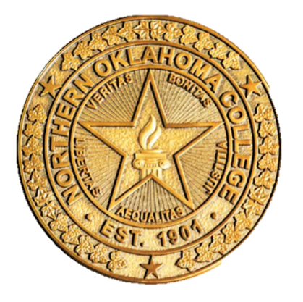
The Northern Oklahoma Presidential Partners Program is an annual giving program through the NOC Foundation supporting the college and enriching the experience of NOC students who desire to support the institution’s tradition of excellence.
2017-2018 Programs/Activities Supported
2018 Davinci Honors Banquet Registration
Cultural Engagement Center
Maverick Baseball/Softball Batting Complex
#LIFECHANGING Campaign
Maverick Athletic Training Equipment
NOC Employee Professional Development
NOC Diversity Activities
Guest Artist Art Exhibits and Receptions
PLC Activities
Maverick Cheer
KAYE Radio
Wellness Center Equipment
NOC Employee Wellness Challenge
Guest Speakers: Dr. Greg Graham and Rob Collins
After a successful completion of our annual Presidential Partners Program drive campaign, we are pleased to report that we received $32,167 in total contributions for the 2017-2018 academic year. These donations supported Northern Oklahoma College’s mission while supporting projects and expenses for students, faculty and staff.

Slide 13
Presidential Partners Program
2017-2018 Campaign - Donors
VISIONARY PARTNER ($5,000 – Above): Diemer Family Foundation; Dr. Cheryl & Tom Evans; Charles Zody
LEADER PARTNER ($2,500 - $4,999): Dr. Rick Edgington
SCHOLAR PARTNER ($1,000 - $2,499): Bank SNB; John & Linda Brown; John & Sharon Campbell; Joe & Jane Cornelson; Jeff & Felicia Cowan;
Peter & Annie Dillingham; Evans Family Foundation; John & Virginia Groendyke; Mike & Kim Loftis; Bert & Janice Mackie; Bill & Susie Phelps; Renfro Family Foundation; Patrick Rooney; Drs. Donald & Pamela Stinson
BENEFACTOR PARTNER ($500 - $999): Bill & Barbara Bridwell; Tom & Lynda Dolezal; GH2 Architects; Ike & Marybeth Glass; Howard Johnson; Ford & Maxine Lasher; Tom & Judy Poole
PATRON PARTNER ($250 - $499): Bivin & Associates, Inc.; Jack Bowker Ford Lincoln;
Dennis & Valorie Buss; Jodi Cline; Tim & Ginny Coffman; Dan & Kay Dillingham; Don and Brenda Dobbs; Jason & Cara Beth Johnson; Coby & Sheri Snyder; Vernon & Norma Young
Thank you to the following partners for their support!

Slide 14
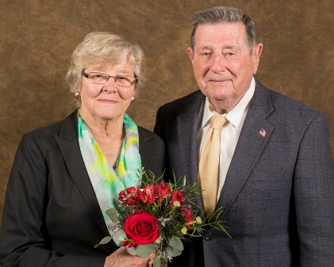
NEW SCHOLARSHIPS
Marlin “Ike” and Marybeth Glass Scholarship – Through the generous support of Ike and Marybeth Glass, the establishment of this permanently restricted endowed scholarship fund will provide students an opportunity to pursue their educational goals at Northern Oklahoma College on the Tonkawa, Enid or Stillwater campuses.
Livestock Judging Fund– Through the generous support of donors, the establishment of this permanently restricted endowment fund will benefit the livestock judging team at Northern Oklahoma College as well as enhance the Agriculture program on the Tonkawa Campus.
Class of 1961 Scholarship – Through the generous support of members of Northern’s Class of 1961, the establishment of this temporarily restricted fund will provide students and opportunity to pursue their higher educational goals on the Northern Oklahoma College Tonkawa campus.
.

Slide 15
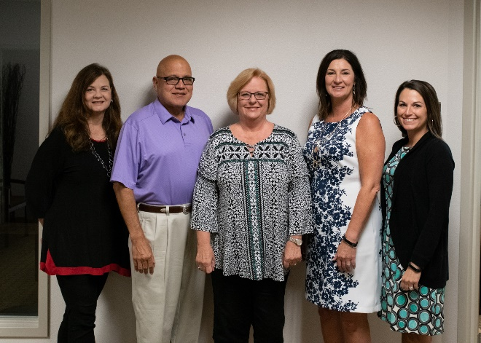
AMENDED SCHOLARSHIPS
Jordan Marquardt Memorial Scholarship – Through the generous support of friends and family, this scholarship fund will benefit female students from Blackwell attending Northern Oklahoma College Tonkawa.
John L. and Linda J. Brown Scholarship – Scholarship Fund has officially changed to reflect the following: Preference will be given to a graduate of Medford High School or Ponca City High School who plans on attending college at NOC Tonkawa, Enid or Stillwater.

Slide 16
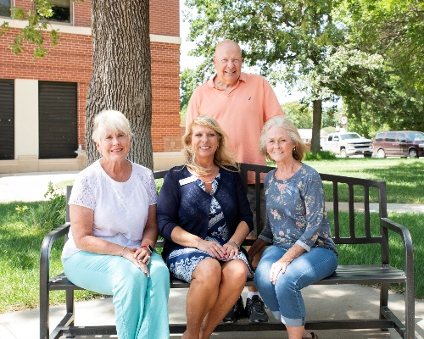
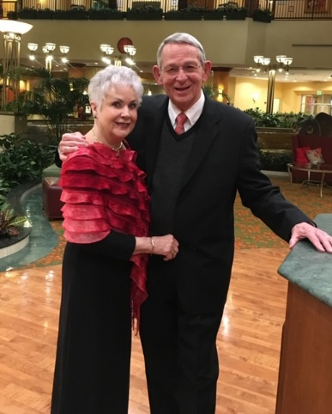
AMENDED SCHOLARSHIPS
North Central Oklahoma Arts Council Scholarship – Formally the Tonkawa Area Arts and Humanities Council Scholarship, this fund changed its name in June 2018. If a student receives the scholarship as a freshman, the scholarship may be continued for the recipients sophomore year at NOC Tonkawa.
Carl and Brenda Renfro Scholarship Formally the Carl Renfro Scholarship, this fund’s name changed to the Carl and Brenda Renfro Scholarship in December 2018.

Slide 17
PENDING SCHOLARSHIPS
Margaret Steichen Memorial Music
Larry Rupp Memorial Nursing
Robert N. Colombe and Robert B. Colombe Memorial
NOC Sheep Center

Slide 18
NOC Foundation Grants
Masonic Fraternity of Oklahoma Endowment Grant
The Foundation has awarded over $6900 for the 2018-2019 academic year to the following programs:
Honors Composition II/ Lincoln Academy and Lake Park Elementary, “This I Believe.”
Music Theatre, New York City Fall Break Trip
Nursing Division, Missouri Hope Disaster Training
Digital Media Institute, Epic Shorts Student Film Festival
Criminal Justice, American Criminal Justice Association Conference
Art, Crystal Bridges Museum of Art
Business Division, Stillwater Business Club Scholarships

Slide 19
NOC Foundation Grants
Presidential Partners Grant
The Foundation has awarded over $23,000 to the following programs for 2018-2019:
NOC Professional Development
President’s Leadership Council Activities
NASNTI, Joe Don Brave Artist Reception
NASNTI, Advisory Meeting
Maverick Cheer, Nationals Choreography
NOC Diversity, Hispanic Month Guest Speaker
Language Arts, Chautauqua Teachers Institute
Criminal Justice, Bonnie & Clyde Program Expense
President’s Leadership Council, Promotional Item
Ag, Science & Engineering, National Council on Undergraduate Research Conference
NOC/OSU Gateway, Alumni Spotlights
DMI, Student Showcase
Journal Record Woman of the Year Banquet
Enid Young Professional Event
NOC Employee, NOC Shirts
NOC Employee Christmas Luncheons
NOC Employee Wellness Program

Slide 20
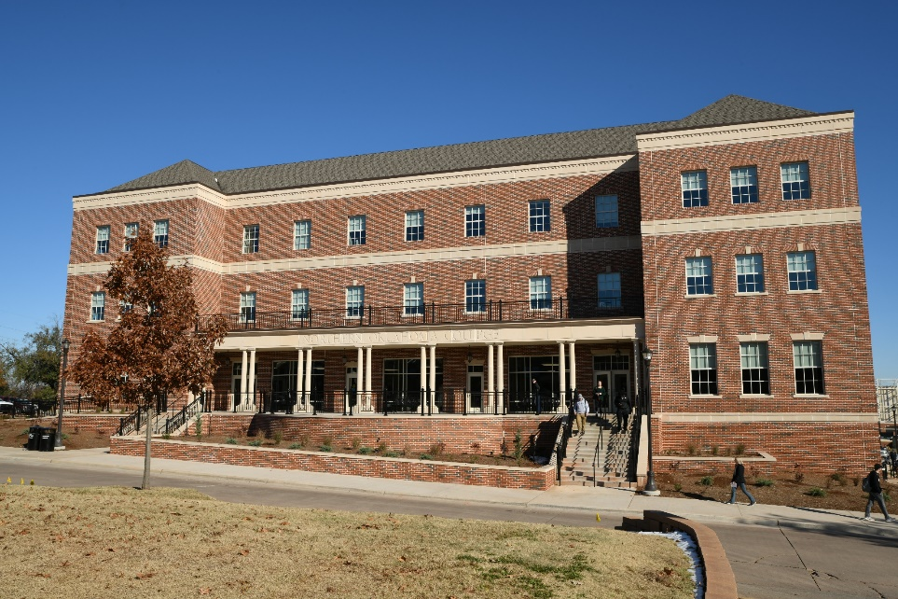
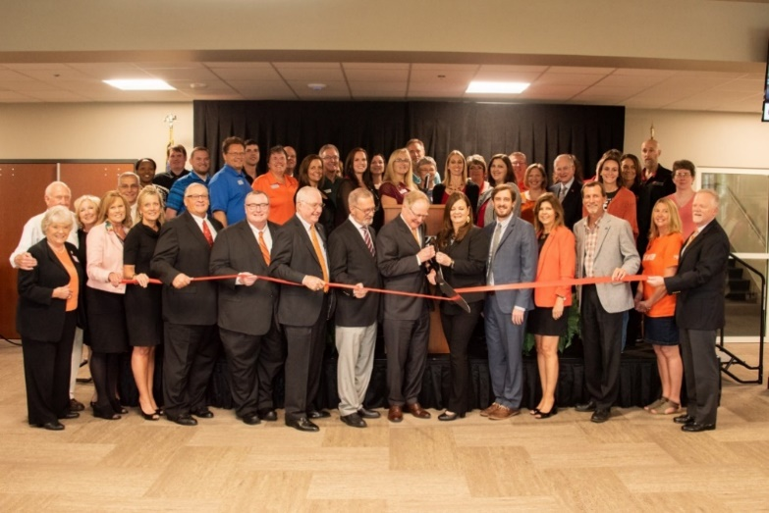
NOC STILLWATER CLASSROOM BUILDING GRAND OPENING
Northern held a grand opening and ribbon cutting in Stillwater on September 7 to celebrate the Northern Oklahoma College Stillwater Classroom Building.

Slide 21
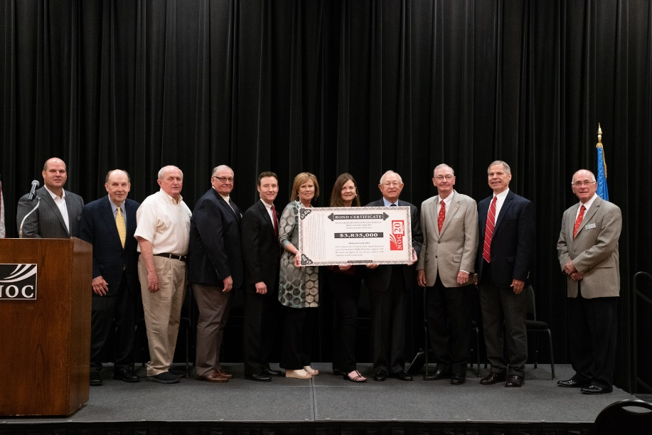
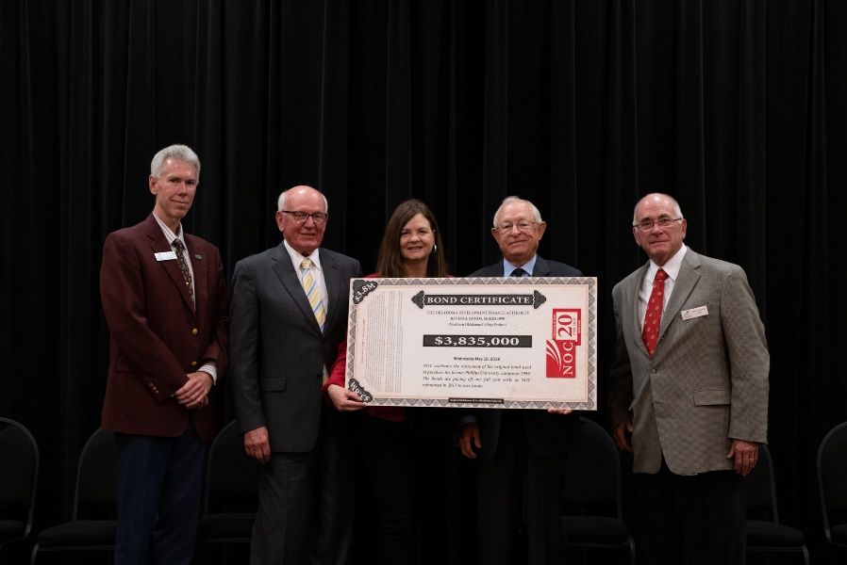
NOC Enid Capital Bond
Payoff Celebration
NOC Celebrated the bond payoff as we retired the original bond to purchase the NOC Enid Campus on May 16, 2018. This event kicked off a year-long celebration of 20 years for NOC Enid.

Slide 22
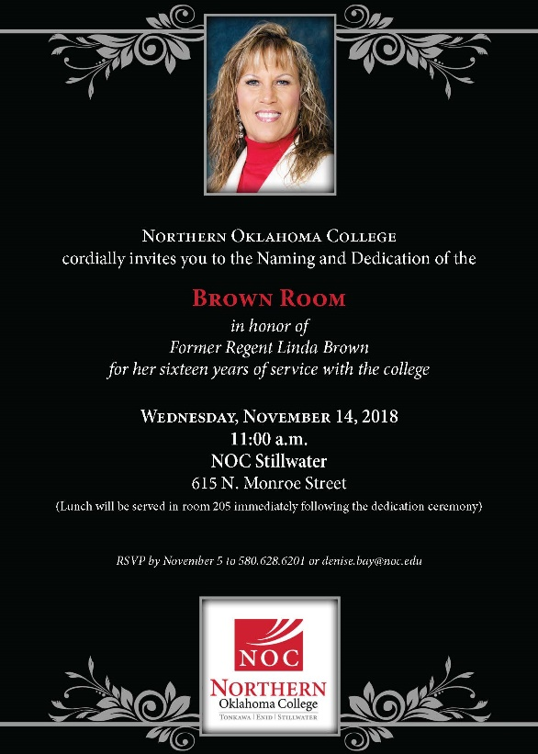
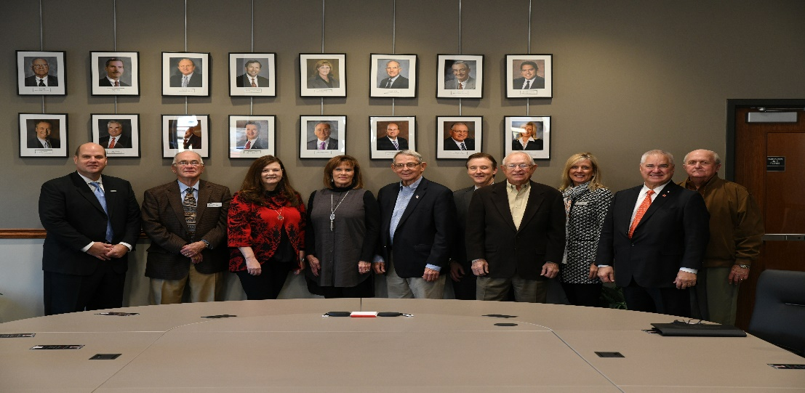
Brown Room Dedication
In honor of NOC Regent Linda Brown, NOC held a naming and dedication ceremony for the Brown Room on November 14 at the NOC Stillwater Classroom Building. Regent Brown served on the Northern Board of Regents for 16 years.

Slide 23
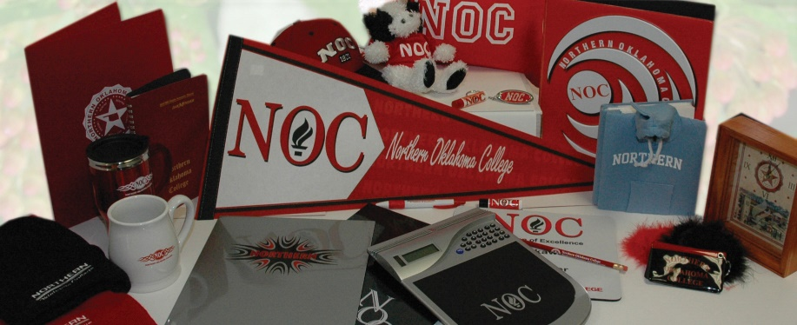
NOC Alumni & Friends Association
Developed in January 2006, the NOC Alumni and Friends Association is a great way for members to stay connected with NOC and former classmates. Membership is open to all graduates of Northern, former students, and friends of NOC.
As a member of the Association you have the right to the following benefits:
Official Membership Card
NOC Alumni Automobile Decal
Dependents are eligible for a Non-Residential Legacy Scholarship
Free Admittance to Alumni Events
$5 Fall, Spring & Summer Discounts at the Wellness Center (Tonkawa)
10% Discount on NOC Logo Merchandise at the Bookstores
Special Notice/Invitation Alumni & Campus Events

Slide 24
Enid Higher Education Council, Inc.
2018 – 2021 Campaign Drive
Through the generous support of the Enid Higher Education Council, Inc. along with businesses and individuals in the Enid area, the establishment of the Enid Higher Education Scholarship provides students an opportunity to pursue their higher education goals in Enid. The purpose of the scholarship is to assist students with financial support as they begin their college careers at NOC Enid and continue their seamless education with Northwestern Enid.
Thank you to the following donors who have made this scholarship possible:
Anonymous NBC Oklahoma Brent and Marcy Price
AT&T Central National Bank Farm Credit of Enid
David and Sharon Trojan Culligan of Enid Bob and Cathie Berry
Atwood Distributing, L.P. Rick and Kim Caruthers Steve and Lisa Glasser
BancCentral Dense Mechanical, Bob Dense Dr. Wayne McMillen
Rick and Janet Cunningham Dillingham Foundation Henson Construction Company
Greater Enid Chamber of Commerce Enid Public Schools OGE Energy Corp. Foundation, Inc.
Tom and Cheryl Evans Humphrey/Guarantee Abstract Scheffe Prescription Shop
Groendyke Transport, Inc. INTEGRIS Bass Baptist Health Center Dr. Steven Mackie
Bank of Oklahoma GBV Enterprise, Inc. Stan and Darlene Tatum
Security National Bank Harold Hamm Foundation St. Mary’s Regional Medical Center
Dr. Jerry Blankenship Dr. and Mrs. Barry Pollard Kyle Williams
BKD, LLP Ed and Susan Vineyard Michael and Kelley Wright
John B. Stambaugh P.C . Kevin and Mindy Shimanek

Slide 25
Enid Entrepreneur Leadership Series
2015-2018 Campaign Drive
Through the generous support of the Enid Higher Education Council, Inc. along with businesses and individuals in the Enid area, the establishment of the Entrepreneur Leadership Series provides students the inspiration and tools to be the next general of Enid business owners. Sponsorships provide guest speakers, workshops and training opportunities to students in the Enid area.
Thank you to the following donors who have made this series possible:
Paul and Joan Allen Edward Jones, Michael P. Wright OG&E Energy Corp.
Associated Therapeutic Services, PC Emrick’s Van and Storage P&K Equipment
Atwood Distributing, L.P. Encompass Financial Services Pope Distributing Co., Inc.
Central Machine & Tool Co. Enid Regional Development Alliance David S. Russell, M.D.
Central National Bank Envirotech Security National Bank
Cummins Construction Groendyke Transport, Inc. St. Mary’s Regional Medical Center
Dense Mechanical, Bob Dense Johnston Enterprises/Johnston Seed Co. Traynor, Long & Wayne, P.C.
Dan and Kay Dillingham KOCH Nitrogen Co. Ward Petroleum/Ward Foundation
Dillingham Foundation NBC Oklahoma Whiterock Resources, LLC
C.E. Dinsmore Northcutt Chevrolet Toyota Buick Woodlief Family Giving

Slide 26
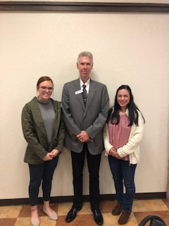
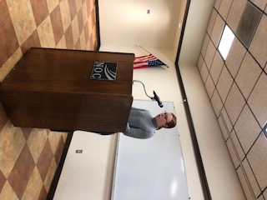

Enid Higher Education Council Donor Event
Approximately 40 board members, donors, students, and guests attended the quarterly meeting as well as a donor appreciation event of the NOC/NWOSU Joint Advisory Board on November 27 on the NOC Enid campus. NOC Enid scholarship recipient MacKinzie Simmons did an outstanding job representing NOC as she thanked the donors.

Slide 27

OSRHE Endowed Chair Program
2016 STATUS REPORT ON THE PROGRAM
Approved NOC Accounts with the Oklahoma State Regents
1 Chair (Approved) 2 Chairs (Pending) 0 Professorships 5 Lectureships Total = 8
PROPOSED ENDOWED CHAIR SUBMITTED FOR APPROVAL JUNE 2012:
Leora E. Calkins Agriculture and Life Sciences Chair – If approved, the endowed chair would provide support for the Agriculture and Life Sciences Division to begin recruiting efforts to appoint a faculty member as holder of the chair on the Tonkawa Campus of Northern Oklahoma College.
$250,000 private donation provided by the Estate of Leora E. Calkins
$250,000 requested public matching monies
$500,000 Endowed Chair

Slide 28
OSRHE Endowed Chair Program
Ima Faythe Berglund Mathematics Chair* – If approved, the endowed chair would provide support for the Science and Mathematics Division to begin recruiting efforts to appoint a faculty member as holder of the chair on the Tonkawa Campus of Northern Oklahoma College.
$250,000 private donation provided by the Estate of Ima Faythe Berglund
$250,000 requested public matching monies
$500,000 Endowed Chair
*APPROVED – SEPTEMBER 2012 (Matching Funds Began 2013)
Ima Faythe Berglund Science Chair – If approved, the endowed chair would provide support for the Science and Mathematics Division, along with the Agricultural and Life Science Division, to begin recruiting efforts to appoint a faculty member as holder of the chair on the Tonkawa Campus of Northern Oklahoma College.
$250,000 private donation provided by the Estate of Ima Faythe Berglund
$250,000 requested public matching monies
$500,000 Endowed Chair

Slide 29
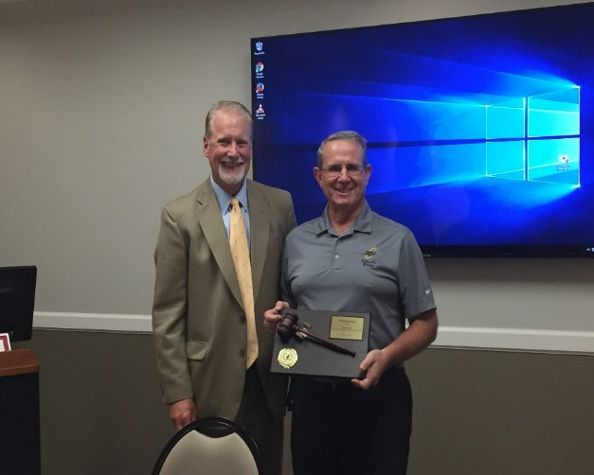
Proclamation and Presentation of Gavel
Chairman David Cummings presented to outgoing Chairman Mr. Mark Detten a plaque with gavel for his service to the NOC Foundation Board as the 2017-2018 Chair.

Slide 30
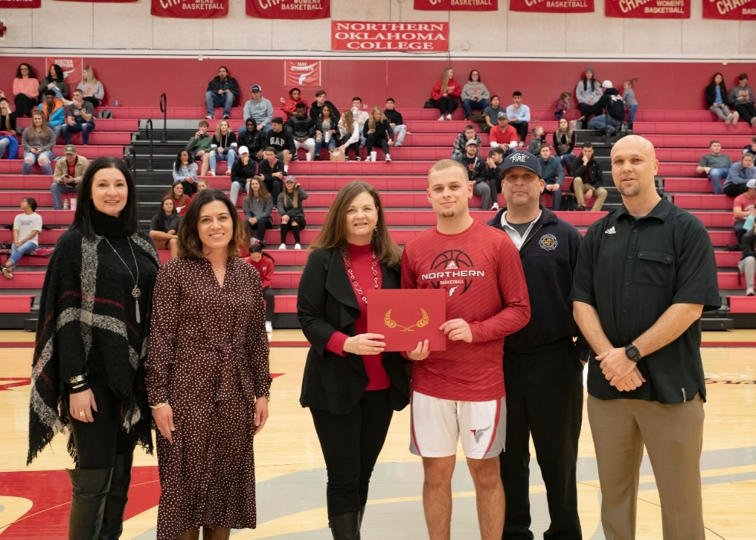
Scholarship Presentations
2018-2019 HAYS SCHOLARSHIP RECIPIENT
2018-2019 holder of the Donald R. Hays Basketball Scholarship is Andrew Gronigan. NOC President Cheryl Evans presented the certificate to Andrew. Joining them are NOCF Executive Director Sheri Snyder; Men’s Basketball Coach Donnie Jackson; and Andrew’s family.

Slide 31
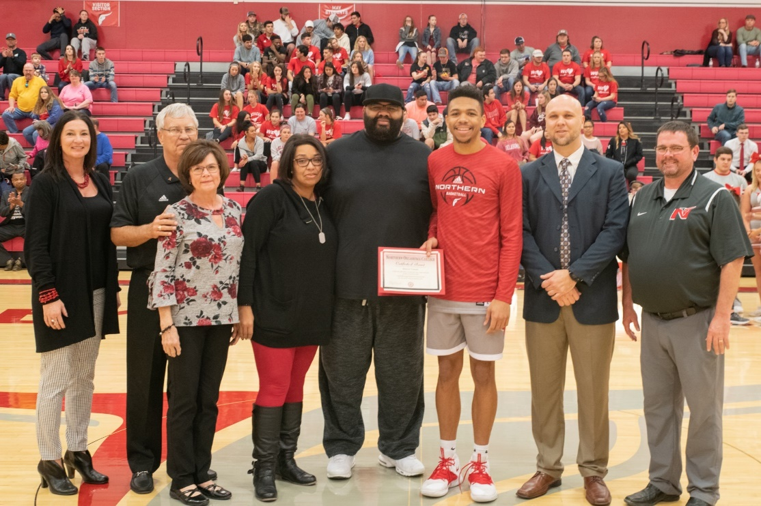
Scholarship Presentations
2018-2019 WEIBERG SCHOLARSHIP RECIPIENT
2018-2019 holder of the Jared Weiberg Scholarship is Barron Tanner. NOC Athletic Director Jeremy Hise presents the certificate to Barron. Joining are NOCF Executive Director Sheri Snyder; Mick and Vina Weiberg; Coach Donnie Jackson and Barron’s parents.

Slide 32
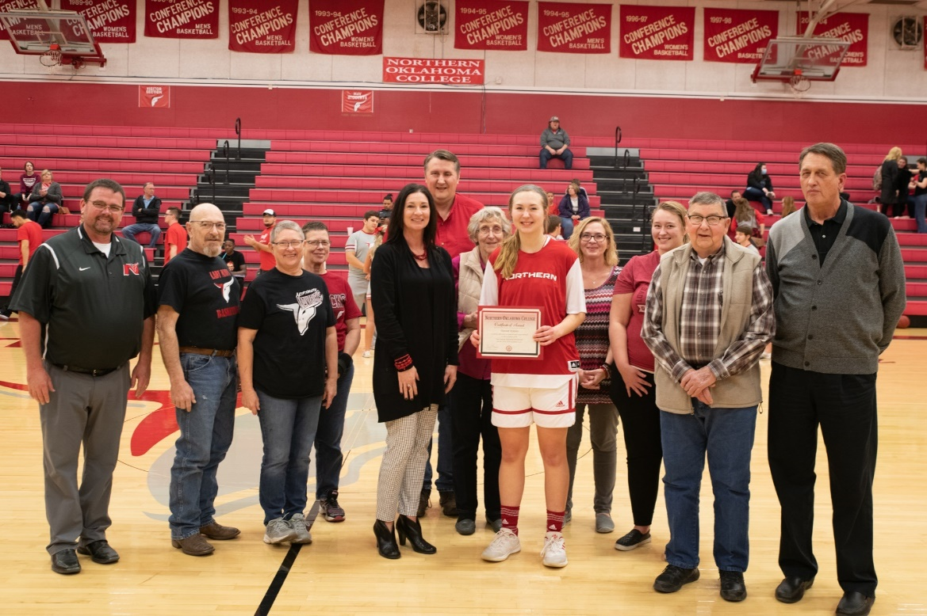
Scholarship Presentations
2018-2019 CANADAY SCHOLARSHIP RECIPIENT
2018-2019 holder of the Leo Canaday Scholarship is sophomore Hannah Maples. NOCF Executive Director Sheri Snyder presents the certificate to Hannah. Joining are NOC Athletic Director Jeremy Hise; Coach Greg Krause and Hannah’s family.

Slide 33
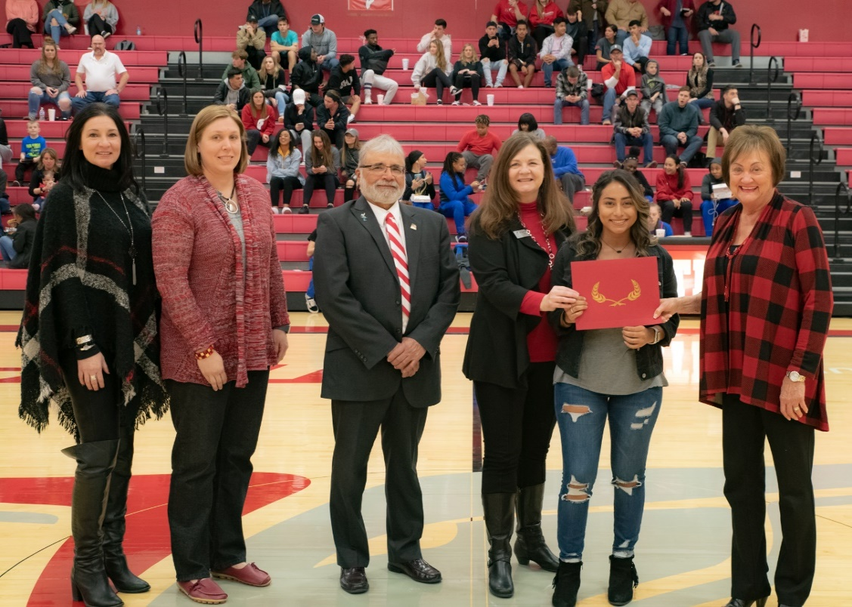
Scholarship Presentations
2018-2019 Nevona Kegans Scholarship Recipient
2018-2019 holder of the Nevona Kegans Scholarship is Mayra Vega. NOC President Cheryl Evans presents the certificate to Vega. Joining are NOCF Executive Director Sheri Snyder; Athletic Training Instructor Suzi Brown and Nevona Kegans Bossert.

Slide 34
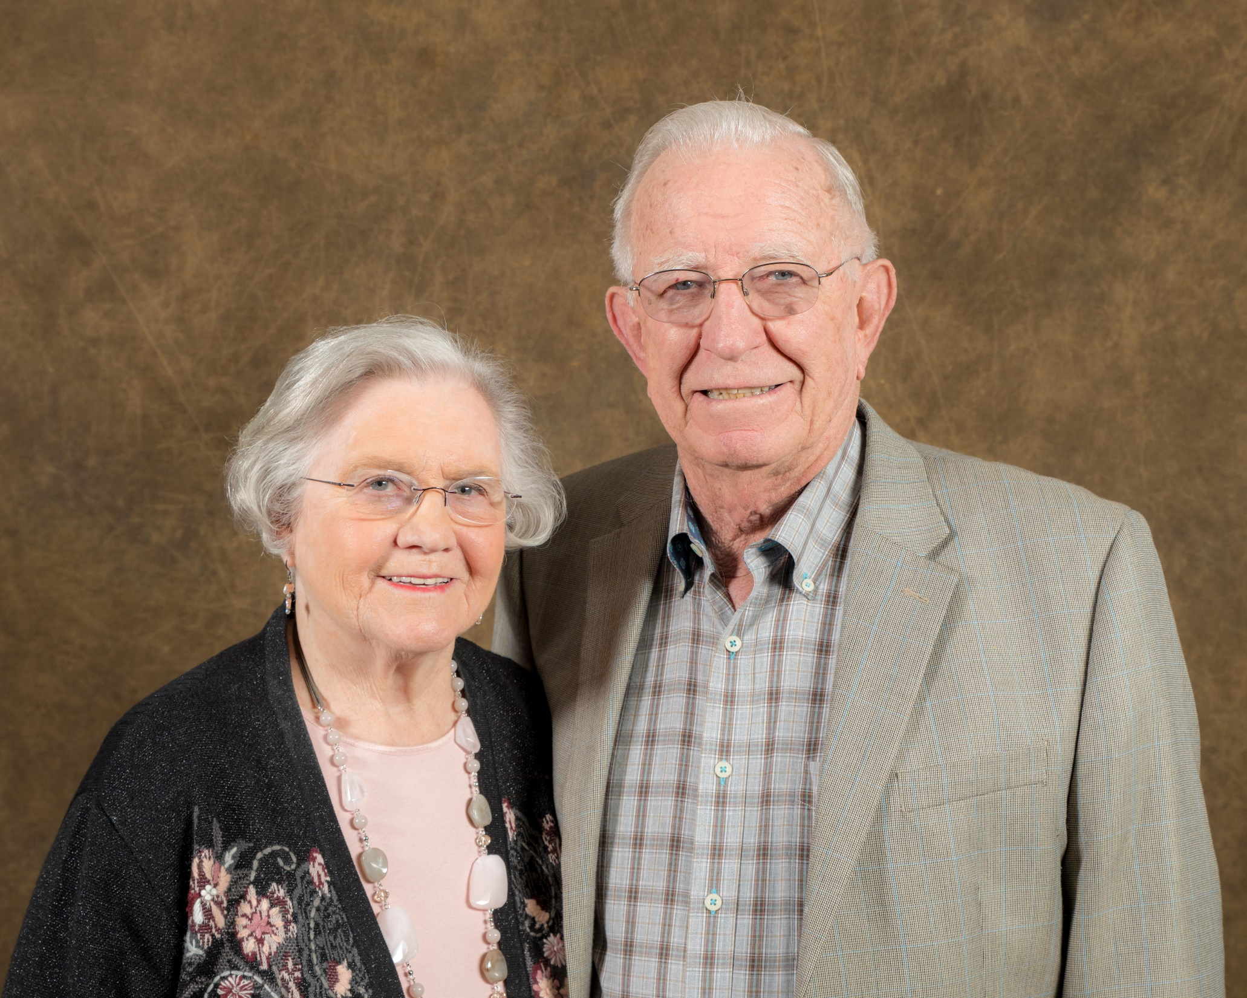
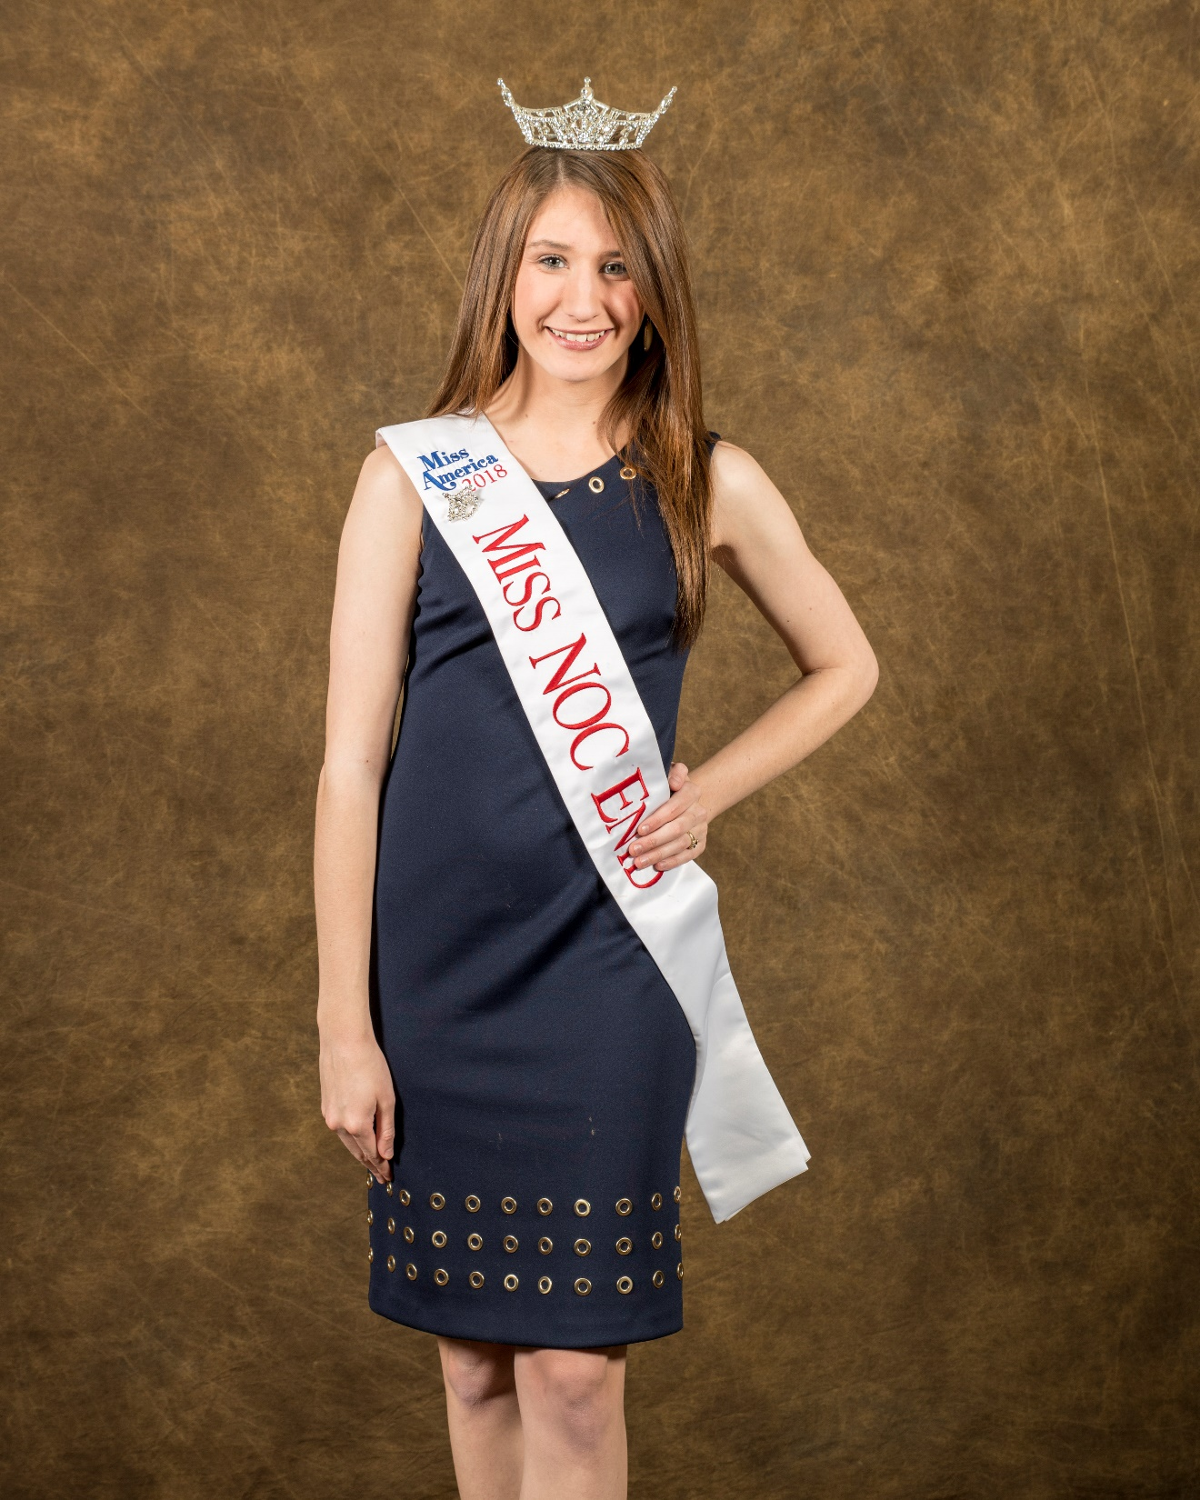
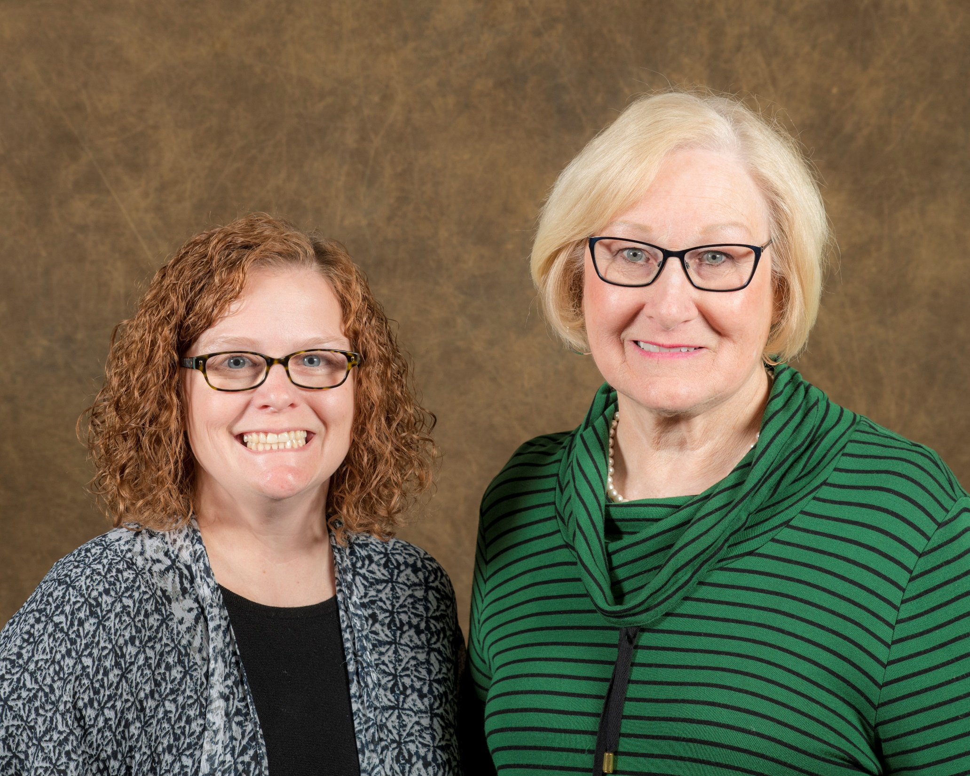
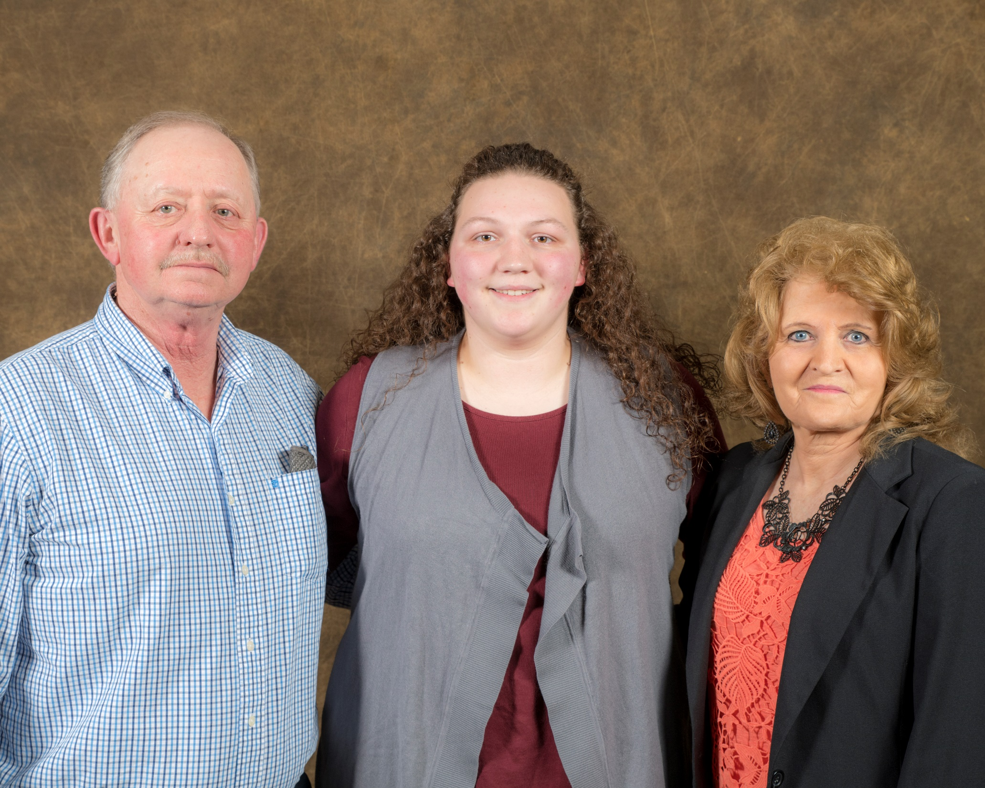
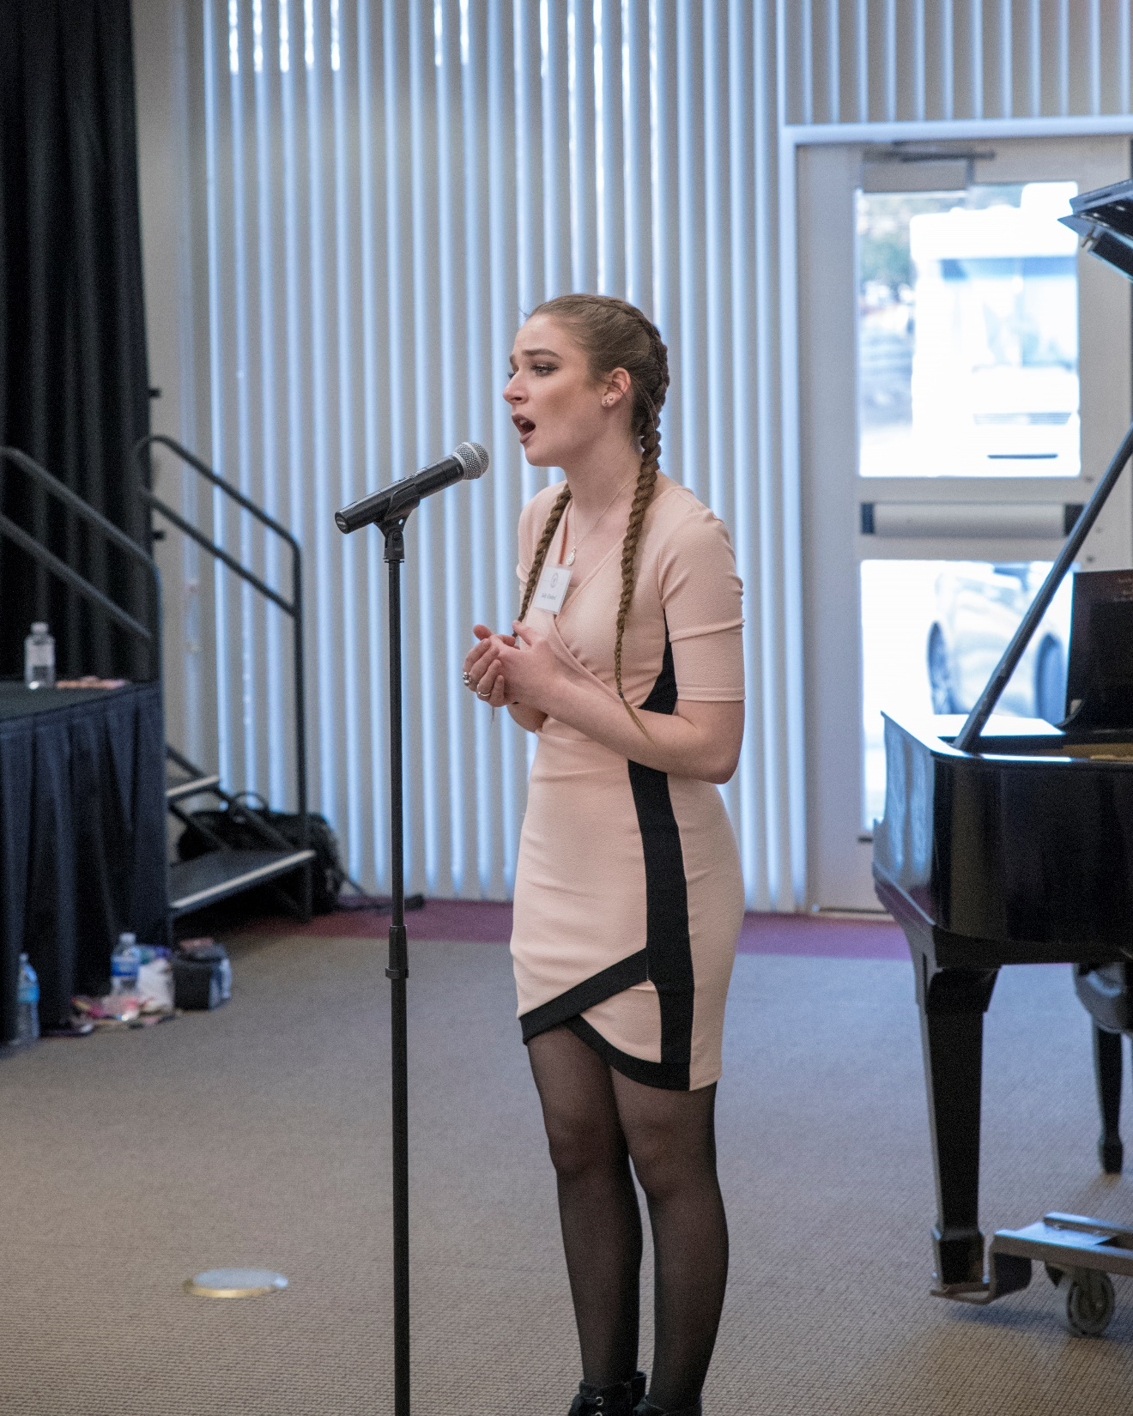
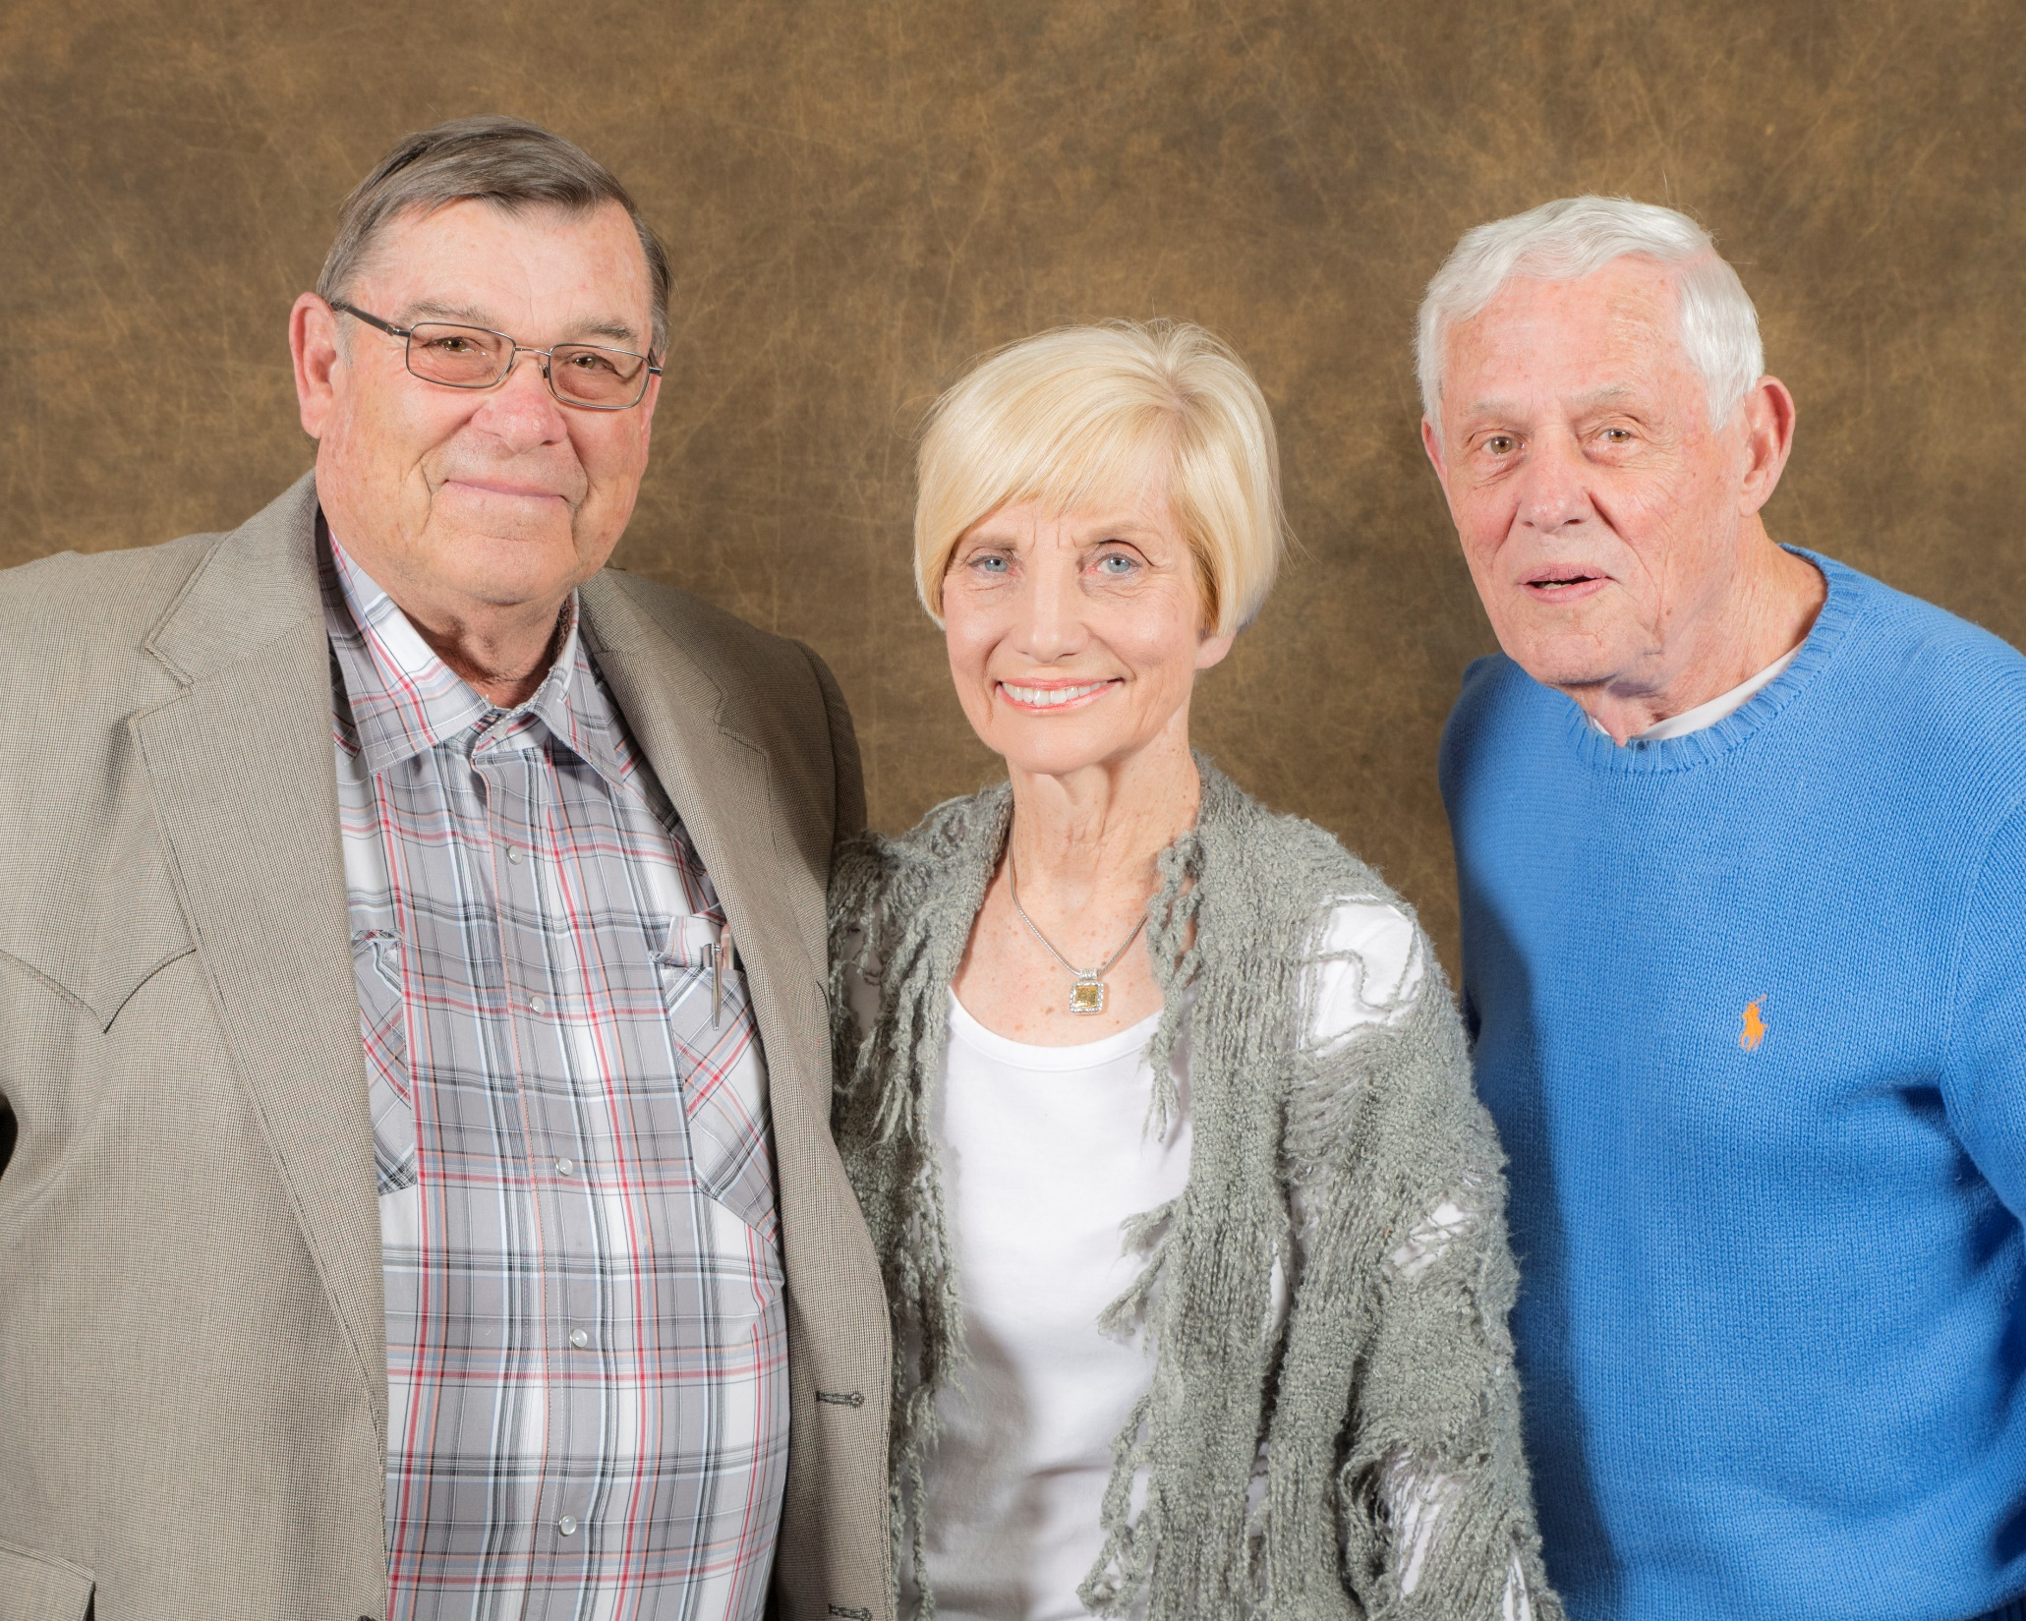
2018 Donor Recognition Dinner

Slide 35
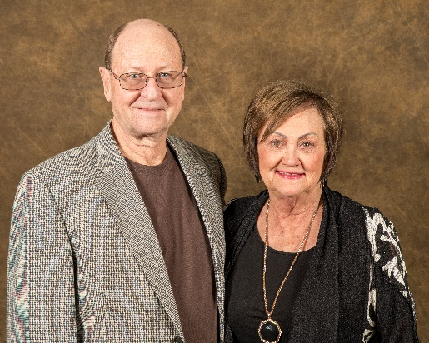
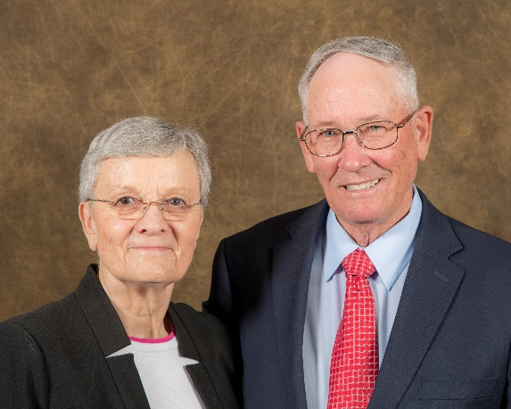
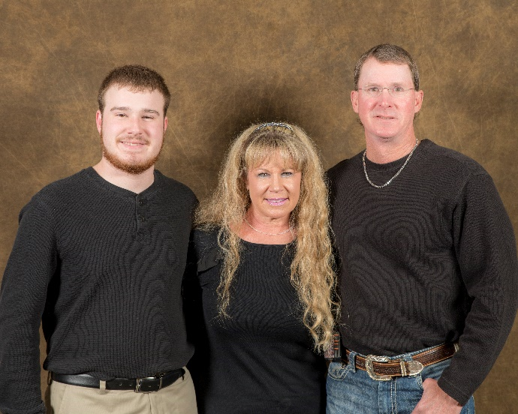
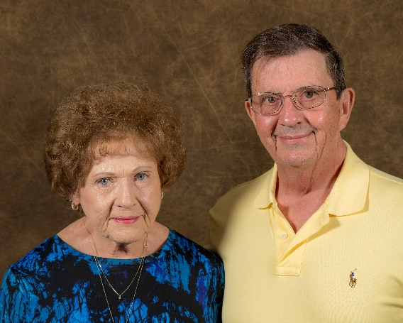
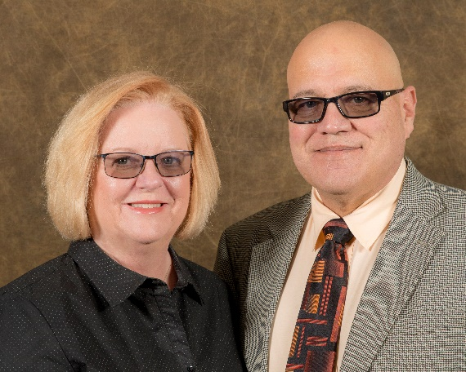
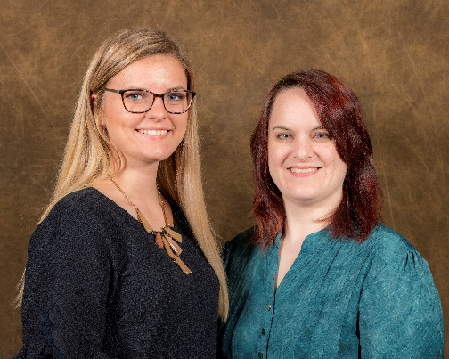
2018 Donor Recognition Dinner

Slide 36
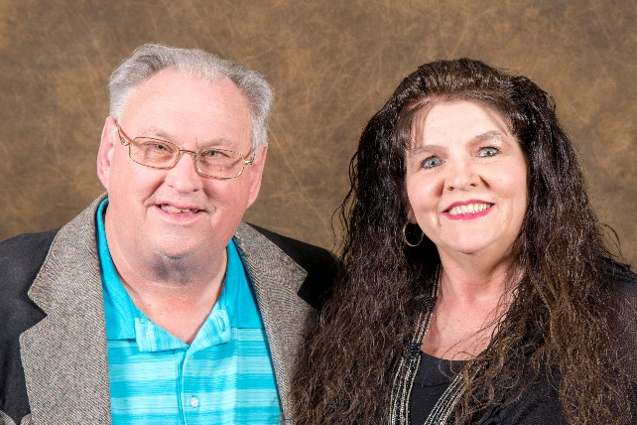
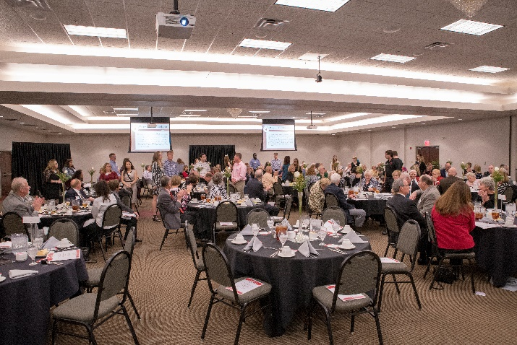



2018 Donor Recognition Dinner

Slide 37






2018 Donor Recognition Dinner

Slide 38


NOC Students Visit Oklahoma State Capitol
Higher Education Day at the Capitol
A contingency group of 17 from NOC attended Higher Education Day at the Capitol on Tuesday, February 13.
Oklahoma’s Promise Day at the Capitol
A contingency group of 7 from NOC attended Oklahoma’s Promise Day at the Capitol on April 16. The purpose is to show appreciation to the Legislature’s ongoing support of the Oklahoma’s Promise scholarship program.
NOC President’s Leadership Council at the Capitol
NOC Student and Employees with Chancellor Johnson

Slide 39


OSRHE Business Partnership Excellence Award
NOC had the honor to recognize Diemer Construction Company, LLC as the 2018 Business Partner during an awards luncheon at the University of Central Oklahoma. This award is designed to highlight successful partnerships and to further cultivate the higher learning environment through the State Regents’ Economic Development Grants.

Slide 40


Alumni and Foundation Events
NOC Alumni and Friends Ballpark Day –The NOC Foundation and Alumni hosted a ballpark day Saturday, April 15 at David Allen Memorial Ballpark. NOC Jets Basketball coach Aaron Butcher and 2015 NOC Tonkawa Softball Alum, Tori Wilde threw out the first pitches for the softball games. 2012 NOC Maverick Baseball Alum, Dylan Nave and Miss NOC Enid, Lexi Neahring threw out the pitches for the baseball game. The NOC Bookstore sold Northern merchandise and a dinner was served.

Slide 41

Alumni and Community Relations Events
OSU Tailgating Football Event
50 guest attended NOC’s OSU tailgating event on September 22 to cheer on the Cowboys as they took on Texas Tech.
NOJC Maverick Football Reunion
NOC Foundation attended the annual NOJC Maverick Football Reunion held at Bass Pro in Broken Arrow on October 26.

Slide 42


2018 Distinguished Alumni Hall of Fame Inductees
Two Northern alums were inducted into the Northern Oklahoma College Distinguished Alumni Hall of Fame at the Alumni and Friends Reunion held Saturday, March 31 in the Renfro Center. The 2018 inductees included: Mr. Bill McCloud, Class of 1973 and Mr. Chad Weiberg, Class of 1991.
Bill McCloud Chad Weiberg
Congratulations NOC 2018 Distinguished Alumni Inductees!

Slide 43


Community Event
Gala XXII Concert
Over 330 guests attended the annual Gala concert on April 28 in the Kinzer Performing Arts Center. Maestro Gerald Steichen conducted the Gala, featuring Mezzo-Soprano Jessica Medoff and NOC music faculty Dineo Heilmann, Shannon Bradford, Edward Dixon, Chad Anderson, Brandon Haynes and the Gala Orchestra.

Slide 44

Carl and Carolyn Renfro
Fall 2018 Endowed Lectureship Program
Over 500 participants were in attendance at our Carl and Carolyn Renfro Fall Lectureship with David Grann, Killers of the Flower Moon: The Osage Murders and the Birth of the FBI on October 17.

Slide 45
Greater Gifts Drive & NOC Employee Campaign
The annual greater gifts drive (direct mailing campaign) was mailed out to our alumni/donor database on November 16. Additionally, the annual employee campaign was also sent out to solicit program and scholarship support. So far this year, the 2018-2019 annual drive and employee campaign has received over $61,500 in total contributions and employee payroll deductions pledged of over $38,000 from 35 NOC employees with the majority of those funds designated towards scholarships, programs, or departmental support.

Slide 46

Thank you for your continued support!

Slide 47
2019 Upcoming Events
NOC Alumni and Friends Reunion is Saturday, March 30, 2019. Highlights include the induction of the 2019 Distinguished Alumni, Mr. Todd Miller, Class of 1989 and the recognition of the Class of 1969 and the 2019 Honor Graduates.
Roustabouts Benefit Show is Saturday, March 30, 2019
NOC Alumni & Friends Ballpark Day, Maverick Baseball Complex, Tonkawa is Sunday, April 13, 2019
The Oak Ridge Boys, sponsored by the Carl and Carolyn Renfro Endowed Lectureship, Thursday, April 25, 2019, Kinzer Performing Arts Center, 7:30 p.m.
24th Annual Gala Concert is Sunday, April 28, 2019, Kinzer Performing Arts Center, 7 p.m.
NOC Commencement is Saturday, May 4, 2019
Tonkawa/Stillwater Commencement, Foster-Piper Fieldhouse, 9:30 a.m.
Enid Commencement, Briggs Auditorium, 3:00 p.m.

Slide 48


