Slide 1

Year In Review
March 9, 2023

Slide 2
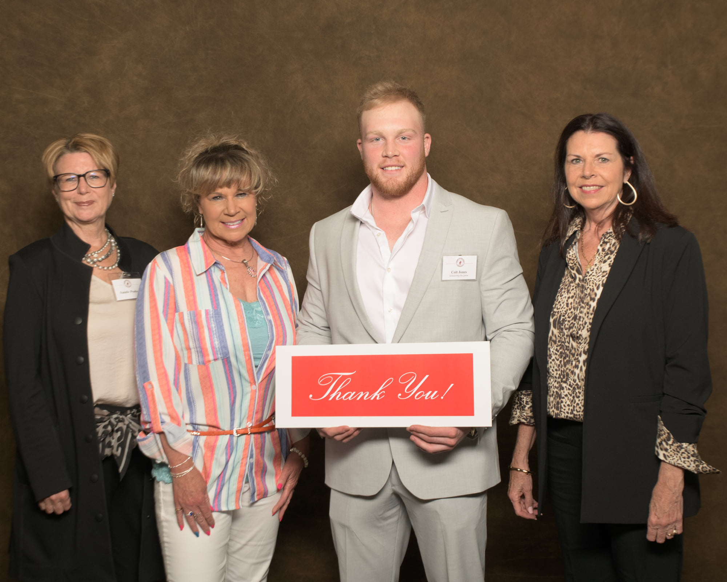

Slide 3
NOC Mission Statement
Northern Oklahoma College, the State’s first public community college is a multi-campus, land-grant institution that provides high-quality, accessible, and affordable educational opportunities and services which create life-changing experiences and develop students as effective learners and leaders within their communities in a connected, ever-changing world.

Slide 4
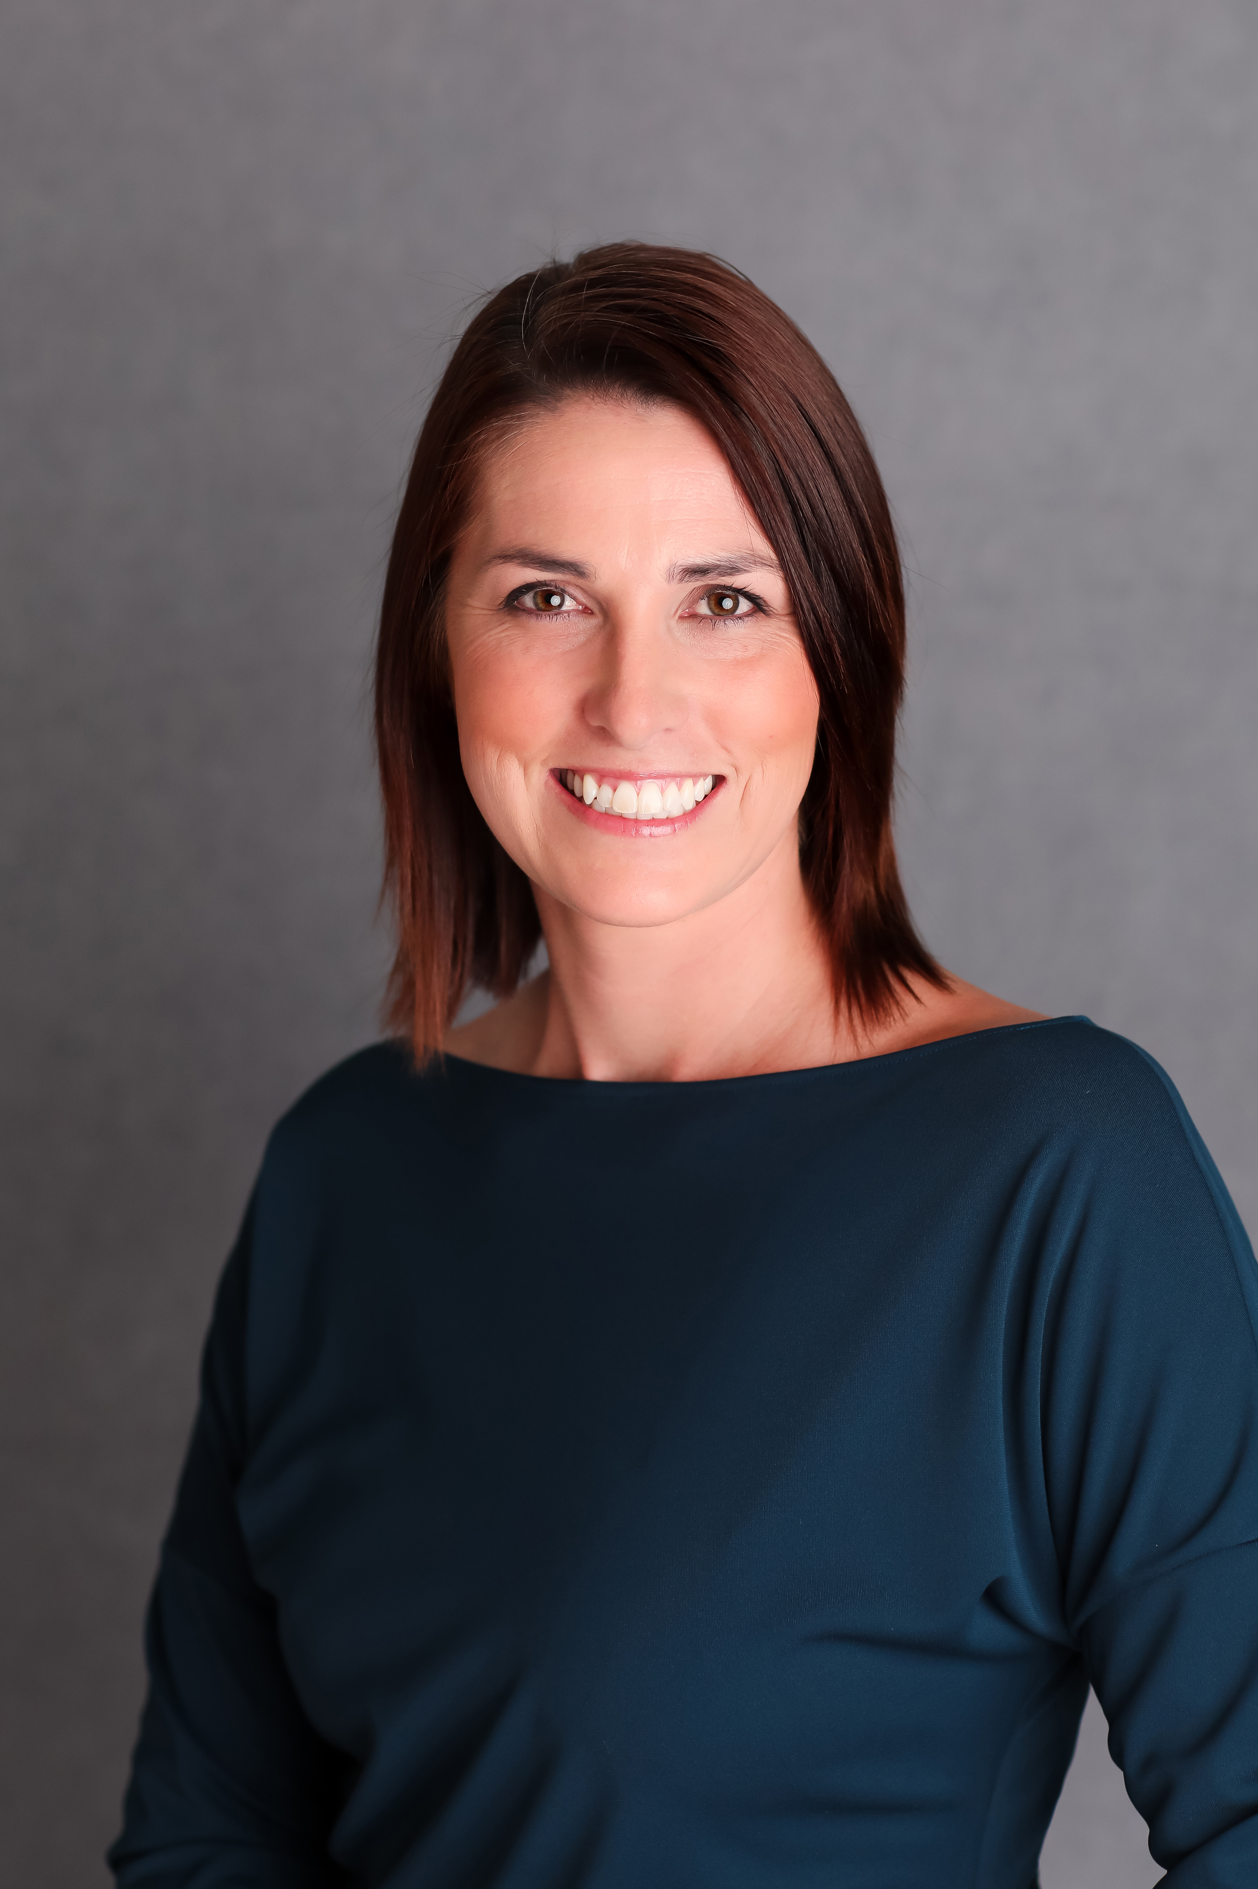
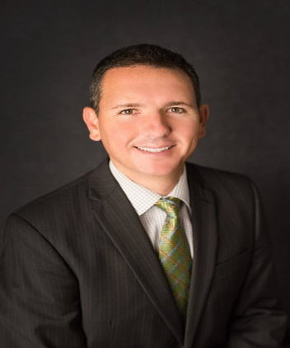
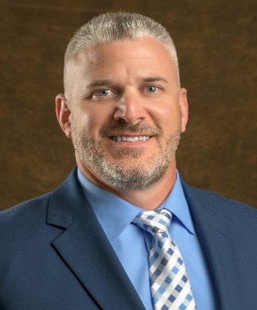
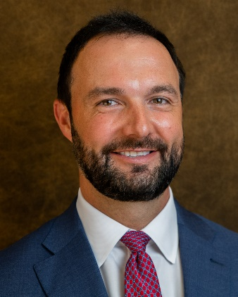
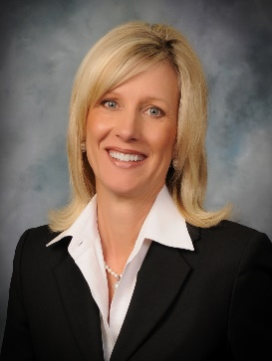
NOC Board of Regents
2022-2023
Jami Groendyke, Chair
Enid, OK
Bradley Fox, Vice Chair
Ponca City, OK
Jason Turnbow, Secretary
Enid, OK
Michael Martin, Member
Stillwater, OK
Jodi Cline, Member
Ponca City, OK
Notes:
Add photo of Regent Martin and update offices

Slide 5
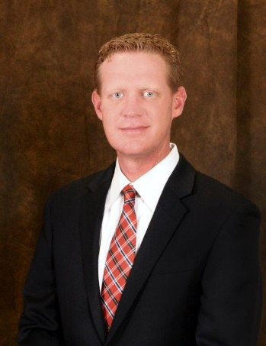
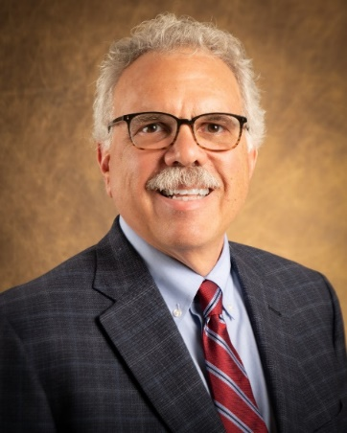
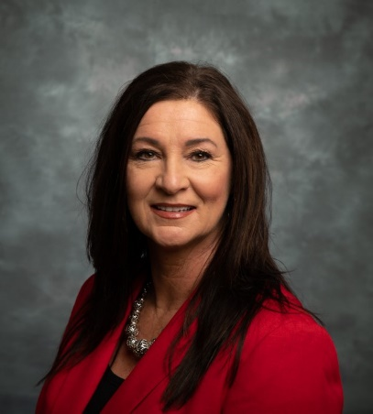
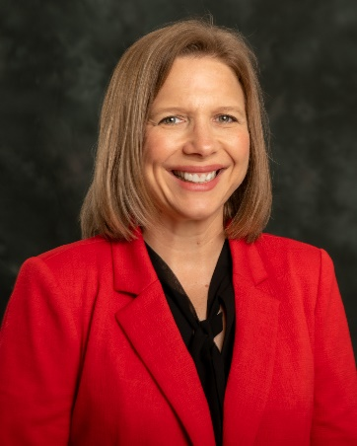
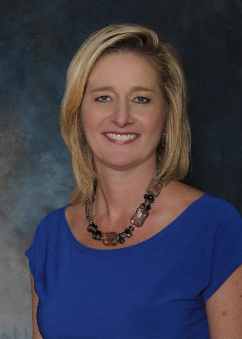
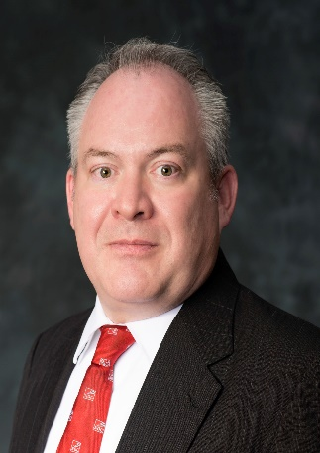
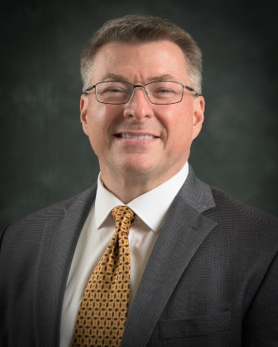
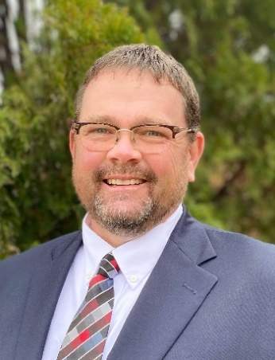
NOC Executive Council
Dr. Clark Harris
President
Sheri Snyder
Vice President Development
& Community Relations
Diana Watkins
Vice President for Academic Affairs
Jason Johnson
Vice President for Student Affairs
Anita Simpson
Vice President for Financial Affairs
Dr. Rick Edgington
Vice President for Enrollment Management
Wade Watkins
Interim Vice President for NOC Stillwater
Jeremy Hise
Vice President for NOC Enid

Slide 6
Purpose of the Foundation
The purpose of the Northern Oklahoma College Foundation shall be to enhance the educational opportunities and the environment of Northern Oklahoma College. The Foundation is organized exclusively for the benefit of the educational, literacy, and scientific activities of the college chartered under the constitution and laws of the State of Oklahoma. The principal function of Northern Oklahoma College Foundation, Inc. is to promote Northern Oklahoma College and the welfare of its programs and students by providing scholarships and other awards as deemed appropriate.

Slide 7
Mission of the Foundation
The Northern Oklahoma College Foundation seeks private support by establishing lifelong relationships with its donors, alumni, and friends while supporting the mission of Northern Oklahoma College and providing financial assistance and quality educational experiences to our students, programs, and employees.

Slide 8
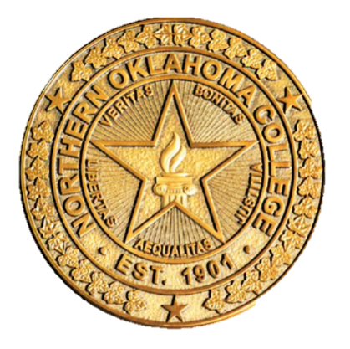
Presidential Partners Program
2022-2023 Campaign Donors
Visionary Partners ($5,000 – Above) Diemer Family Foundation – Bob Diemer
Leader Partner ($2,500 - $4,999) Dr. Rick Edgington, Evans Family Foundation
Scholar Partner ($1,000 - $2,499) Jamie and Hayden Groendyke; John & Virginia Groendyke; Dr. Clark & Paula Harris; Bert & Janice Mackie; Bill & Susie Phelps; Renfro Family Foundation – Carl & Brenda Renfro
Benefactor Partners ($500 - $999) John & Linda Brown; Equity Bank
Patron Partners ($250 - $499) Dr. Jerry Blankenship; Tim Coffman; Evelyn Coyle; Dr. Cheryl & Tom Evans; Jeff & LynnDe Funk; J. Kelly Johnson; Jason & Cara Beth Johnson; Tom & Judy Poole

Slide 9
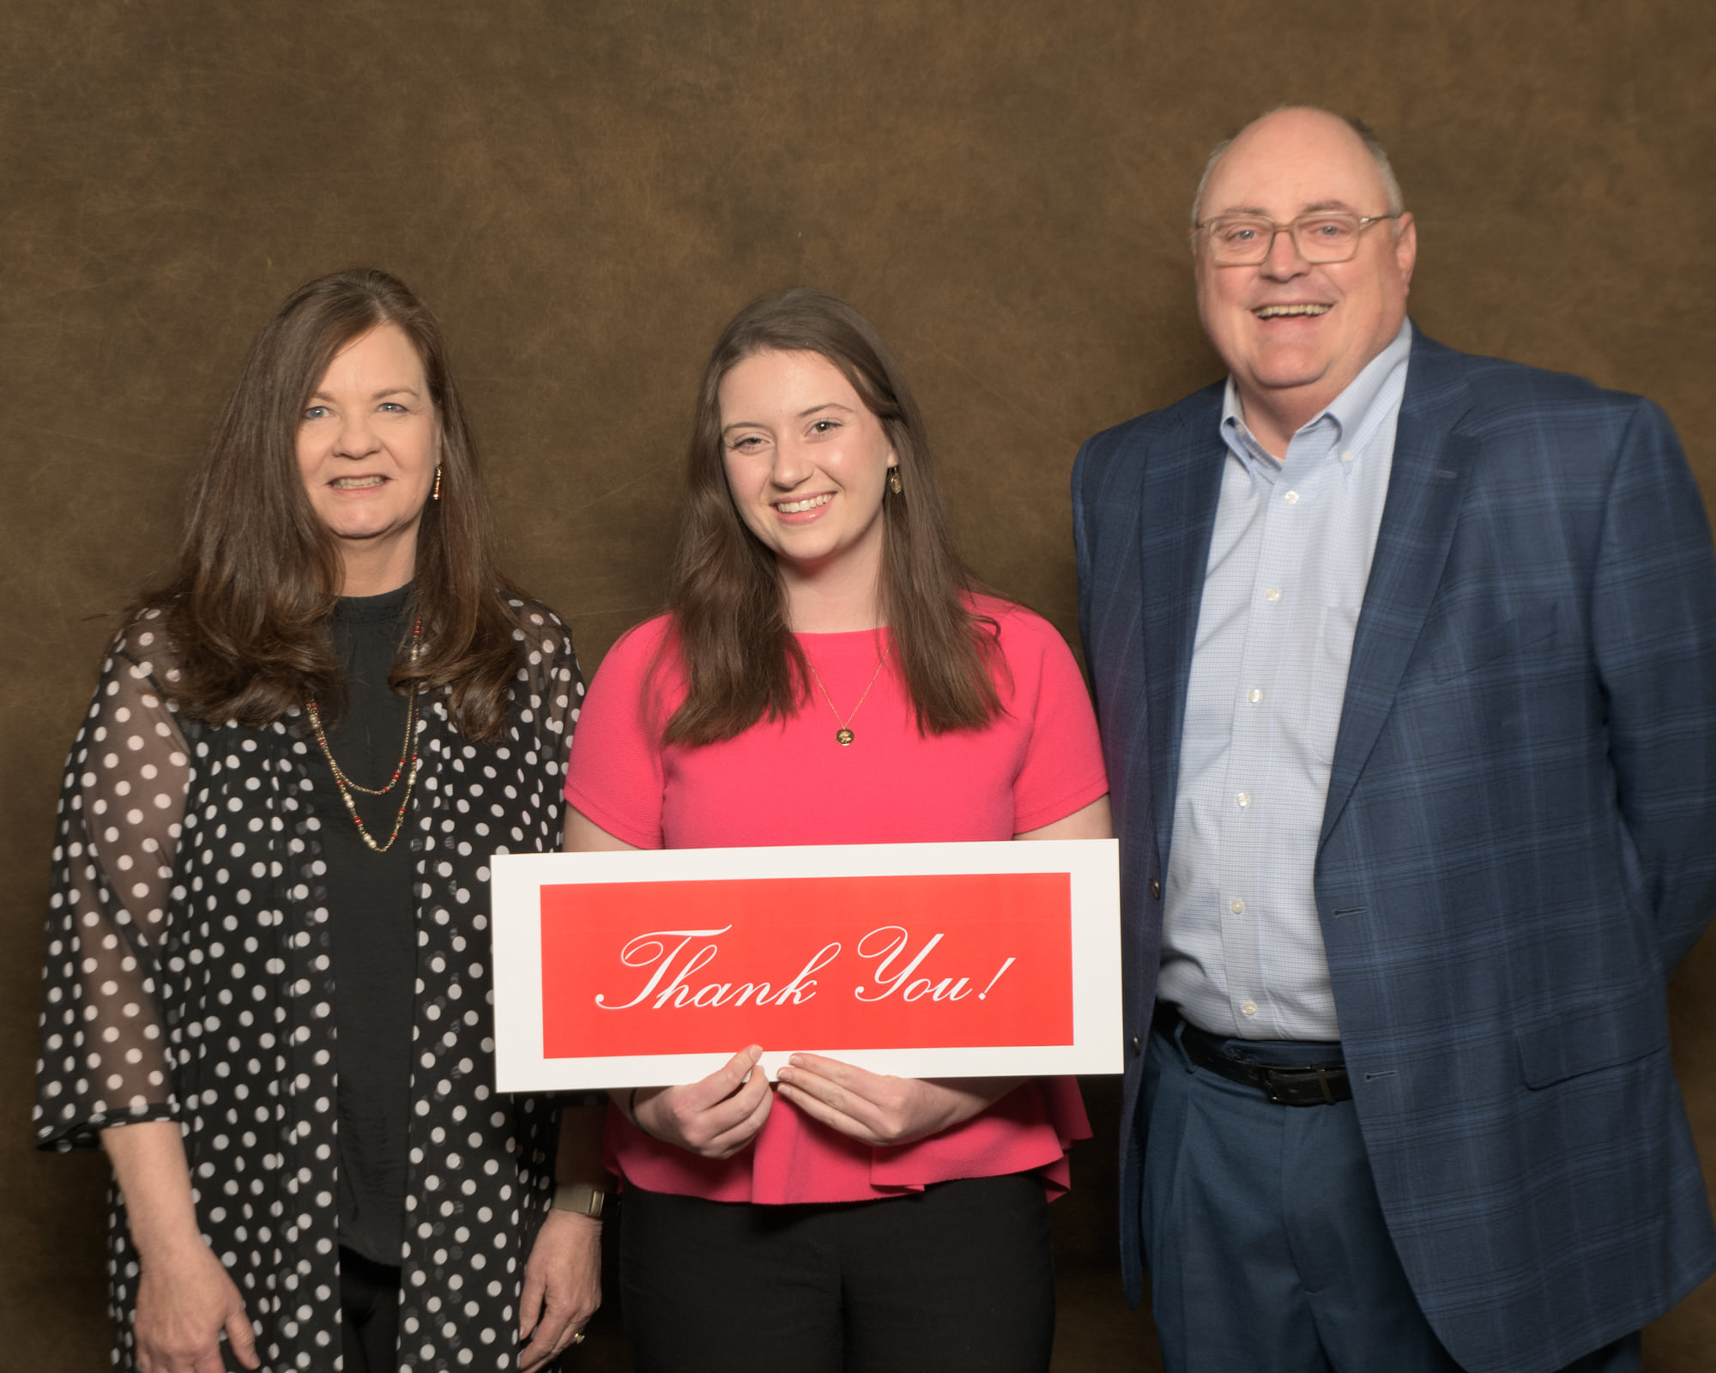

Slide 10
Academic Year | Scholarship Award | Number of Recipients | Loan Award | Number of Recipients
2021-2022 | $196,654 | 399 | 0 | 0
2020-2021 | $196,692 | 394 | $60 | 1
2019-2020 | $245,123 | 395 | $75 | 1
2018-2019 | $260,351 | 392 | $105 | 2
2017-2018 | $261,764 | 333 | $570 | 3
2016-2017 | $249,529 | 312 | $26,579 | 107
2015-2016 | $219,334 | 243 | $25,429 | 95
2014-2015 | $209,576 | 248 | $20,815 | 62
2013-2014 | $143,574 | 189 | $3,225 | 14
2012-2013 | $96,670 | 135 | $10,359 | 53
2011-2012 | $99,800 | 201 | $6,569 | 35
2010-2011 | $79,989 | 90 | $17,326 | 92
2009-2010 | $78,966 | 114 | $1,134 | 7
2008-2009 | $79,220 | 118 | $3,802 | 21
2007-2008 | $88,960 | 126 | $3,757 | 27
2006-2007 | $79,220 | 118 | $4,333 | 24
2005-2006 | $63,848 | 117 | $6,848 | 40
2004-2005 | $59,333 | 121 | $17,975 | 103
2003-2004 | $44,787 | 116 | $15,545 | 85
2002-2003 | $56,008 | 138 | $14,778 | 86
2001-2002 | $64,645 | 161 | $9,354 | 55
2000-2001 | $33,030 | 74 | $8,545 | 52
1999-2000 | $24,641 | 76 | $11,763 | 79
1998-1999 | $25,806 | 71 | $7,457 | 48
1997-1998 | $21,850 | 54 | $5,645 | 43
Scholarship History

Slide 11





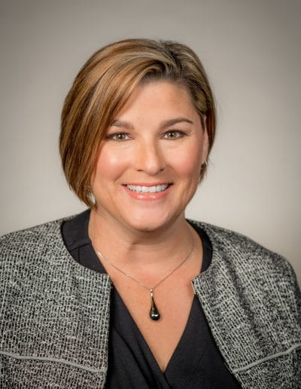


Northern Oklahoma College Foundation, Inc.
Board of Trustees 2022-2023
David Cummings
Dr. Gordon Laird
Mike Loftis
Past Chair
LynnDe Funk
Mark Detten
Chair
Misty Thurman
Vice-Chair
Community Leaders
Bert Mackie
Tom Poole

Slide 12


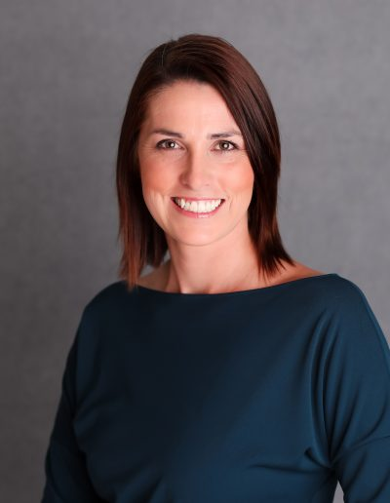

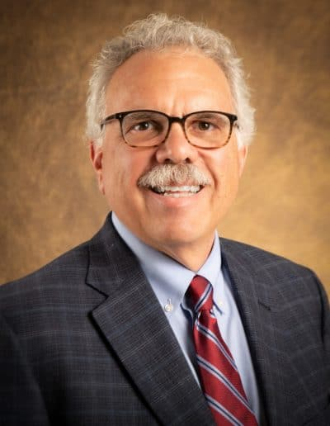
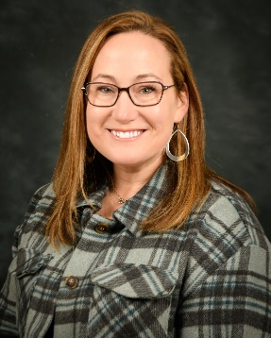
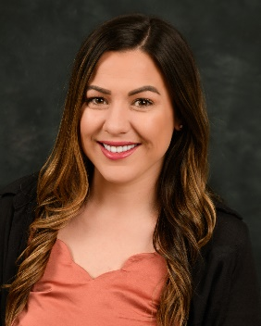
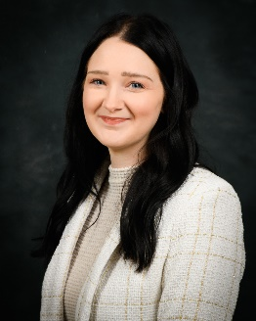
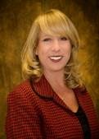
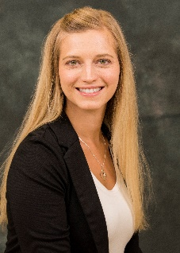
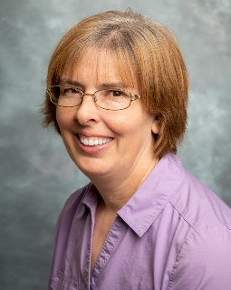
Northern Oklahoma College Foundation, Inc.
2022-2023
Regents, Administrators and Support Staff
Sheri Snyder
Executive Director
Regent Brad Fox
Regent Jami Groendyke
Anita Simpson
Treasurer
Dr. Clark Harris
NOC President
Rachel Love
Asst. to the Treasurer
Brittany Cox
Asst. to the Director
Heather Swain
Gift Processing
Candy Oller
Development & Donor
Relations
Kayla Wooderson
Alumni & Community Relations
Kerri Gray
Scholarships

Slide 13
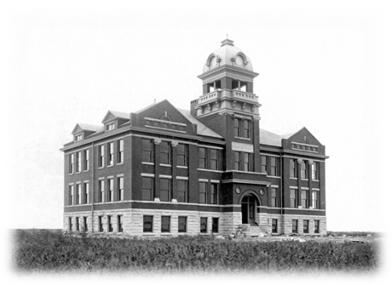
The Central Hall Society
Consider Remembering NOC in your Planned Giving
The Northern Oklahoma College Foundation has established the Central Hall Society in order to recognize those Alumni and Friends who have remembered NOC in their estate planning. The Central Hall Society recognizes and honors the legacy of these donors.
Membership in the Central Hall Society is open to those who:
Make planned gifts in the form of charitable remainder trusts (including pooled income funds and uni-trusts), lead trusts, gift annuities, or deferred gift annuities; or
Make gifts of life insurance or have named the college as the beneficiary of their policy; or
Have confirmed non-contingent, bequest provisions; or
Have named the college as a non-contingent beneficiary of their IRA or other retirement plans

Slide 14
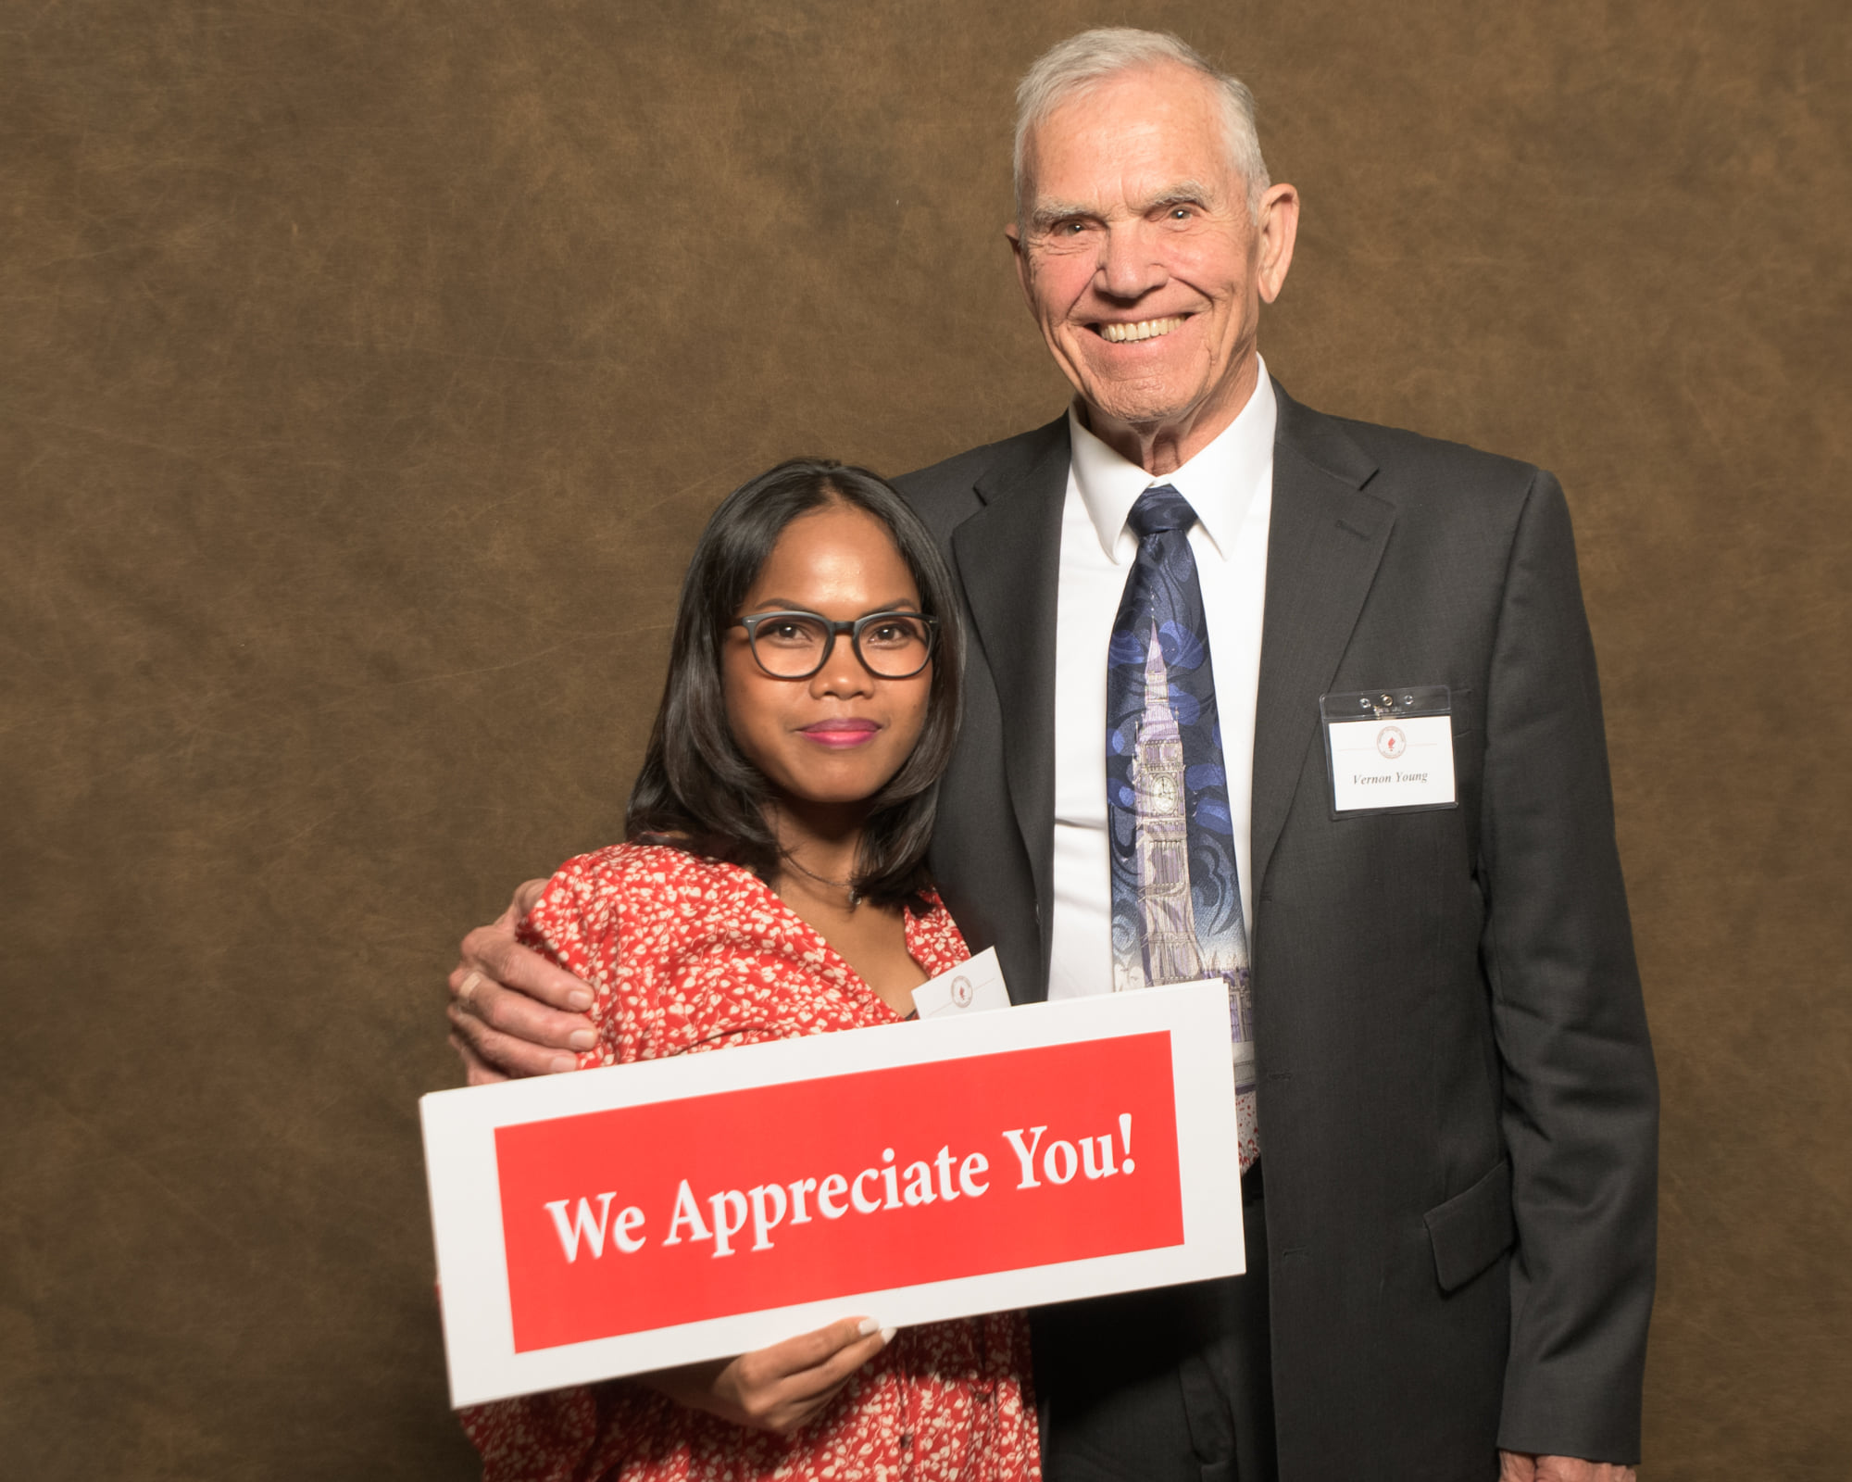

Slide 15
NEW SCHOLARSHIPS
Judith L. Whitmore Nursing - Enid
This scholarship will go to a full-time, first-year nursing student in the NOC Enid Nursing program with a 3.0 or higher GPA. The recipient will be determined by the NOC Enid Scholarship Committee – Nursing Division.
Tonkawa H.S. Concurrent Enrollment

Slide 16
Northern Oklahoma College Foundation
2023 Honor Roll

Slide 17
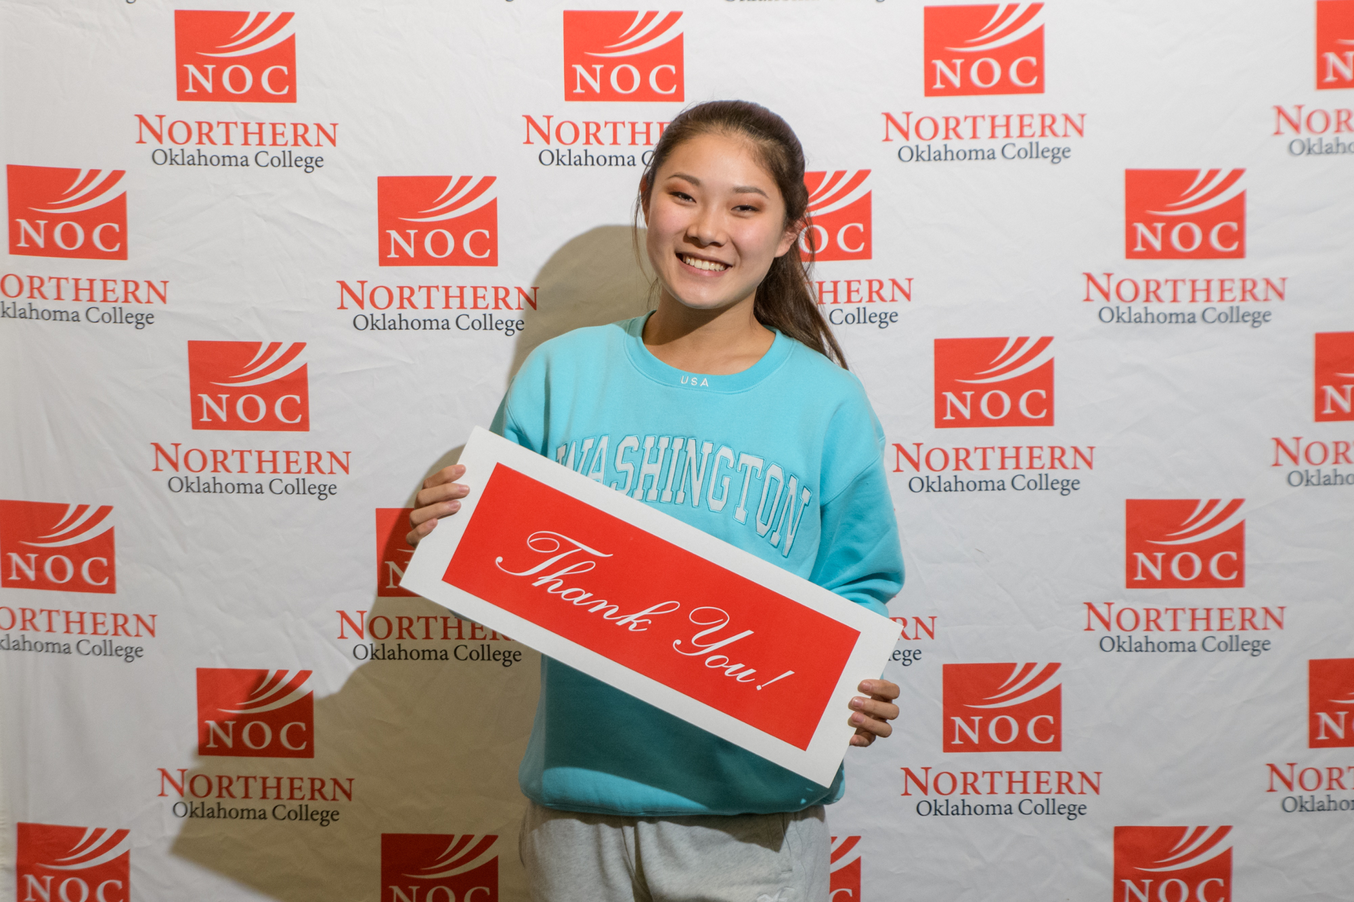

Slide 18
Major Club
Michael Adams
Gene Belcher Educational Foundation
George and Floretta Bellmon Revocable Trust
Jackie & Marc Conrady
Jim & Jeanine Deterding
Diemer Family Foundation – Robert Diemer
Gene V. Dougherty Estate – Vince Dougherty
Dr. Rick Edgington
Enel Green Power NA, Inc.
Enid Concrete Co., Inc.
Enid Higher Education Council, Inc.
Evans & Associates Construction Co., Inc.
Evans Family Foundation
Bruce and Janet Evans
Hurst Construction & Fabrication, LLC
Oliver and Joy Kerfoot Estate – Karen Kerfoot
Loftis Corporation– Mike and Kim Loftis

Slide 19
Major Club (Continued)
Pamela and Joseph McNeal Memorial –
Angela Almeyda
Bill and Susie Phelps
Doctor Pickens Museum, Inc. – Hugh Pickens
Renfro Family Foundation –
Carl and Brenda Renfro
Kenneth and Dianne Smith
Steichen Family Decedent’s Trust
University Center Foundation, Inc. at Ponca City
Wind for Schools

Slide 20
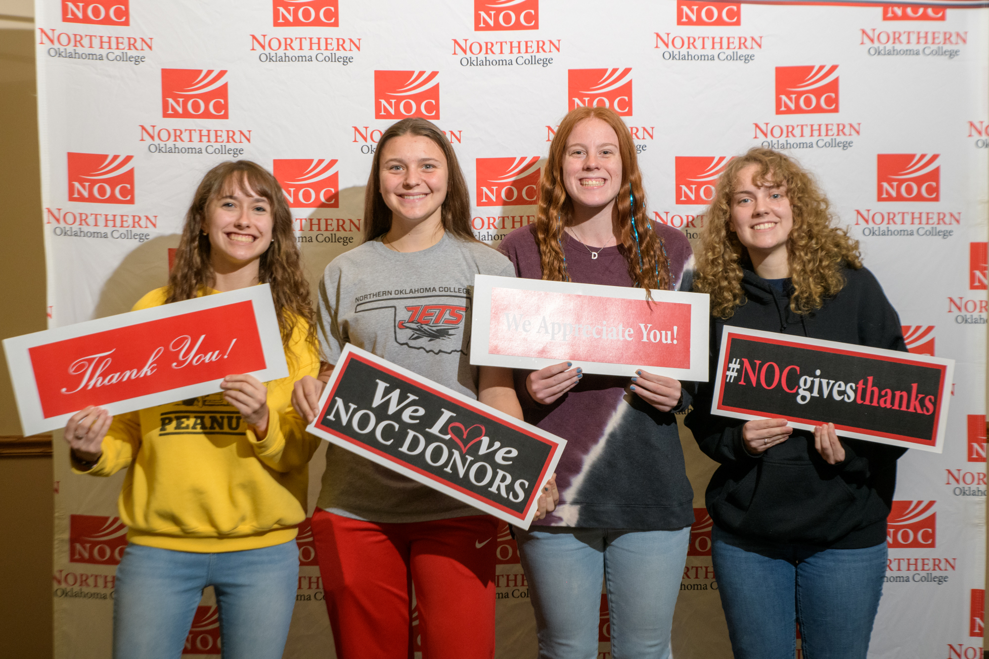

Slide 21
Heritage Club
Dirk and Ann Allen
John and Linda Brown
John Campbell
Drs. Kurt and Sarah Campbell
Stan and Kendall Claybaker
Evelyn Coyle
Bruce Dale
Richard and Lori Davis
Robert Easterling
The Ellis Foundation
Robert and Jacque Erner
Dr. Cheryl and Tom Evans
Jeff and LynnDe Funk
Hayden and Jami Groendyke
John and Virginia Groendyke
Dr. Clark and Paula Harris
Jeremy and Brandy Hise
Inasmuch Foundation

Slide 22
Heritage Club (Continued)
Jason and Cara Beth Johnson
Bert and Janice Mackie
Dr. Pete and Tricia Moore
Madalynne L. Peel Foundation
Peter Pan Cleaners
Tom and Judy Poole
Eric and Anita Simpson
Coby and Sheri Snyder
Drs. Don and Pamela Stinson
Dr. Wendy McConnell Stone
Tom Walker
Mick and Vina Weiberg
Sherri Whitehead

Slide 23
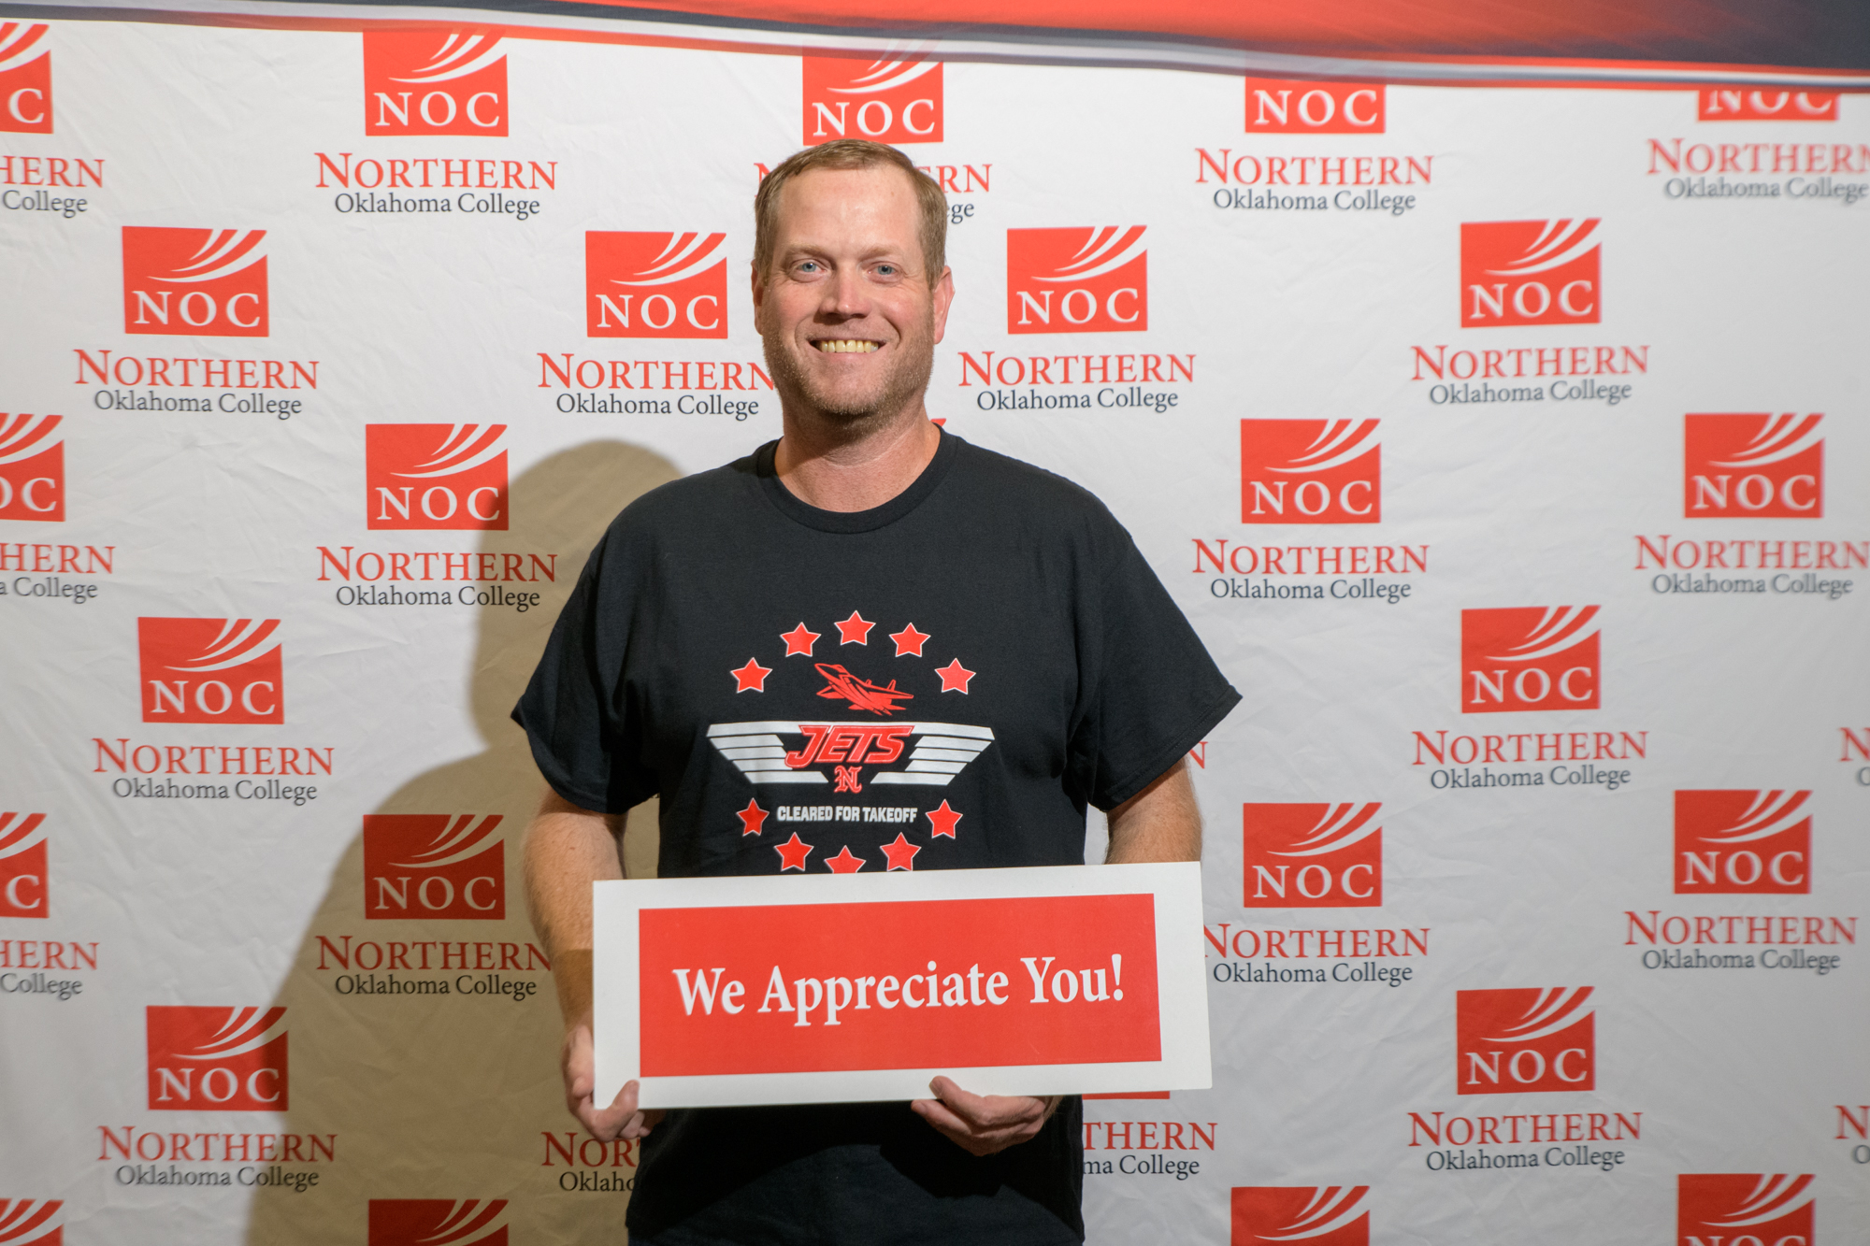

Slide 24
President’s Club
Stan Anderson
JoAnn Black
Art and Nevona Bossert
Robert Case
David and Deanna Cummings
Andrew and Kristi DesJarlais
Dr. Ann and Tom Dugger
Equity Bank – Ponca City
First National Bank of Oklahoma
Justin and Mara Funk
Dr. Jill and David Green
Dineo Heilmann
Jerry Kirkpatrick
Jena Kodesh
Ford and Maxine Lasher
Steve and Cheryl Marquardt
Brad Purdy
Irma Quade

Slide 25
President’s Club (Continued)
Jim and Sue Ann Rodgers
Mrs. Edgar (Leigh Ann) Snyder
Tara Thomas
Randy Walker

Slide 26
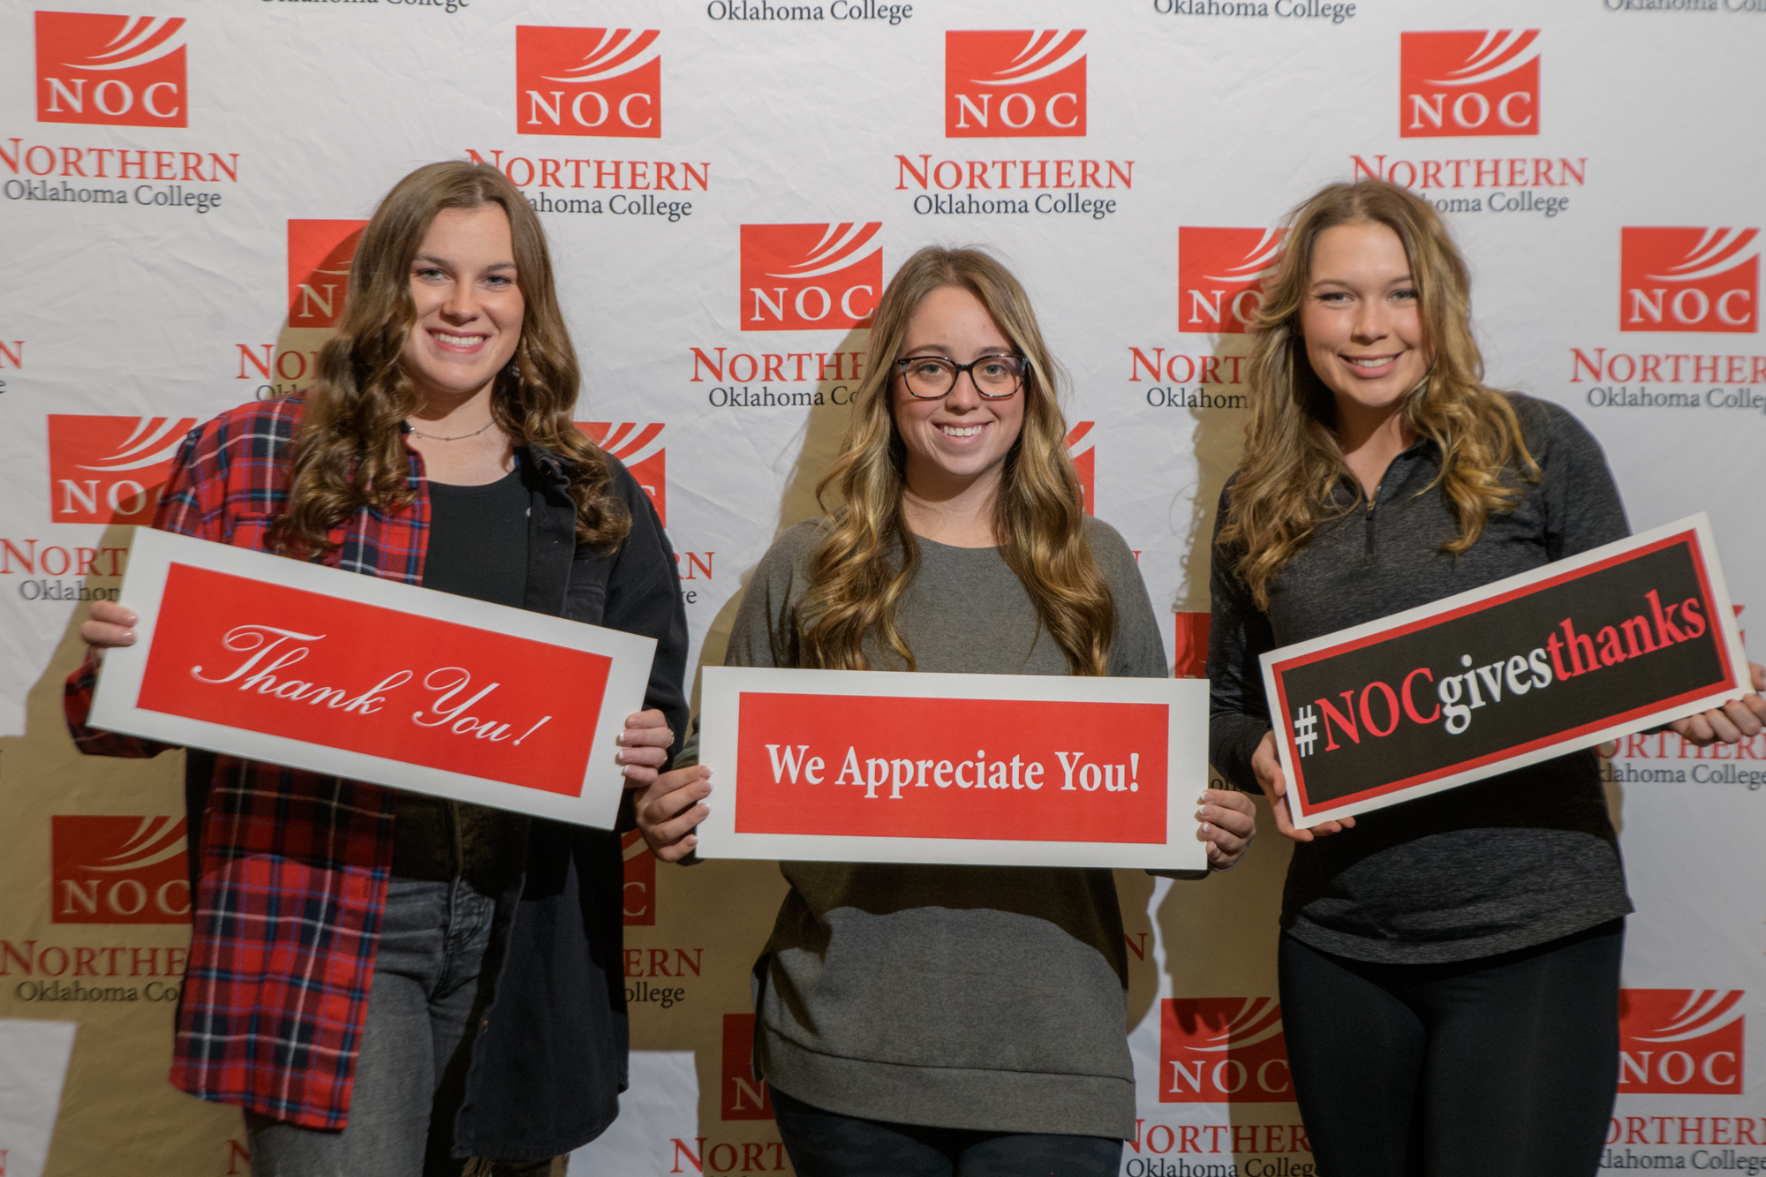

Slide 27
Crimson Club
Nancy Appleman
Ronald Austin, DDS
Dr. Jerry Blankenship
Carol Bouldin
Dennis and Valorie Buss
Dr. Jeremy Cook
Meg Coots
Mark and Jayne Detten
Don and Brenda Dobbs
Jack Drake
Steve and Jeanna Friesen
Mike and Lynn Goodale
Janet Jarvis
J. Kelly Johnson
Bill and Kim Korn
Louis and Janet McCarter
Candy Oller
Phillips66 Matching Gift Program

Slide 28
Crimson Club (Continued)
Ody Rico
Vincent Siren
Barry Steichen
Tommy and Suzy Stergas
Connie Van Ausdall
Dennis and Melanie Williams
Daniel Wood
Vernon and Norma Young

Slide 29
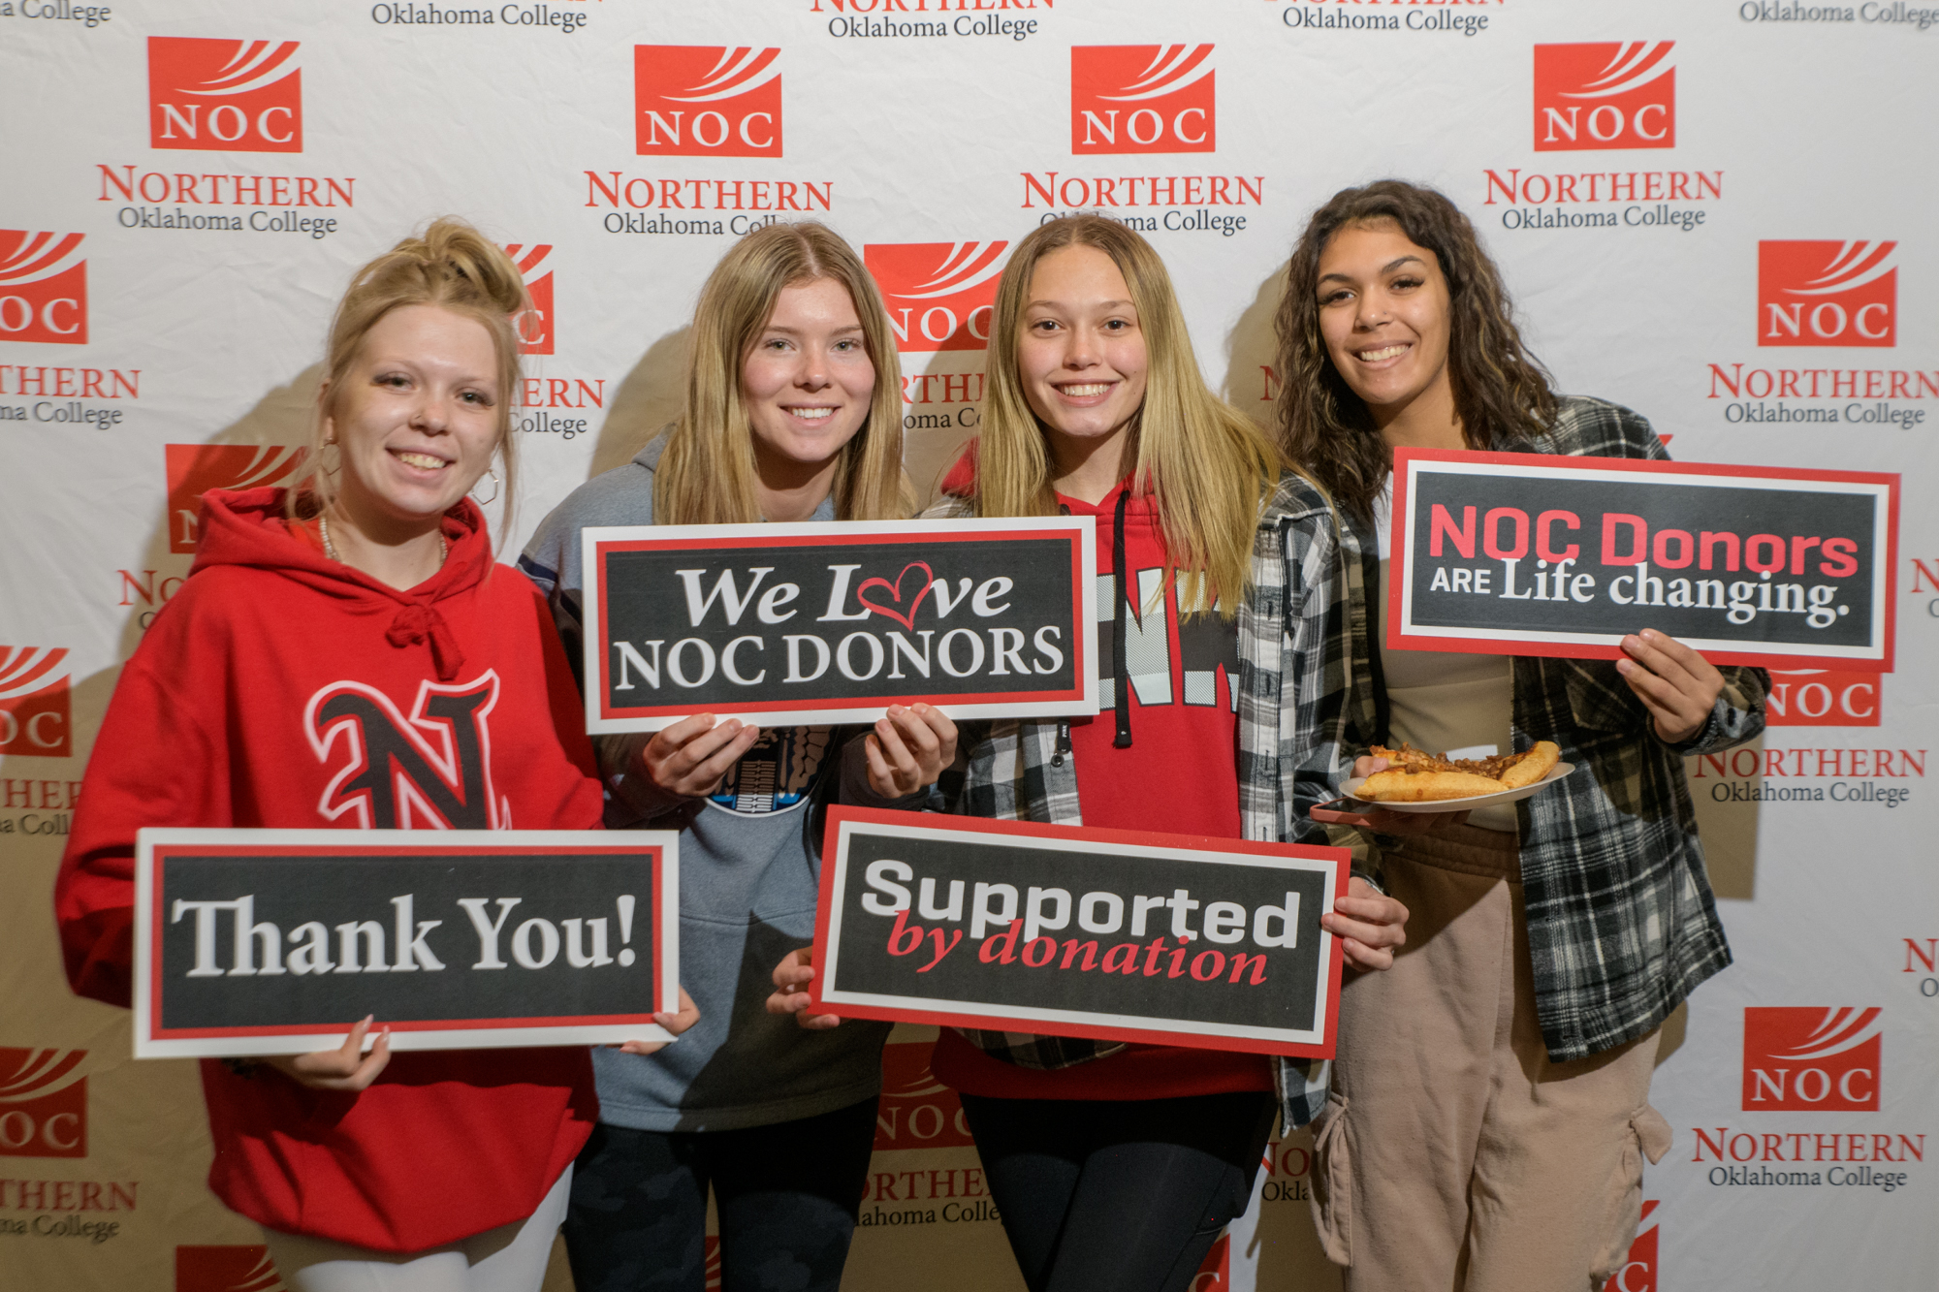

Slide 30
Round Up Club
Elaine Albers
Art Center of Tonkawa
Dr. Paul Bowers
Aaron and Suzi Brown
Carolyn Brown
Rhett and Jill Butler
Royce and Kathlyn Caldron
Anna Cales
Mark and Cherri Calvert
Dr. Jack Cnossen
Tim and Ginny Coffman
ConocoPhillips Matching Gift Program
Tamera Davis
Delphi Study Club
Diemer Construction Company Employees
Robert Doenges
Larry and Sharon Dye
Leonard and Vickie Epperson

Slide 31
Round Up Club (Continued)
James and Marilyn Gilbert
Phil and Debora Gooch
Brad Gordon
Brandt and Pat Harris
Richard Hefton
Kirby Hill
Mark Hilyard
William Hodge
Leslie Johns
Clayton and Nancy Johnson
Cameron and Sherryl Nelson
Homer and Barbara Nicholson
Lisa Nordquist
Kim Ochoa
James Parnell
Ryan and Jennie Paul
Natalie Prather
Laurence “Bo” Riseling

Slide 32
Round Up Club (Continued)
J. Wesley Ruzek
Salt Fork Armory, LLC – Coby Snyder, Jr.
Linus and Sue Schmitz
Rick Scott Construction, Inc.
Stephanie Scott Bundy
Scott and Brittany Seabridge
Danny and Toni Snow
Ruth Steichen Estate
Mary Steichen
Major George and Nancy Stirman
Emma Lou Stiver
Christopher Storm
Marta Sullivan
Randy and Robyn Turney
John VanPool
Sharon Worden
Laural Zavodny

Slide 33
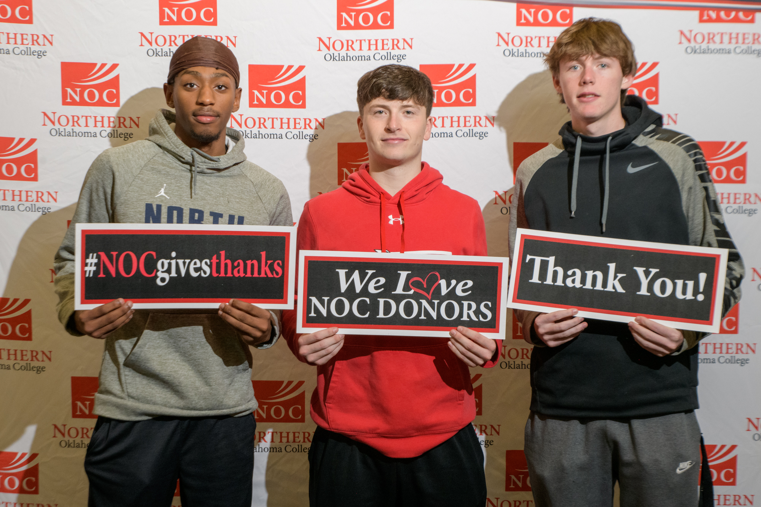

Slide 34
Gift In Kind
Diemer Construction, LLC
Dr. Justin Funk
Doctor Pickens Museum, Inc. – Hugh Pickens
Renfro Family Foundation – Carl and Brenda Renfro
Shell Club Lambs – Larry Shell
The Swinford Group LLC – Wayland Swinford
Dr. Frankie Wood-Black

Slide 35
2022-2023 Foundation Scholarship Recipients

Slide 36
Foundation Scholarship Recipients
H.S. “Hap” and Amelia Aisenbrey Scholarship
Anna Willis
Hannah Haley
Jordan Nelson
Dr. Christina Akers Memorial Scholarship
Gin Muang
Kira Buffalohead
Mom & Pops Allen Scholarship
Caleb Webster

Slide 37
Foundation Scholarship Recipients
Art Center of Tonkawa Scholarship
Mariah Roebuck
Phyllis Kendall Asbury Scholarship
Karmen Newman
Emily Lewis
Joan Bartlett Memorial Scholarship
Abigail Cardwell
Dale and Mirth Beall Scholarship
Haylee Rogers

Slide 38
Foundation Scholarship Recipients
Gene Belcher Foundation Scholarship
PENDING
George and Floretta Bellmon Scholarship
Cade Ring
Ima Faythe Berglund NOC Endowment Engineering Scholarship
Don Brown
Elric Cope
Charlie Gilbreath
David Miller
Jared Meeks

Slide 39
Foundation Scholarship Recipients
Ima Faythe Berglund NOC Endowment Science Scholarship
Colin Davis
Charli Moore
Emma Kimbrel
Matthew Pawlikowski
Lainey LeForce
Caleb Webster
Anna Willis
Samantha Lee
Judy Blan Memorial Scholarship
Curtis Conner
Agness M. Bray Memorial Scholarship
Jayden Ott
Clay Massey

Slide 40
Foundation Scholarship Recipients
John L. and Linda J. Brown Scholarship
Hattie Steichen
Victoria Sue Brown Scholarship
Jocee Buellesfeld
A.D. Buck Scholarship
Connor Simon
Alyssa Bush
Ronald & Carla Sue Buck Scholarship
Braiden Holloway

Slide 41
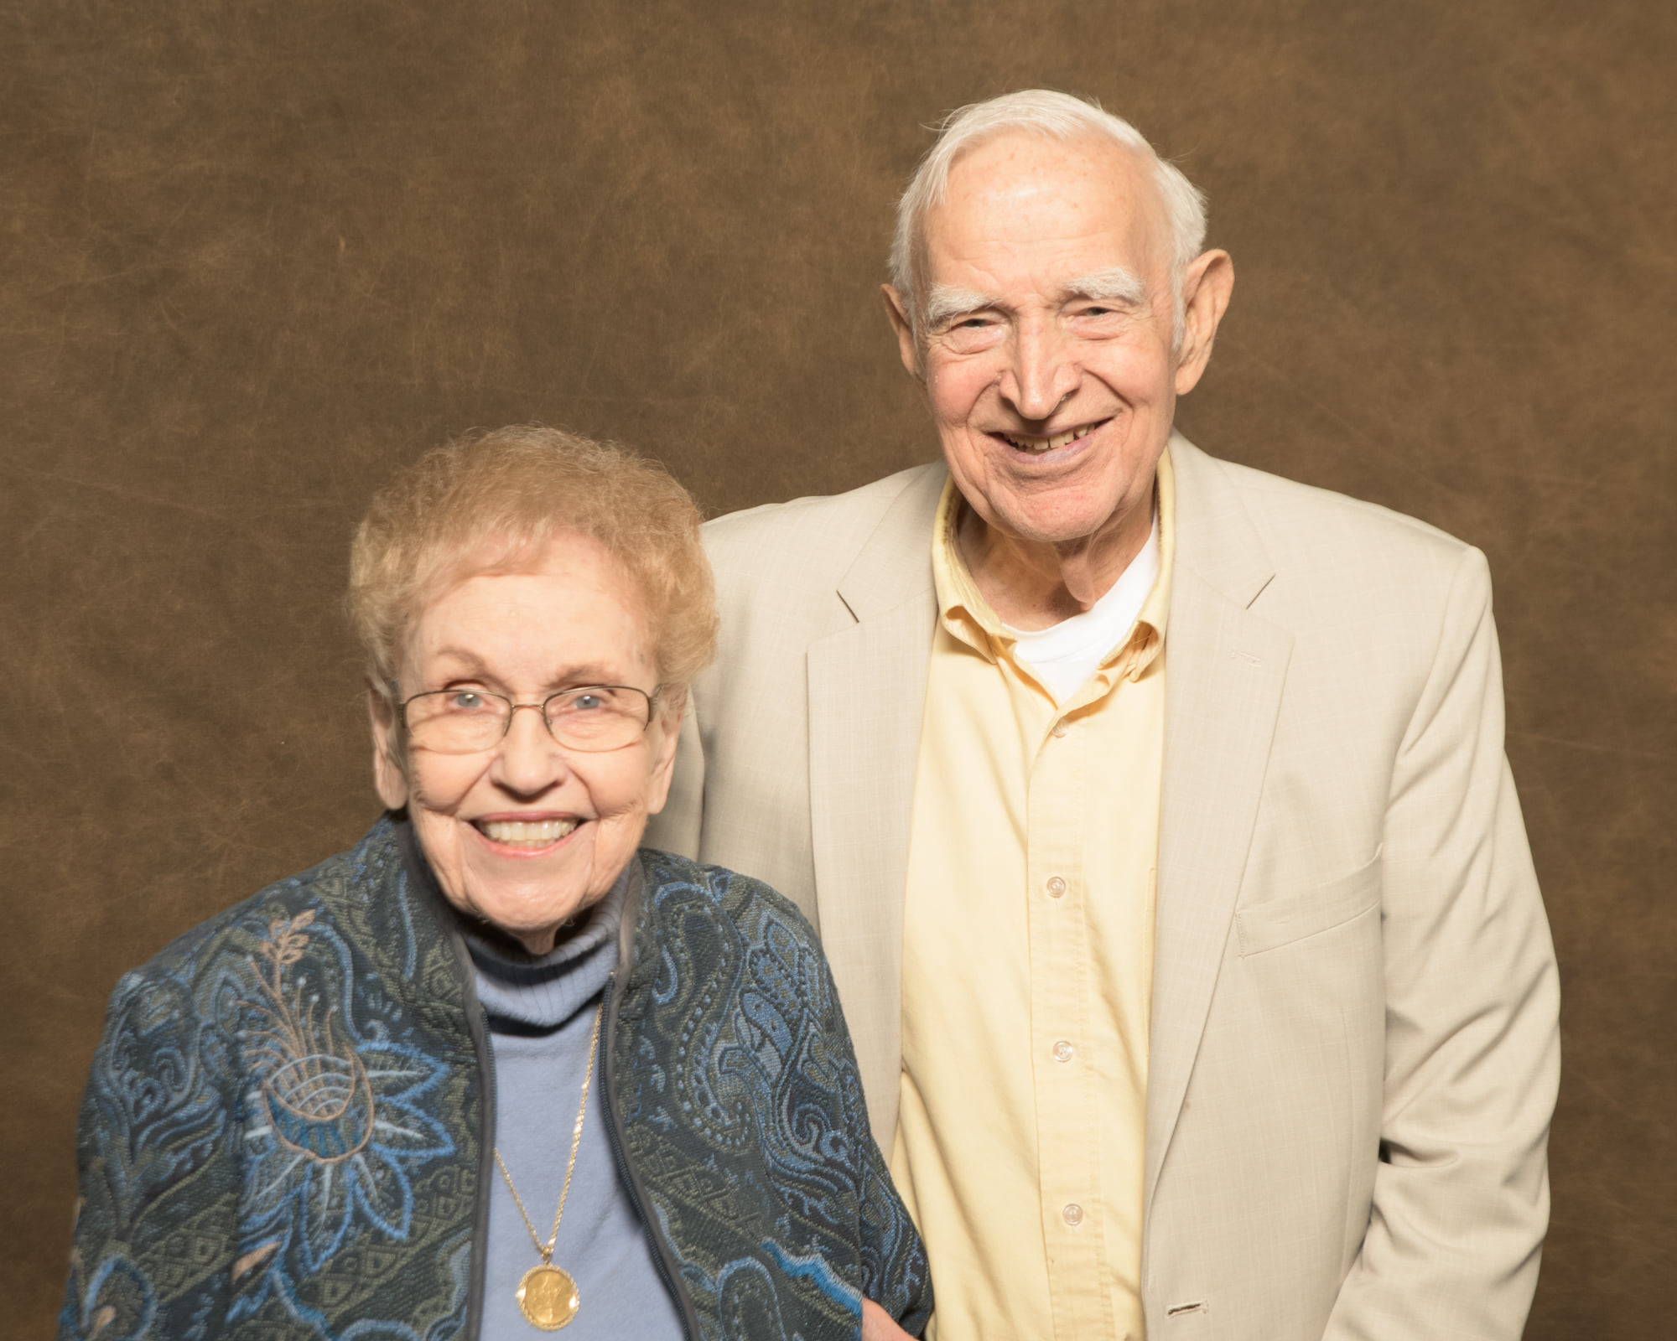

Slide 42
Foundation Scholarship Recipients
James W. Buttram Memorial Scholarship
Madison Quillin
Leora E. Calkins Endowed Scholarship
Maya Gentry
Mallory Riley
Jayce Bickford
Noah Woodward
Hattie Steichen
Jacey Burden
James Grein
Anna Lois Denton
Katelyn Qualls
Kenzie Glenny
Samuel Haley

Slide 43
Foundation Scholarship Recipients
Leo Canaday Memorial Scholarship
Allison Green
Jennie Goodson Cannon Scholarship
Jace Calfy
Charity Clark
Brenna Leonard
Roy Chaney Scholarship
Samantha Lee
Class of 1961 Scholarship
Ethan Howard

Slide 44
Foundation Scholarship Recipients
Robert Bryant Colombe Scholarship
Halie Shirley
Colton Anson
Lee and Iola Combrink Student Scholarship
Jaylyn Bennett
Rowena Gharst Corr Scholarship
David Hernandez
Delphi Study Club Scholarship
Katelyn Qualls

Slide 45
Foundation Scholarship Recipients
Carol Diemer Memorial Scholarship
Kenzie Glenny
Earl G. Dodson Scholarship
Bailey Hoeltzel
Jerry and Lucille Donnelly Scholarship
Kira Pendleton
Northern Divisional Book Scholarship
Ashlyn Larman
Connor Simon
Graeme Rios
Karman Newman

Slide 46
Foundation Scholarship Recipients
Verlin and Bonnie Easterling Scholarship
Johnnie Davis
The Ellis Foundation Scholarship
Caitlin Flackman Nagel
Samantha R Smith
Enid Concrete Scholarship
Sierra Woods
Enid Nursing Scholarship
Cris Caez-Rojas

Slide 47
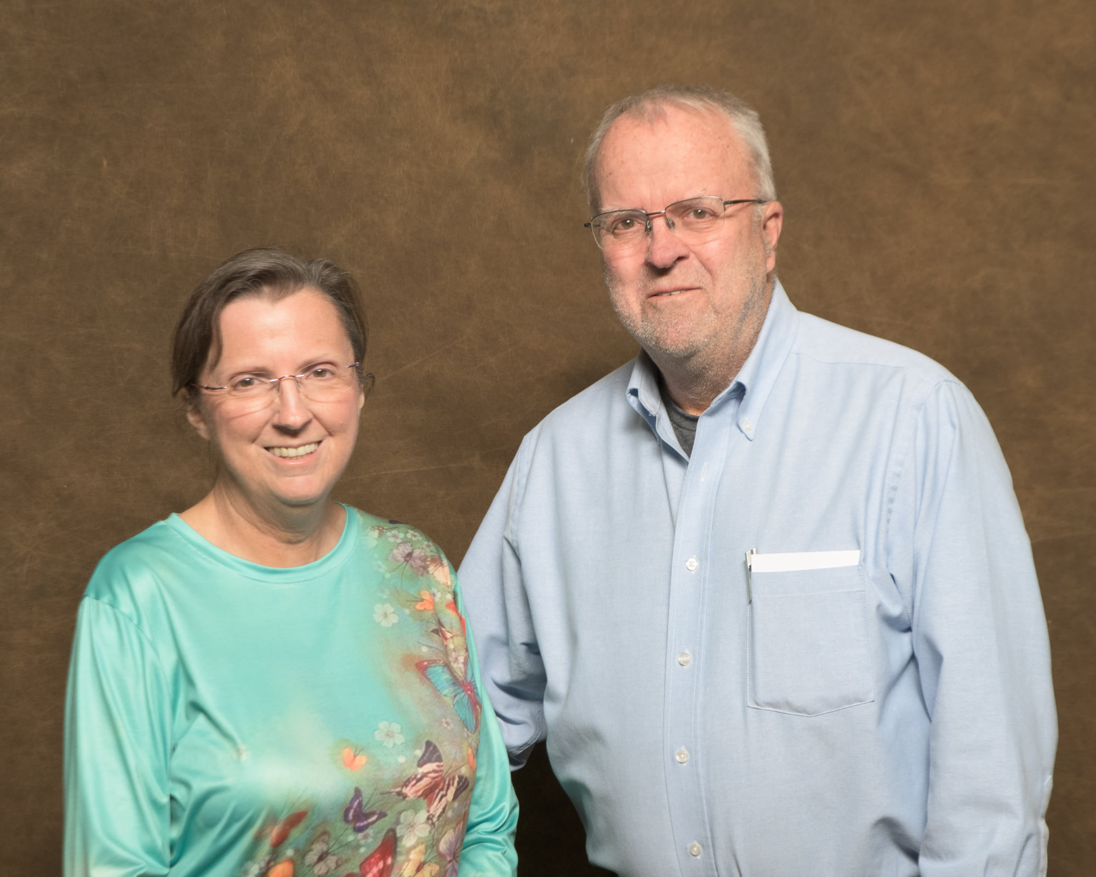

Slide 48
Foundation Scholarship Recipients
Enrollment Management Scholarship
Enid Higher Education Council Scholarship – Freshman
Madison Morse
Ashlan Light
Anna Stotts
Braden Longpine
Courtney Kerr
Lucero Delgadillo
Karlie Irwin
Karlea Rich
Bryant Rice

Slide 49
Foundation Scholarship Recipients
Enid Higher Education Council Scholarship – Part-Time
Enid Higher Education Council Scholarship – Sophomore
Ella Ayers
Patricia Frickenschmidt
Julian Pendergraft
Mary Christine Semrad
Faith Voelzke
Jacqueline Camarena
Cason Matthews
Vanessa Kerr
Diana Garcia
Kalyan Egleston
Essence Kearney
Jared Johnson
Alyson Myers
Camden Roberts
Ann Blodgett
Julia Ruckel

Slide 50
Foundation Scholarship Recipients
Annie Marie Erwin Memorial Book Scholarship
Ava Frank
Alexandria Madden
Brian Halpin
Parrish Payton
Annie Marie Erwin Memorial Nursing Scholarship
Joey Simmons
Annie Marie Erwin Memorial Music Scholarship
Amberlynn Kelly
Edward D. Erwin Memorial Scholarship
Michael Ward

Slide 51
Foundation Scholarship Recipients
Kathleen M. Erwin Nursing School Scholarship
Jennifer Schaefer
Kathleen Marie Erwin Instrumental Music Scholarship
Kira Pendleton
Reverend Phillip Douglas Erwin Nursing Scholarship
Courtney Covert
Robert Kendall Erwin Memorial Nursing Scholarship
Caitlyn Vogel
Maud Etter Memorial Scholarship
Kira Pendleton

Slide 52
Foundation Scholarship Recipients
Thomas Stewart Evans Scholarship
Chris Thompson
Tom and Cheryl Evans Scholarship
Brandi Layton
Evans & Associates Scholarship
Nancy Klippenstein
Kay Farrell Nursing – Enid Scholarship
Cindi Hagans
Lynn Meredith Fulton Memorial Scholarship
Jacqueline Camarena

Slide 53
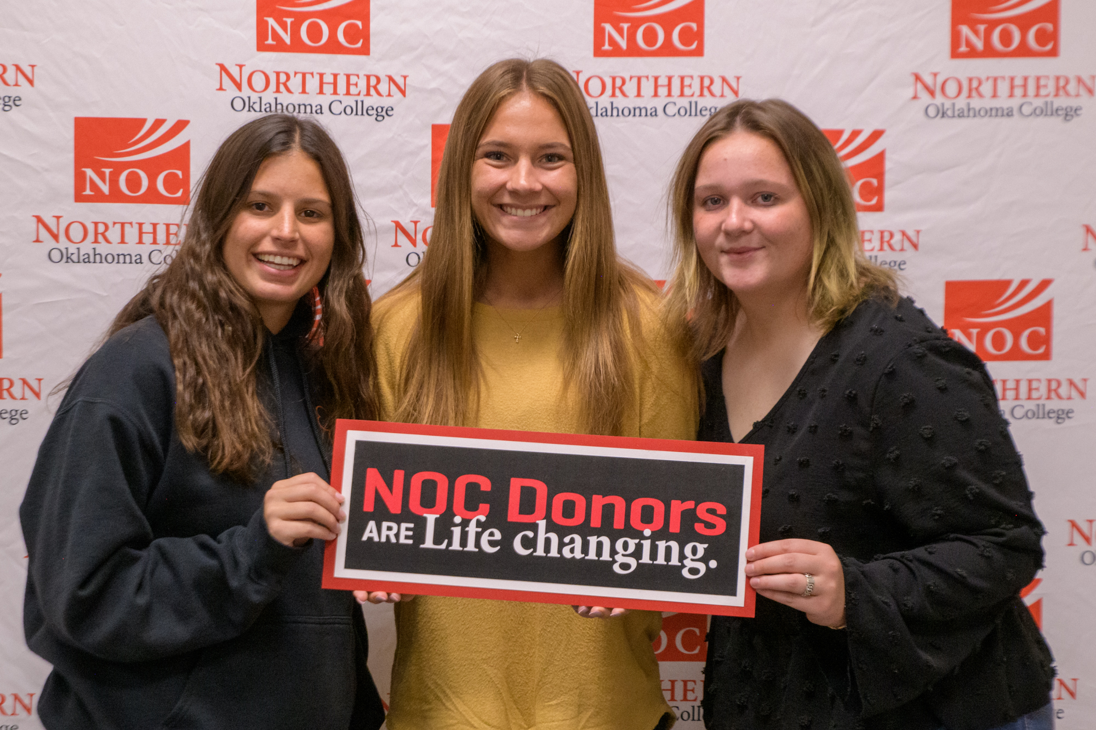

Slide 54
Foundation Scholarship Recipients
Cortlandt H. Frye Sr. Memorial Scholarship
Jessica Belair
Marlin “Ike” and Marybeth Glass Scholarship
Donna Barrows
Margaret Jo Gleeson Memorial Scholarship
Shelby Baker
Harold E. Goodman Law Enforcement Scholarship
Donna Barrows
Wilma Harman Music Scholarship
Emma Valgora

Slide 55
Foundation Scholarship Recipients
Clarence Helton Memorial Scholarship
Kenzie Glenny
Harvey Herrington Memorial Agricultural Scholarship
Karman Newman
Hullet Family Scholarship
Brett Stoup
Curtis Jackson Memorial Scholarship
Elizabeth Goodwin
Anna Jenkins Memorial Scholarship
Makayla McCullough
Ayden Lumbers

Slide 56
Foundation Scholarship Recipients
Kay County Retired Educators Association Fund
McKenzie Keeler
Truman Hague
Nevona Kegans Scholarship
Samantha Smith
Carl and Joy Kerfoot Nursing Scholarship
Haylee Rogers
Melvin and Margaret Korn Scholarship
Brendon Ochoa
David Hernandez

Slide 57
Foundation Scholarship Recipients
Timothy Knutson Memorial Scholarship
Charlotte Kretsch Endowed Scholarship
John Anej
Hazel West Litzenberger Memorial Scholarship
Blake Peterson
Sidnie Saville
Abigal Cardwell
Devin Tebow
Emmaline Dethloff
Gunner Coffey
Jordan Walenciak
Kevin Miller
Lauren Bhend
Macey Reese
Micha Jarret
Molly Dolan
Betzabet Rojo

Slide 58
Foundation Scholarship Recipients
Loftis Access to Success for Blackwell High School Concurrent Student Scholarship
Claire Beck
Harlie May
Khloe Yocham
Kynsley DeWitt
Brendan Donahue
Kylie Hughes
Tucker Jeffries
Virginia Jones
Conner Mitchell
Trista Stormer
Jewel Tremain
Annalaura Vogt (Rowe)
Trinity Mehl
Davin Matthews
Bostyn Chambers
Chesney Kimbrel
Wyatt Swafford
James Tripp
Dick Lambertz Memorial Scholarship
Shyenne Hazen
Ingrid Gomez
LPN Bridge Scholarship
Lauren Eller

Slide 59
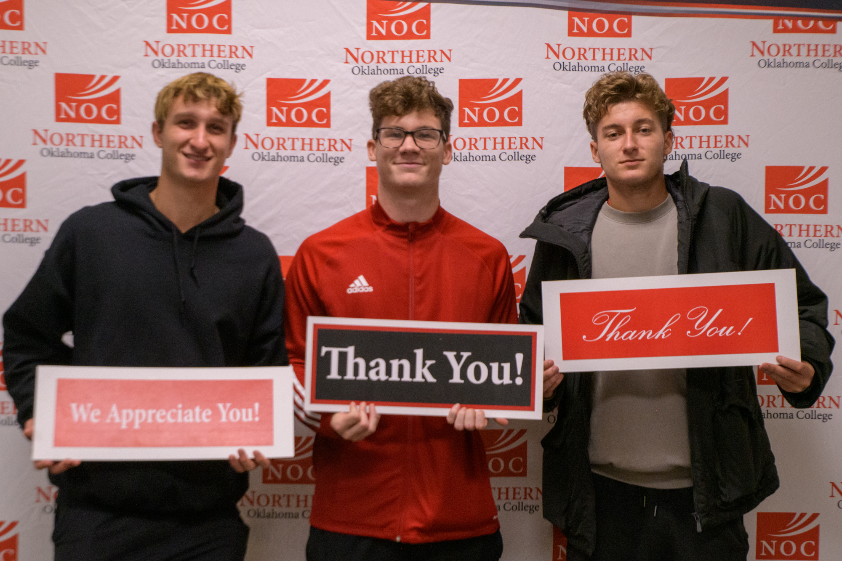

Slide 60
Foundation Scholarship Recipients
Jordan Marquardt Memorial Scholarship
Sharon Park
Dr. D.L. Mathews Scholarship
Kale Campbell
George McCoy Memorial Scholarship
Halie Shirley
Hugh McIntyre Memorial Scholarship
Jake Randall
Alexander Cope

Slide 61
Foundation Scholarship Recipients
Moody Family Room & Board Scholarship
PENDING
A.H. Muegge Memorial
Kylee Cannon
David Paul Muegge Memorial
Patricia Frickenschmidt
Native American Scholarship
Joey Looper
NOC/OSU Gateway Study Abroad Scholarship
Rylee Rosamond
Emma Valgora

Slide 62
Foundation Scholarship Recipients
NOC Alumni Legacy Scholarship
Jordan Nelson
Curtis S. Norman Memorial Scholarship
PENDING
William W. and Dorotha L. Phelps Educational Loan & Scholarship
Brandon Jones
Austin Payne
Antonio Perez
Tom and Judy Poole Endowed Agriculture Scholarship
Canaan Muniz

Slide 63
Foundation Scholarship Recipients
Phillips University Alumni and Friends Scholarship
Phillips 66 Process Technology Scholarship
Lakysia Johnson
Curtis Conner
Anna Stotts
Chloe Middleton
Sidney Redmon
Lennie Resendiz
Nolan Gore
Ryane Vion
Keyauna Heidrick
John Gay
Alyson Myers
Mason Wildman
Adriel Lora
Nathaniel Gutirrez
Kelsie Teply
Jarely Casillas
James Fanning
Alexa Sheik
Betzabet Rojo
Devin Tebow
Emmaline Dethloff
Gunner Coffey
Jordan Walenciak
Kevin Miller
Lauren Bhend
Macey Reese
Micha Jarret
Molly Dolan

Slide 64
Maxine Vollmer Prather Endowed Scholarship
Jayden Ott
Laurie Annie Rodgers Scholarship
Maria Cornwell
Mary Behar Schell Scholarship
Jan Schickram Memorial Vocal Music Scholarship
Alee Hunt
Ray M. Schiltz Memorial Scholarship
Landon Harmon
Foundation Scholarship Recipients
Katelyn Qualls
Anna Lois Denton
Samuel Haley
Kadey Matal

Slide 65
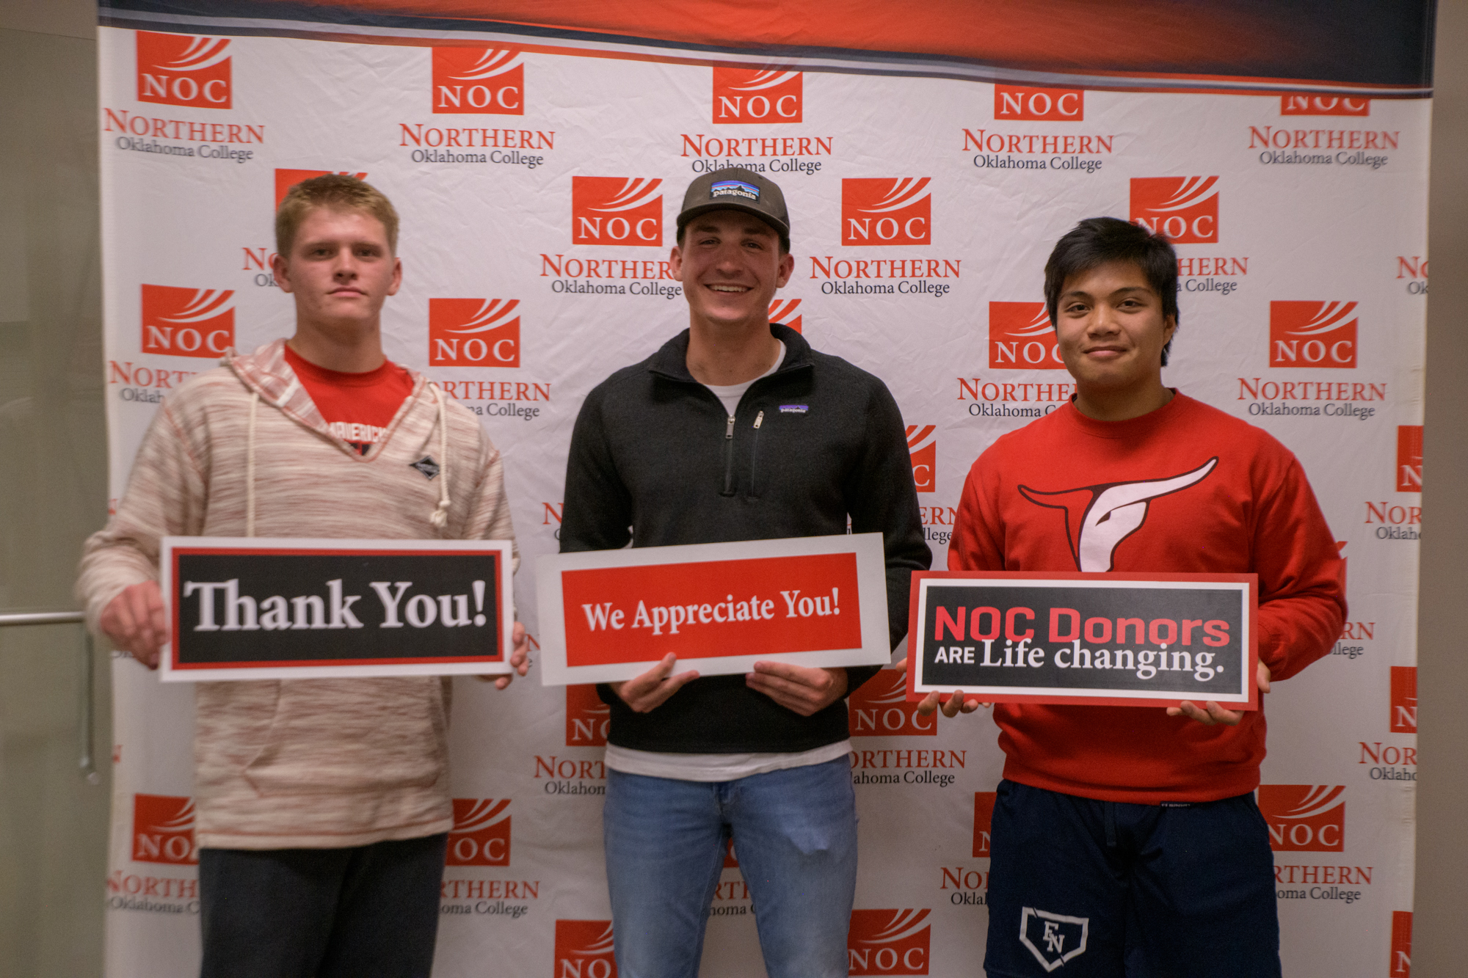

Slide 66
Foundation Scholarship Recipients
Lena Esch Sizelove Memorial Scholarship
Edgar Dominguez
Steichen Family Music Scholarship
Regan Clapper
Taylor Family Character Scholarship
Karlee Meadows
James Grein
Jaci Johnson
Anna Lois Denton
Rebecca Soto
Alex Cope
Riley Price
Jayden Ott
Betty Throop Music Scholarship
Canaan Muniz

Slide 67
Foundation Scholarship Recipients
Jared Weiberg Endowed Memorial Scholarship
Christian Tarango
Wilma Harman Music Scholarship
Emma Valgora
Frances G. Wintersole Trust Scholarship
Angel Zubia
Vivien Gabehart
Adam Worden Memorial Scholarship
David Lee Weaver
Julian Pendergraft

Slide 68
Foundation Scholarship Recipients
Zody Family Scholarship
Melissa Lake
Keith L. Zody Scholarship
Jayde Vaughan

Slide 69
Foundation Scholarship Recipients
University Center of Ponca City Foundation, Inc. Scholarship
Allanah Florez
Amanie Owdetallah
Amaria Bogney
Ana Chavez
Asher Scantlin
Ashton Carlson
Bailey Anson
Bingnan Chen
Blake Dailey
Bryce Bojorquez
Brynn Crandall
Caleb Ashlock
Callie Hurley
Carlton Carney
Cason Wilson
Cayden Anderson
Corey Marazas
Ellie Copeland
Gavin Leigh
Geronimo Quilimaco
Hadleigh Williams
Hailey Creech
Hanna Matthews
Heidi Critchfield
Heidi Fulks-Sinor
Hunter Austin
Jace Schneeburger

Slide 70
Foundation Scholarship Recipients
University Center of Ponca City Foundation, Inc. Scholarship
Jack Busch
Jacob Leonard
Jacob O’Neill
Jessalynn Neufeld
Jillian Crossland
Julian Estrada
Kaylie Thomas
Kylie Ivie
Laura Hernandez
Lexia Kent
Libby Fleming
Lindy Fisher
Luke Hollis
Madelyn Blackstar
Madison Rutz
Madison Thibodeaux
Madux Johnson
Makayla Howard Shed
Mark Strange
Megan Malloy
Megan Polakowski
Miles Greer
Montana Ehrlich
Natalie Ham
Neecya Logan
Paetyn Badley
Rylan Miller

Slide 71
Foundation Scholarship Recipients
University Center of Ponca City Foundation, Inc. Scholarship
Ryleigh Greenwell
Ryleigh Rowe
Savannah Clark
Sergio Gutierrez
Sylvia Simpson
Ty Jansma
Tynli Nickell
Victor Morfin
Viktorya Maier

Slide 72
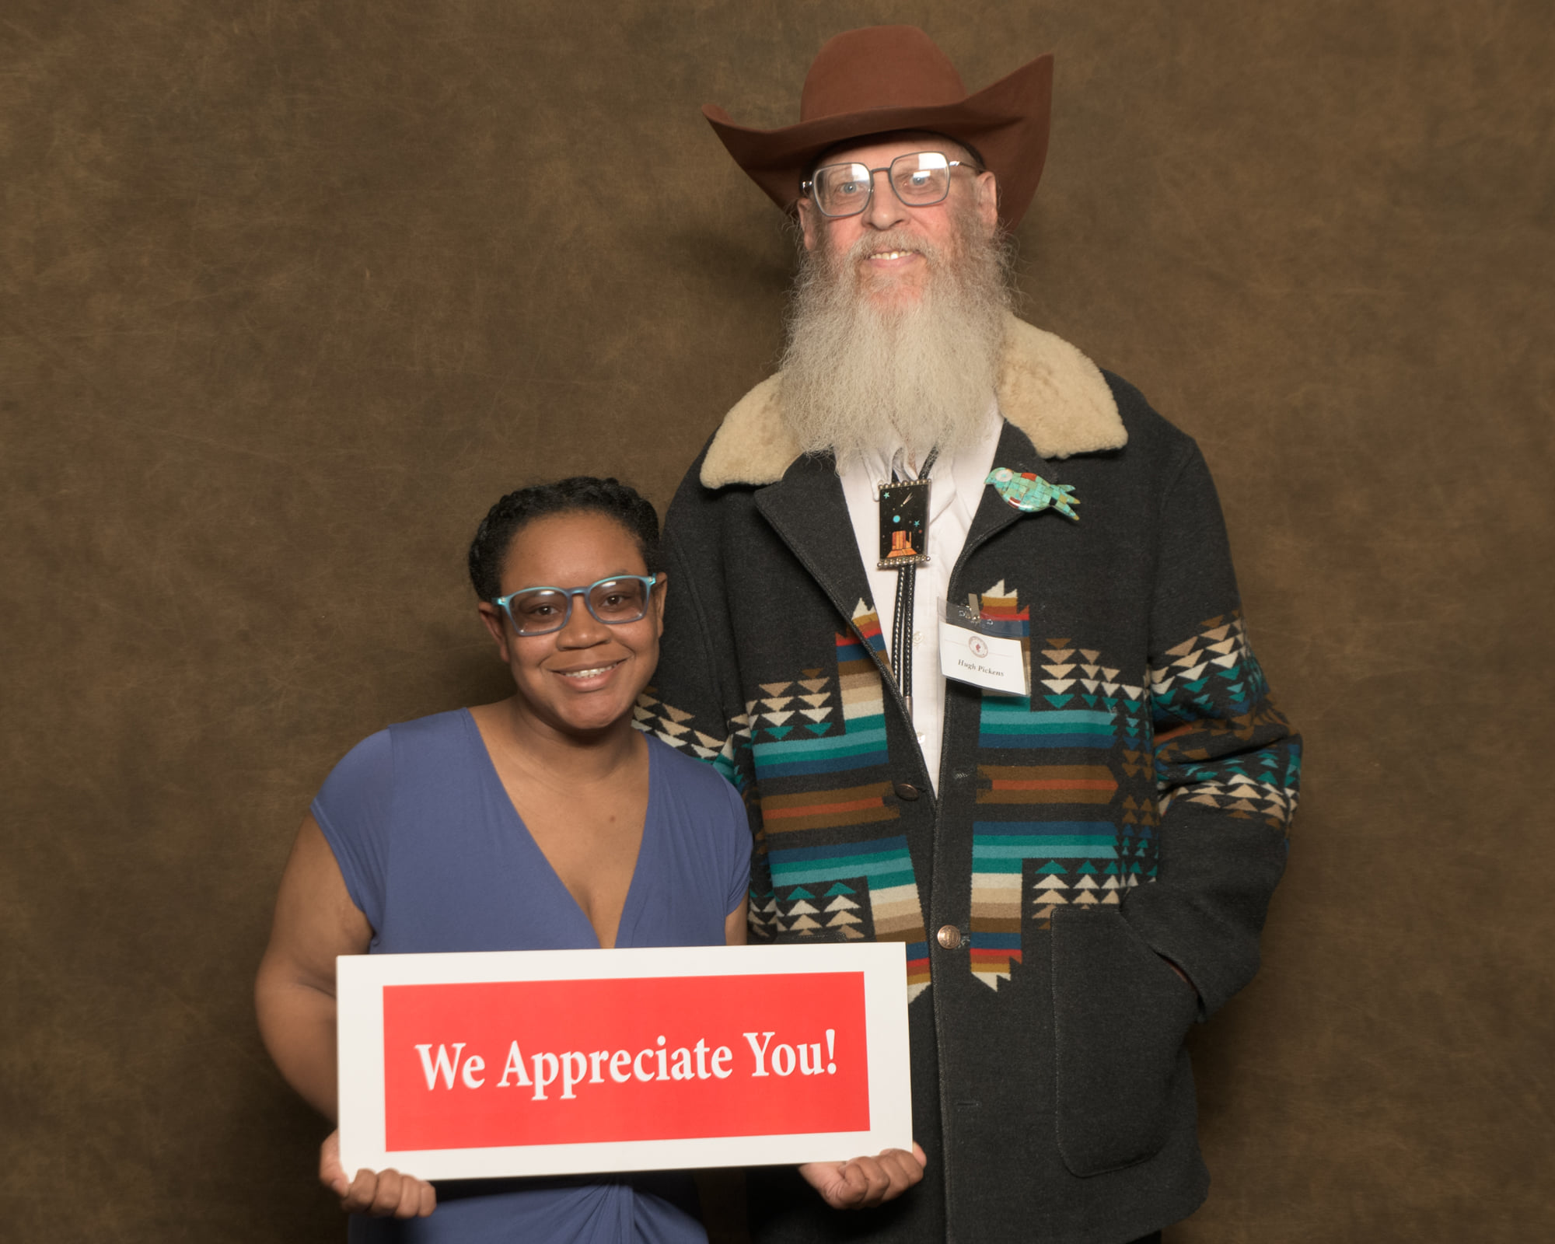

Slide 73
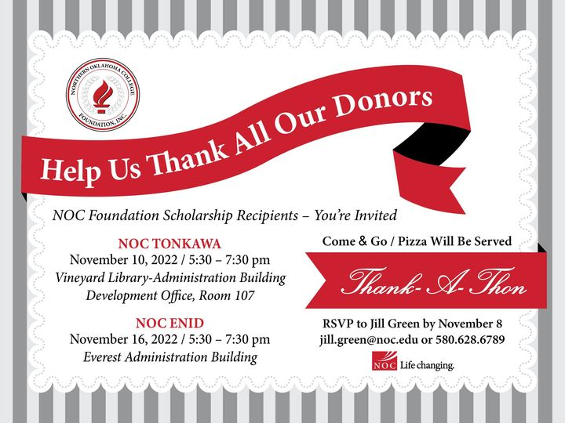
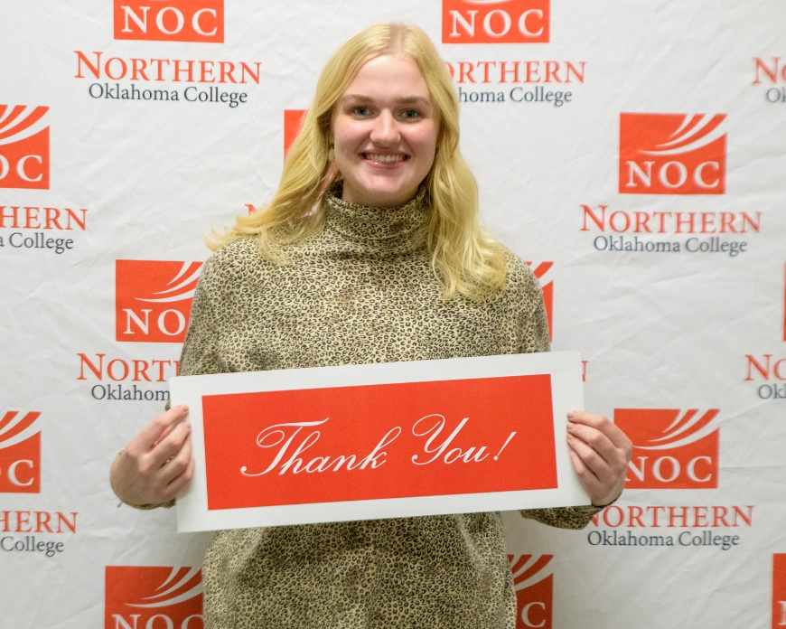
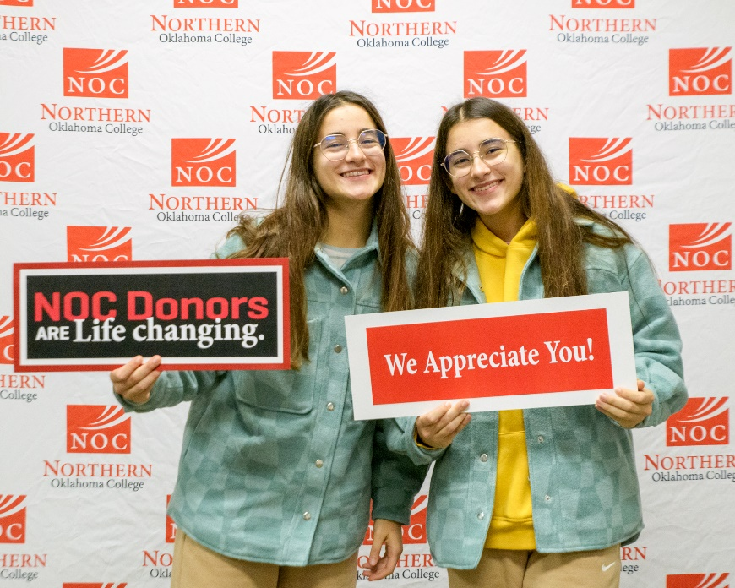
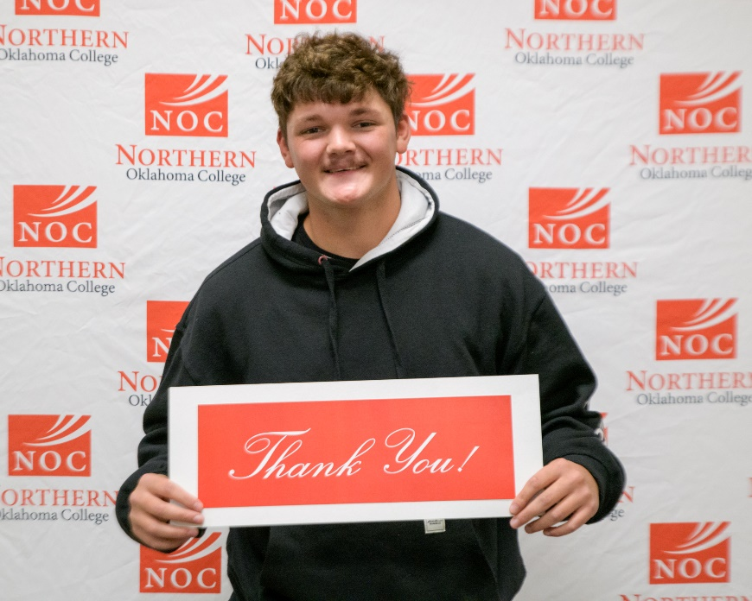
Thank-a-Thon

Slide 74
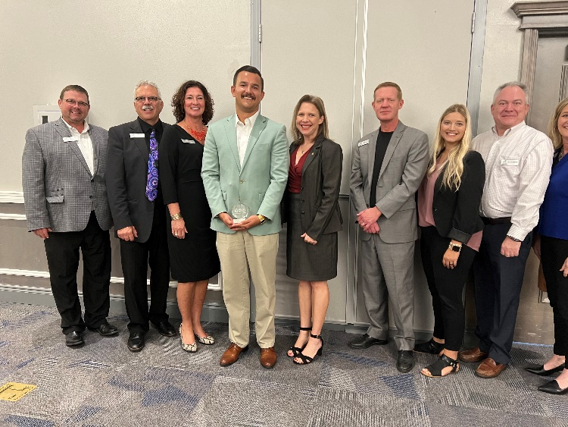
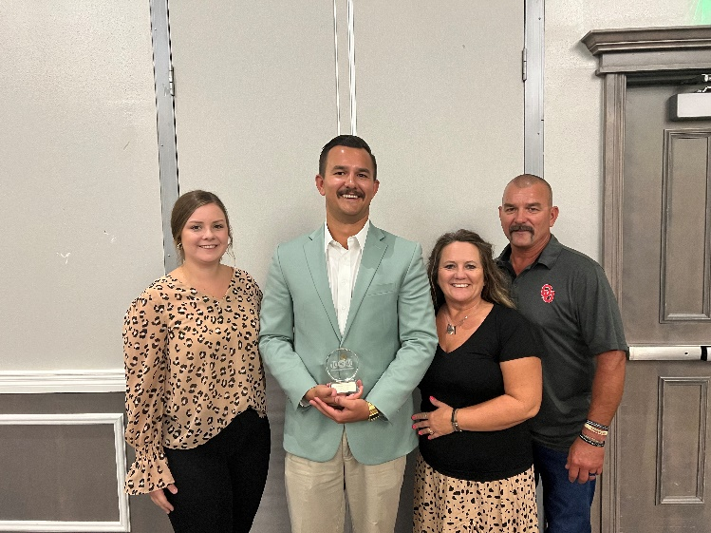
2022 Enid Young Professionals Top 10 under 40 Award
Claye Hammock – NOC Alumni Advisory Board Member

Slide 75
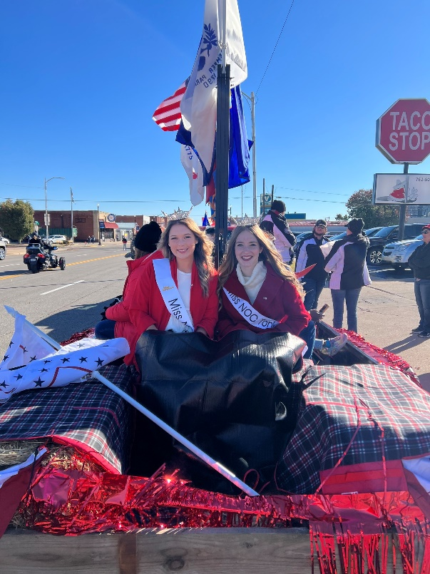
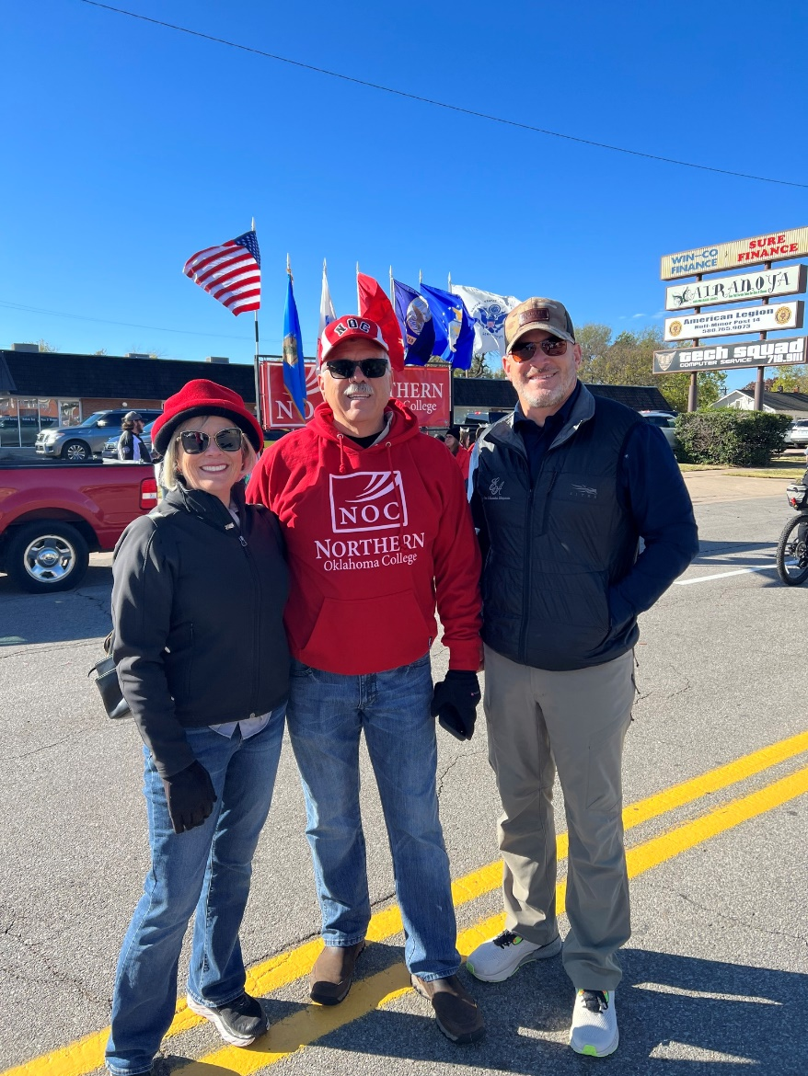
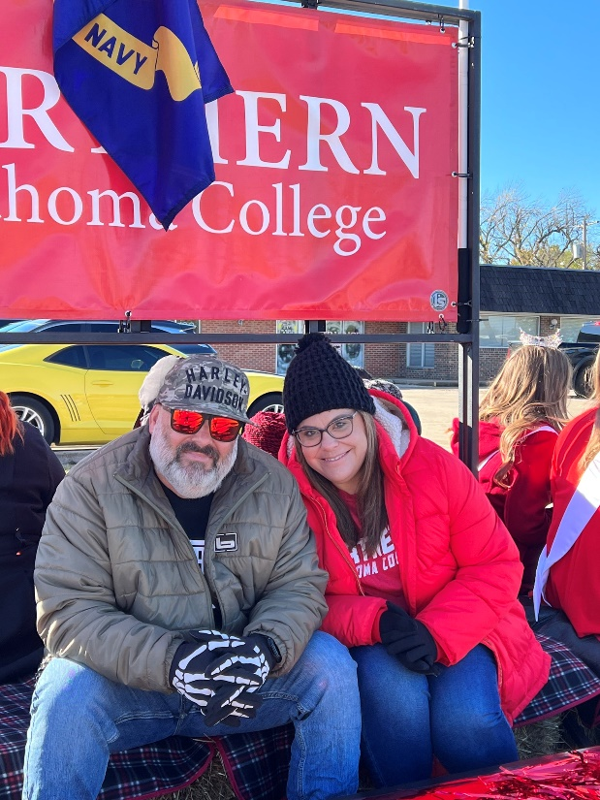
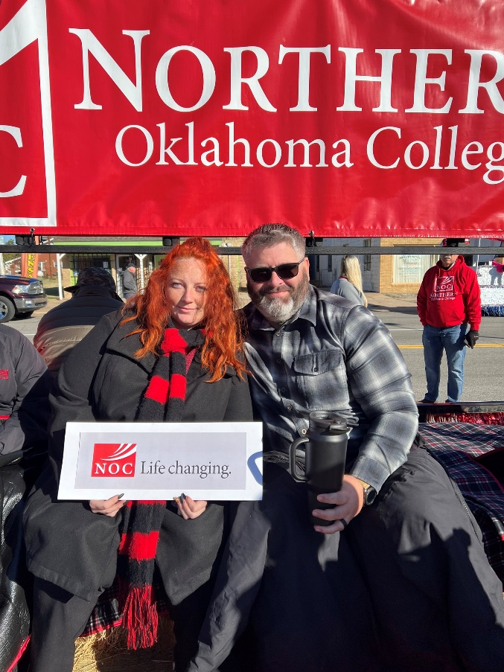
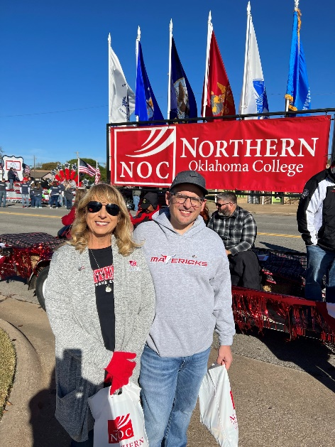
Veteran’s Day Parade

Slide 76



Higher Education Day at the Capitol

Slide 77




Pickens Student Learning Commons

Slide 78






NOC/OSU Annual Tailgate

Slide 79



Slide 80


2022 - 2023 Alumni & Friends Socials

Slide 81






Mavericks All-Athletic Reunion

Slide 82






Jets All-Athletic Reunion

Slide 83




Full Moon Concert

Slide 84

Scholarship Presentations
Christian Tarango awarded the Jared Weiberg Endowed Scholarship

Slide 85


Scholarship Presentations
Allison Green awarded the Leo Canaday Memorial Scholarship
Samantha Smith awarded the Nevona
Kegans Scholarship

Slide 86

2021 Distinguished Hall of Fame Inductees
Dr. Justin Funk – Class of 2005
Ms. Evelyn Coyle – Class of 1951

Slide 87

2022 Distinguished Hall of Fame Inductees
Dr. Tara Tucker-Vaughn – Class of 1989
Mr. Joe Kreger – Class of 1959

Slide 88


Slide 89



Slide 90
Thank You For Your Continued Support!

